Slide 1
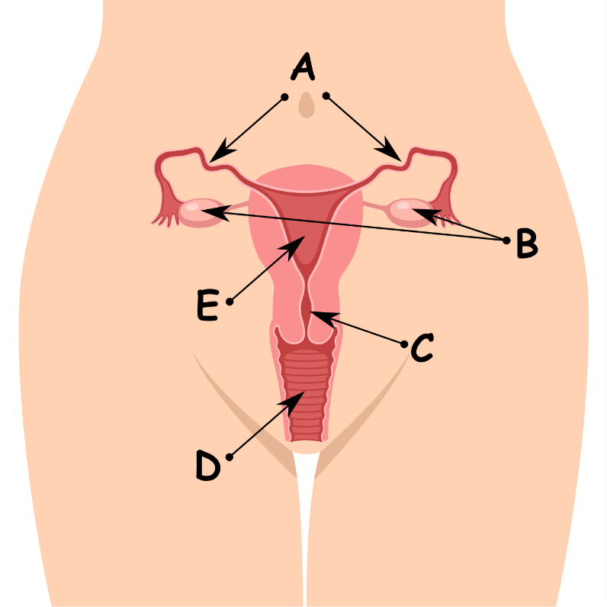
Write down the date and today’s title
REPRODUCTION IN HUMANS; WOMEN
DO IT NOW; Write down A, B, C, D and E. Can you match any of the organs of a women’s reproductive system. Choose from the words opposite.
Names
C. Cervix
D. Vagina
B. Ovaries
E. Uterus or womb
A. Fallopian tubes or oviducts
Names
Cervix
Vagina
Ovaries
Uterus or womb
Fallopian tubes or oviducts
Sequence on click
in slide show.
Stretch
Write out the statements then next to them write true or false.
Women can get pregnant at anytime.
Women can get pregnant at any age.
Women release eggs.
Stretch
Write out the statements then next to them write true or false.
Women can get pregnant anytime. False
Women can get pregnant at any age.
Women release eggs.
Stretch
Write out the statements then next to them write true or false.
Women can get pregnant at anytime. False
Women can get pregnant at any age.
Women release eggs.
Stretch
Write out the statements then next to them write true or false.
Women can get pregnant at anytime. False
Women can get pregnant at any age. False
Women release eggs.
Stretch
Write out the statements then next to them write true or false.
Women can get pregnant at anytime. False
Women can get pregnant at any age. False
Women release eggs. True
Notes:
Answers appear in slide show.

Slide 2
SUMMARY
Girls become sexually mature around age fourteen.
They begin to menstruate and could become pregnant.
The menstrual cycle describes a women’s fertility over 28 days.
Beginning with a women’s period on day 1 (which lasts for 3-5 days) a women ovulates at day 14.
If the egg is fertilised by joining with a sperm cell the women becomes pregnant.

