Slide 1
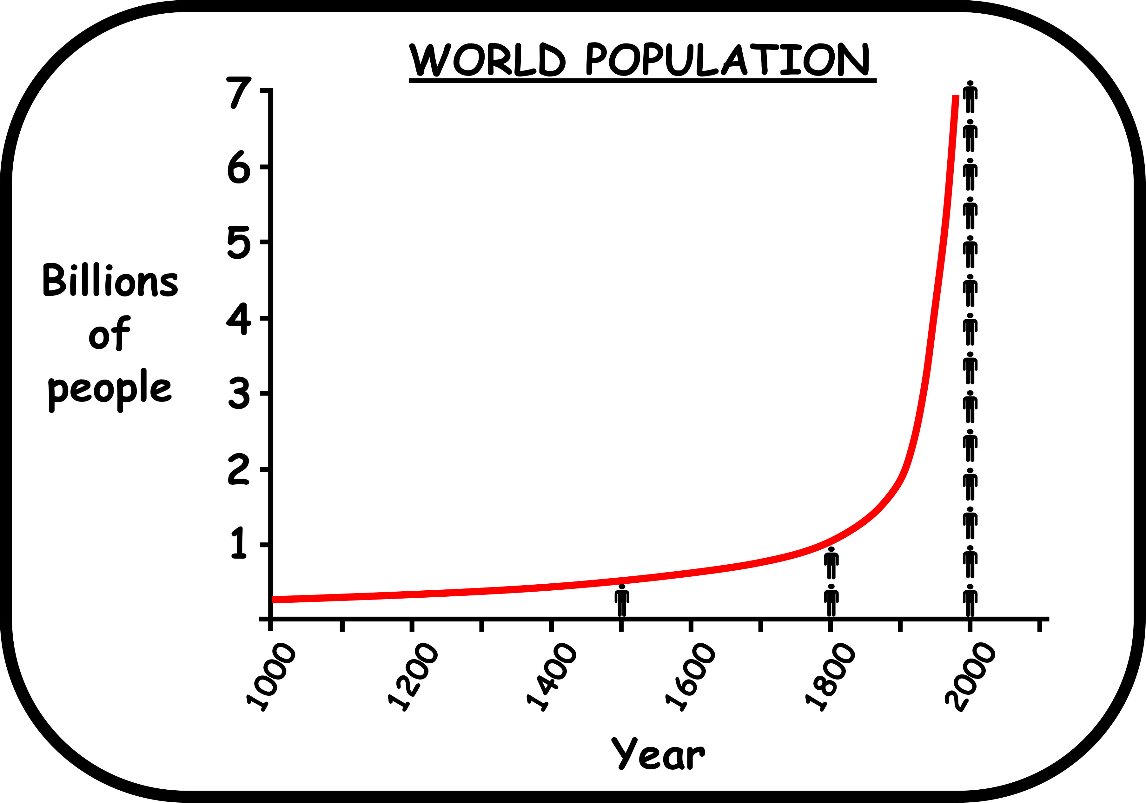
Write down the date and today’s title
THE EARTH’S ATMOSPHERE AND CLIMATE CHANGE
DO IT NOW; The graph below shows human population from the year 1000 to 2000 AD. In your own words describe what the graph shows.
Sequence on click
in slide show.
Stretch
What do all of these people need?
What does this mean for our atmosphere?
Stretch
What do all of these people need? Food, energy, space, water……….
What does this mean for our atmosphere?
Stretch
What do all of these people need? Food, energy, space, water……….
What does this mean for our atmosphere? More pollution, especially the emission of CO₂ which causes global warming.
Notes:
Questions appears in slide show.

Slide 2
SUMMARY
The earth’s atmosphere is the gases that surround the planet.
Due to our growing population, deforestation, consumption of meat and use of fossil fuels, too much carbon dioxide has ended up in the atmosphere.
Carbon dioxide, along with methane from cattle, are the main greenhouse gases.
Greenhouse gases absorb heat that would have escaped into space and this is making earth heat up too fast. It’s called the greenhouse effect.
It is causing the melting of glaciers, rising sea levels, extreme weather, droughts and floods around the world.
The things we can do to help are…

