Slide 1
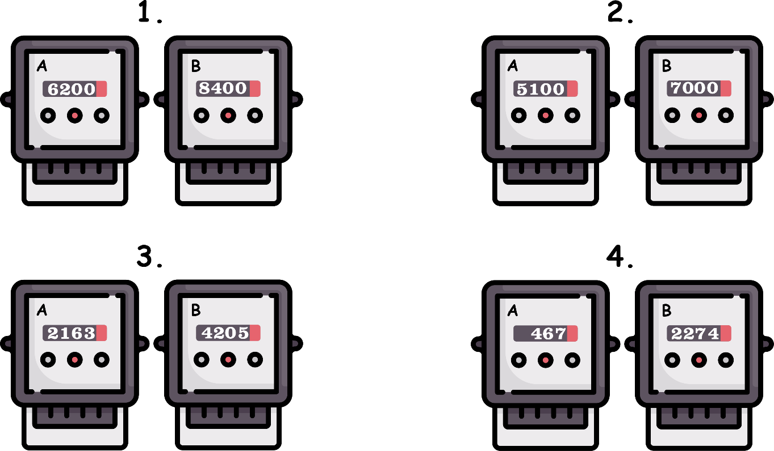
Write down the date and today’s title
THE COST OF ELECTRICITY AND POWER RATINGS
DO IT NOW; Calculate the difference between the numbers A and B (in white) for 1 to 4 below. Without a calculator!
8400
-6200
2200
7000
-5100
1900
Sequence on click
in slide show.
4205
-2163
2042
2274
-467
1807
Stretch
What do you think the above are supposed to be?
Where might you find them?
How often are they read?
Stretch
What do you think the above are supposed to be? Electricity meters
Where might you find them?
How often are they read?
Stretch
What do you think the above are supposed to be? Electricity meters
Where might you find them? Under the stairs/in the pantry/garage
How often are they read?
Stretch
What do you think the above are supposed to be? Electricity meters
Where might you find them? Under the stairs/in the pantry/garage
How often are they read? Every 3 months (quarter)

Slide 2
SUMMARY
The power rating of an electrical appliance tells us how much energy it consumes per second.
The unit of power is the watt. It is 1J of energy consumed per second. 1000 watts is one kilowatt.
To calculate the energy consumed we multiply the power of the appliance (in kw) by the time it is switched on for (in hours). This gives us the number of kilowatt-hours used.
We are charged for how many kilowatt-hours we use quarterly (every 3 months).

