Slide 1
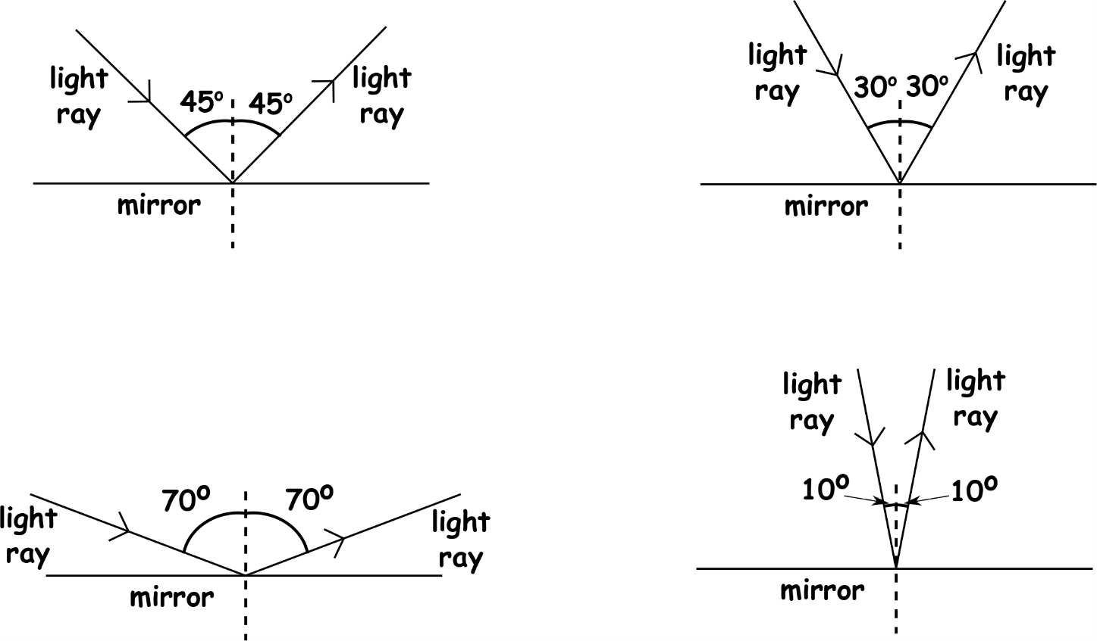
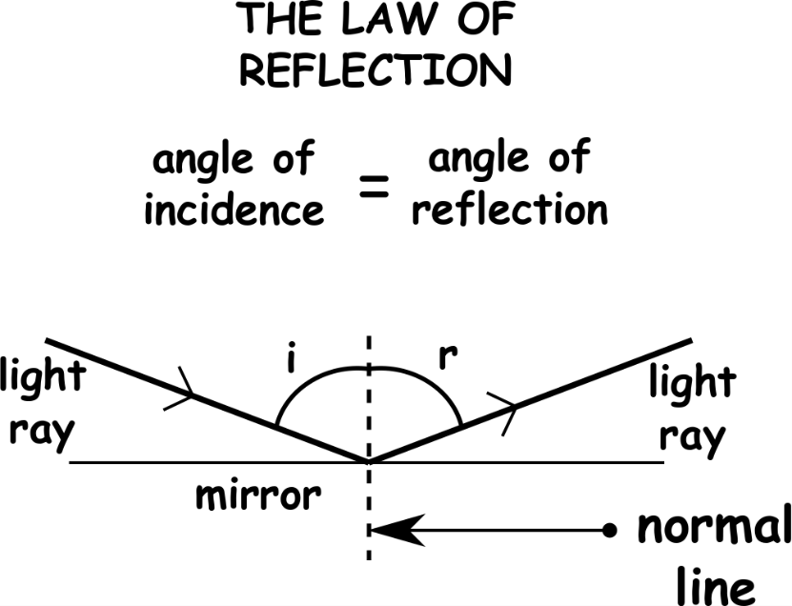
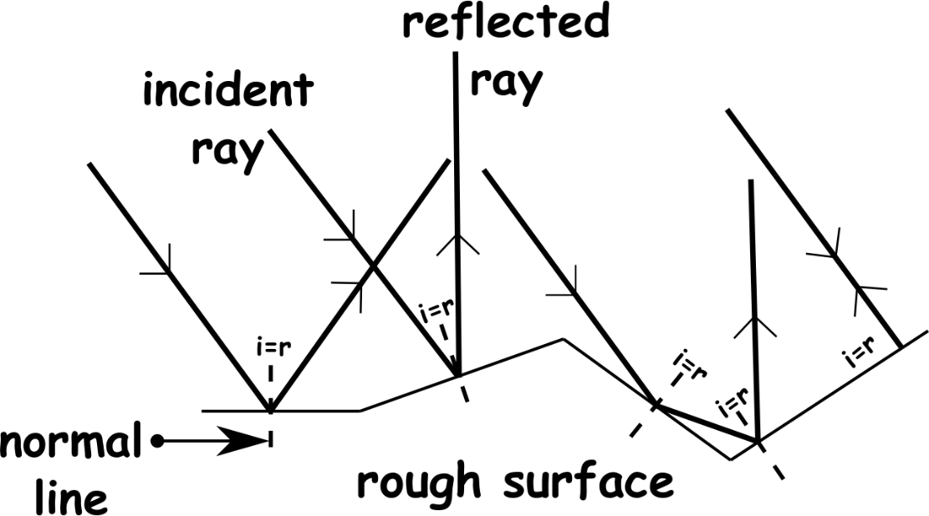
Write down the date and today’s title
LIGHT AND REFLECTION
DO IT NOW; Write down what you notice about the rays of light reflecting off the mirrors below.
Sequence on click
in slide show.
Stretch
Light can also pass through materials, these are called? TRANSPARENT
Materials that partially allow light through are called? TRANSLUCENT
Materials that don’t allow light through are called? OPAQUE
Stretch
Light can also pass through materials, these are called? RENTNSRAPAT
Materials that partially allow light through are called? TANRCESLUTN
Materials that don’t allow light through are called? POAQUE
Notes:
Questions appears in slide show.

Slide 2
SUMMARY
Light travels in straight lines. A thin beam of light called a ray can be used to show how light behaves.
The law of reflection tells us that the angle of incidence is equal to the angle of reflection. Angles are measured from the normal line, a dashed line drawn at right angles to the surface.
The law of reflection applies to all surfaces. Rough surfaces diffuse (spread) the light so can’t don’t see ourselves in them like in a mirror.
We can draw ray diagrams to show why we see virtual images in a mirror.
Transparent? Translucent? Opaque?

