Slide 1
Write down the date and today’s title
SPEED
DO IT NOW; Write down the following units under what you think is the correct column heading.
Speed units
Other units
mph (miles per hour)
m/s (metres per second)
Sequence on click
in slide show.
cm³/s (centre metres
cubed per second)
Km/hr (kilometres per hour)
g/s (grams per second)
N/m² (Newtons per metre
squared)
Stretch
Now you know the answers (or before), what do the speed units have in common?
In maths what does per mean?
Stretch
Now you know the answers (or before), what do the speed units have in common? Distance and time
In maths what does per mean?
Stretch
Now you know the answers (or before), what do the speed units have in common? Distance and time
In maths what does per mean? Divided by (or for every)
Notes:
Answers appear in slide show.

Slide 2
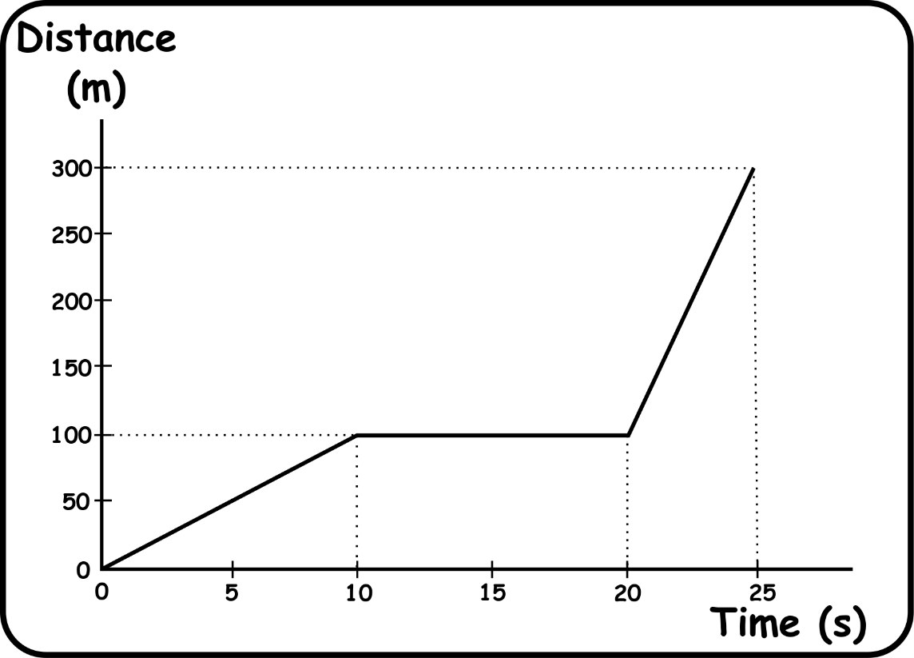
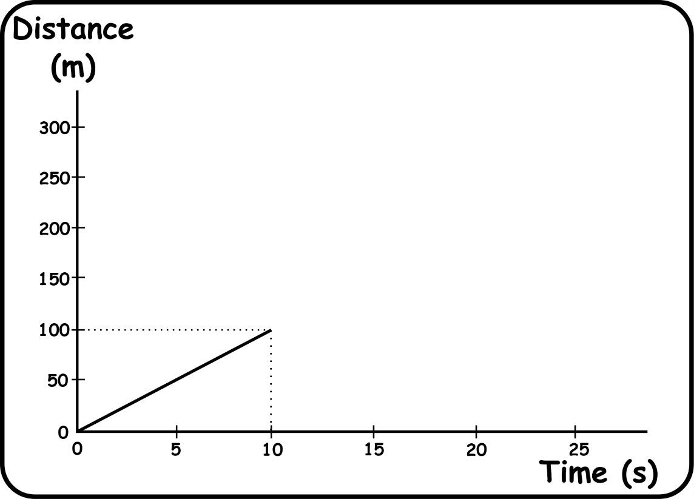
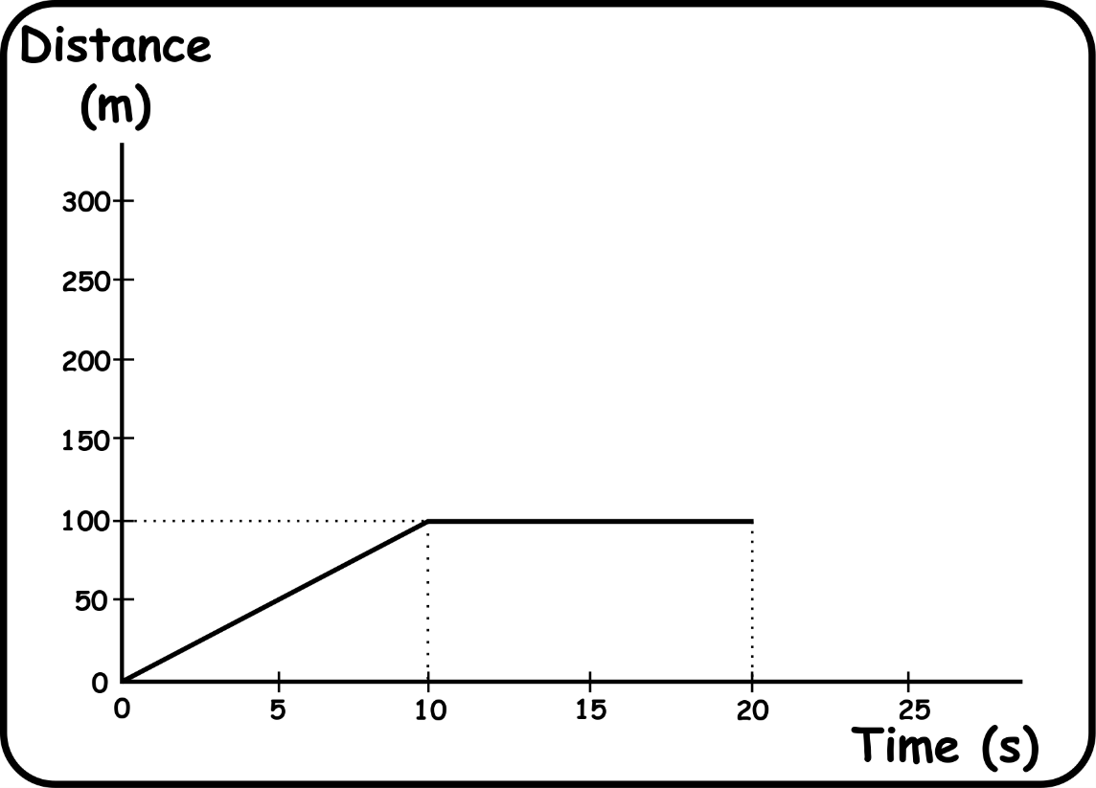
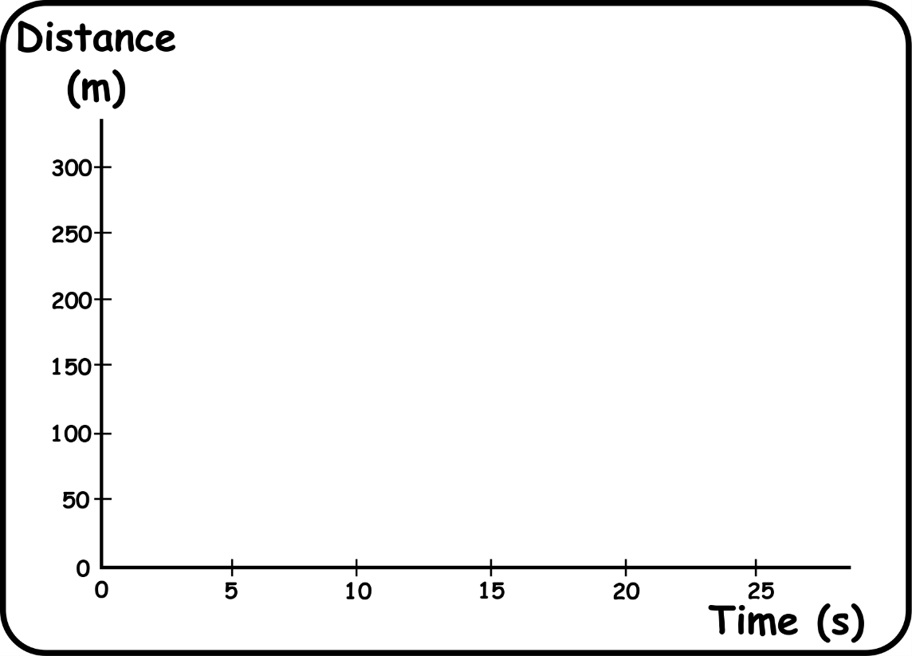
100m in 10 seconds
10 seconds stop
200m in 5 seconds
Watch the following motion being plotted on a distance time graph.

Slide 3
SUMMARY
Speed is a rate, it is how far we travel per unit of time. The scientific unit for speed is metres per second (m/s).
Average speed is calculated by dividing distance travelled (m) by time taken (s).
Motion can be plotted on a distance time graph. The steepness of the lines (the gradient) is the speed of motion.
Speed cameras take two photographs 0.5 seconds apart and use the distance travelled during this time to calculate average speed.

