Slide 1
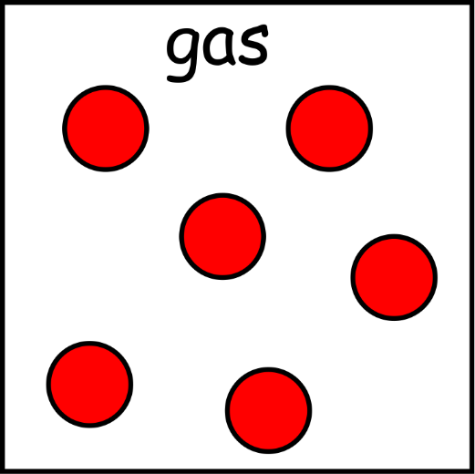
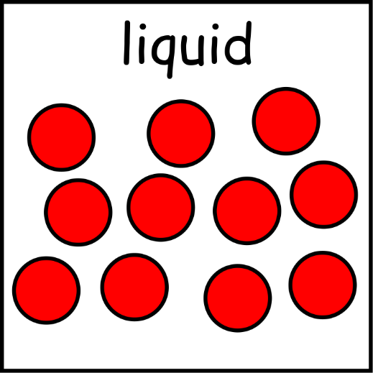
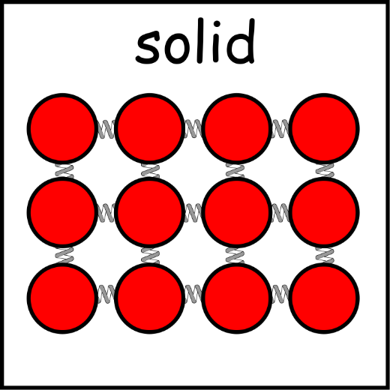
Write down the date and today’s title
THE PARTICULATE NATURE OF MATTER
DO IT NOW; below are diagrams showing the arrangement of particles in a solid, a liquid and a gas. Write down what differences and similarities you can see.
Sequence on click
in slide show.
Stretch
Write down
Which particles you think are moving the fastest? Gas
What we call it when a solid changes to a liquid? Melting
What we call changing from a gas to a liquid? Condensing
In the same space why are there less particles in a liquid and a gas than in a solid? Solids are dense, the particles are held together tightly and closer together
Stretch
Write down
Which particles you think are moving the fastest?
What we call it when a solid changes to a liquid?
What we call changing from a gas to a liquid?
In the same space why are there less particles in a liquid and a gas than in a solid?
Stretch
Write down
Which particles you think are moving the fastest? Gas
What we call it when a solid changes to a liquid?
What we call changing from a gas to a liquid?
In the same space why are there less particles in a liquid and a gas than in a solid?
Stretch
Write down
Which particles you think are moving the fastest? Gas
What we call it when a solid changes to a liquid? Melting
What we call changing from a gas to a liquid?
In the same space why are there less particles in a liquid and a gas than in a solid?
Stretch
Write down
Which particles you think are moving the fastest? Gas
What we call it when a solid changes to a liquid? Melting
What we call changing from a gas to a liquid? Condensing
In the same space why are there less particles in a liquid and a gas than in a solid?

Slide 2
SUMMARY
The idea that substances are made from particles (atoms) has been around for a long time.
In solids the particles are held together by strong forces of attraction, particles are tightly packed together and they are the most dense.
In liquids the particles are held together by weaker forces of attraction than solids and the particles are less tightly packed together so they are less dense.
In gases the particles are free to move, they have very weak or no forces of attraction, particles are widely spaced and gases are the least dense of the states of matter.

