Slide 1
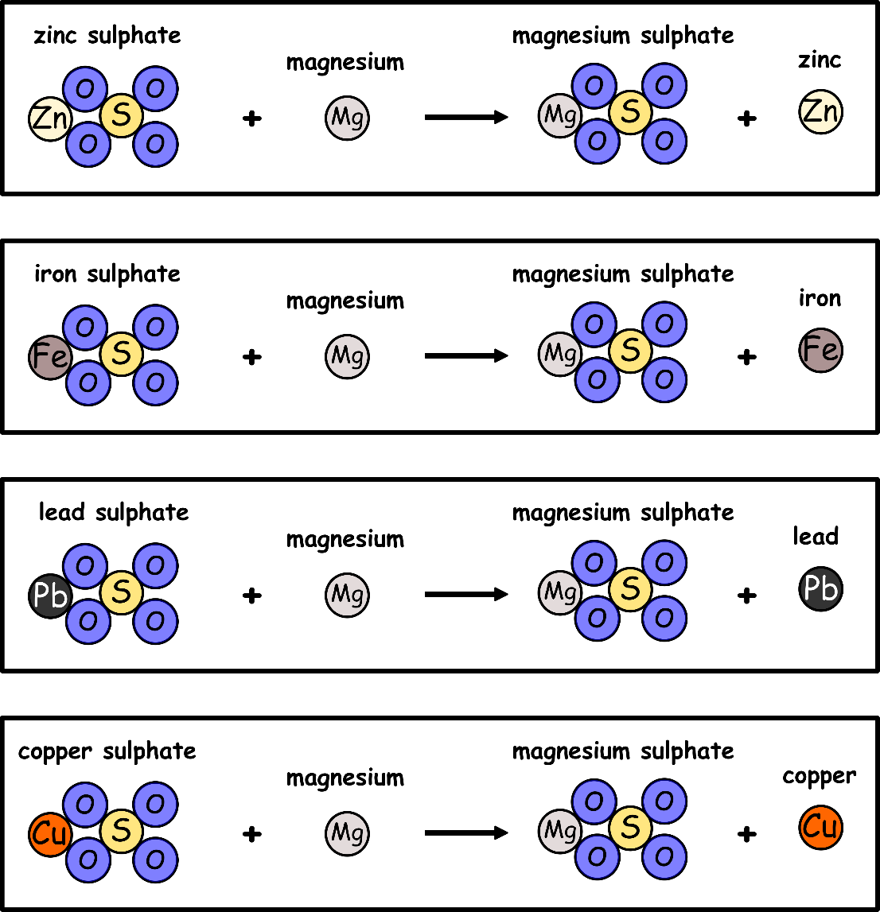
Write down the date and today’s title
DISPLACEMENT REACTIONS
DO IT NOW; The reactivity series below orders elements from least to most reactive. Write out the statements below and then next to them true or false.
Statements
Potassium is the most reactive.
Aluminium is as reactive a magnesium.
Iron is more reactive than copper.
Silver is less reactive than gold.
Sodium is more reactive than lead.
Statements
Potassium is the most reactive. True
Aluminium is as reactive a magnesium. False
Iron is more reactive than copper. True
Silver is less reactive than gold. False
Sodium is more reactive than lead. True
Reactivity series
potassium Most reactive
sodium
calcium
magnesium
aluminium
carbon
zinc
iron
tin
lead
hydrogen
copper
silver
gold
Platinum Least reactive
Sequence on click
in slide show.
Stretch
What pattern do you notice in the pictures above?
Like the big boy can take the toy from the little boy, what can magnesium do in each example?

Slide 2
SUMMARY
The reactivity series puts elements in order of reactivity.
The series enables us to predict the outcome of a reaction.
A metal reacted with a metal salt solution is able to displace the metal in the salt solution if it is higher in the reactivity series, e.g. magnesium is higher than copper so magnesium metal can displace copper metal in a solution of copper sulphate.
Very fast displacement reactions can be explosive and release a lot of heat.

