Slide 1
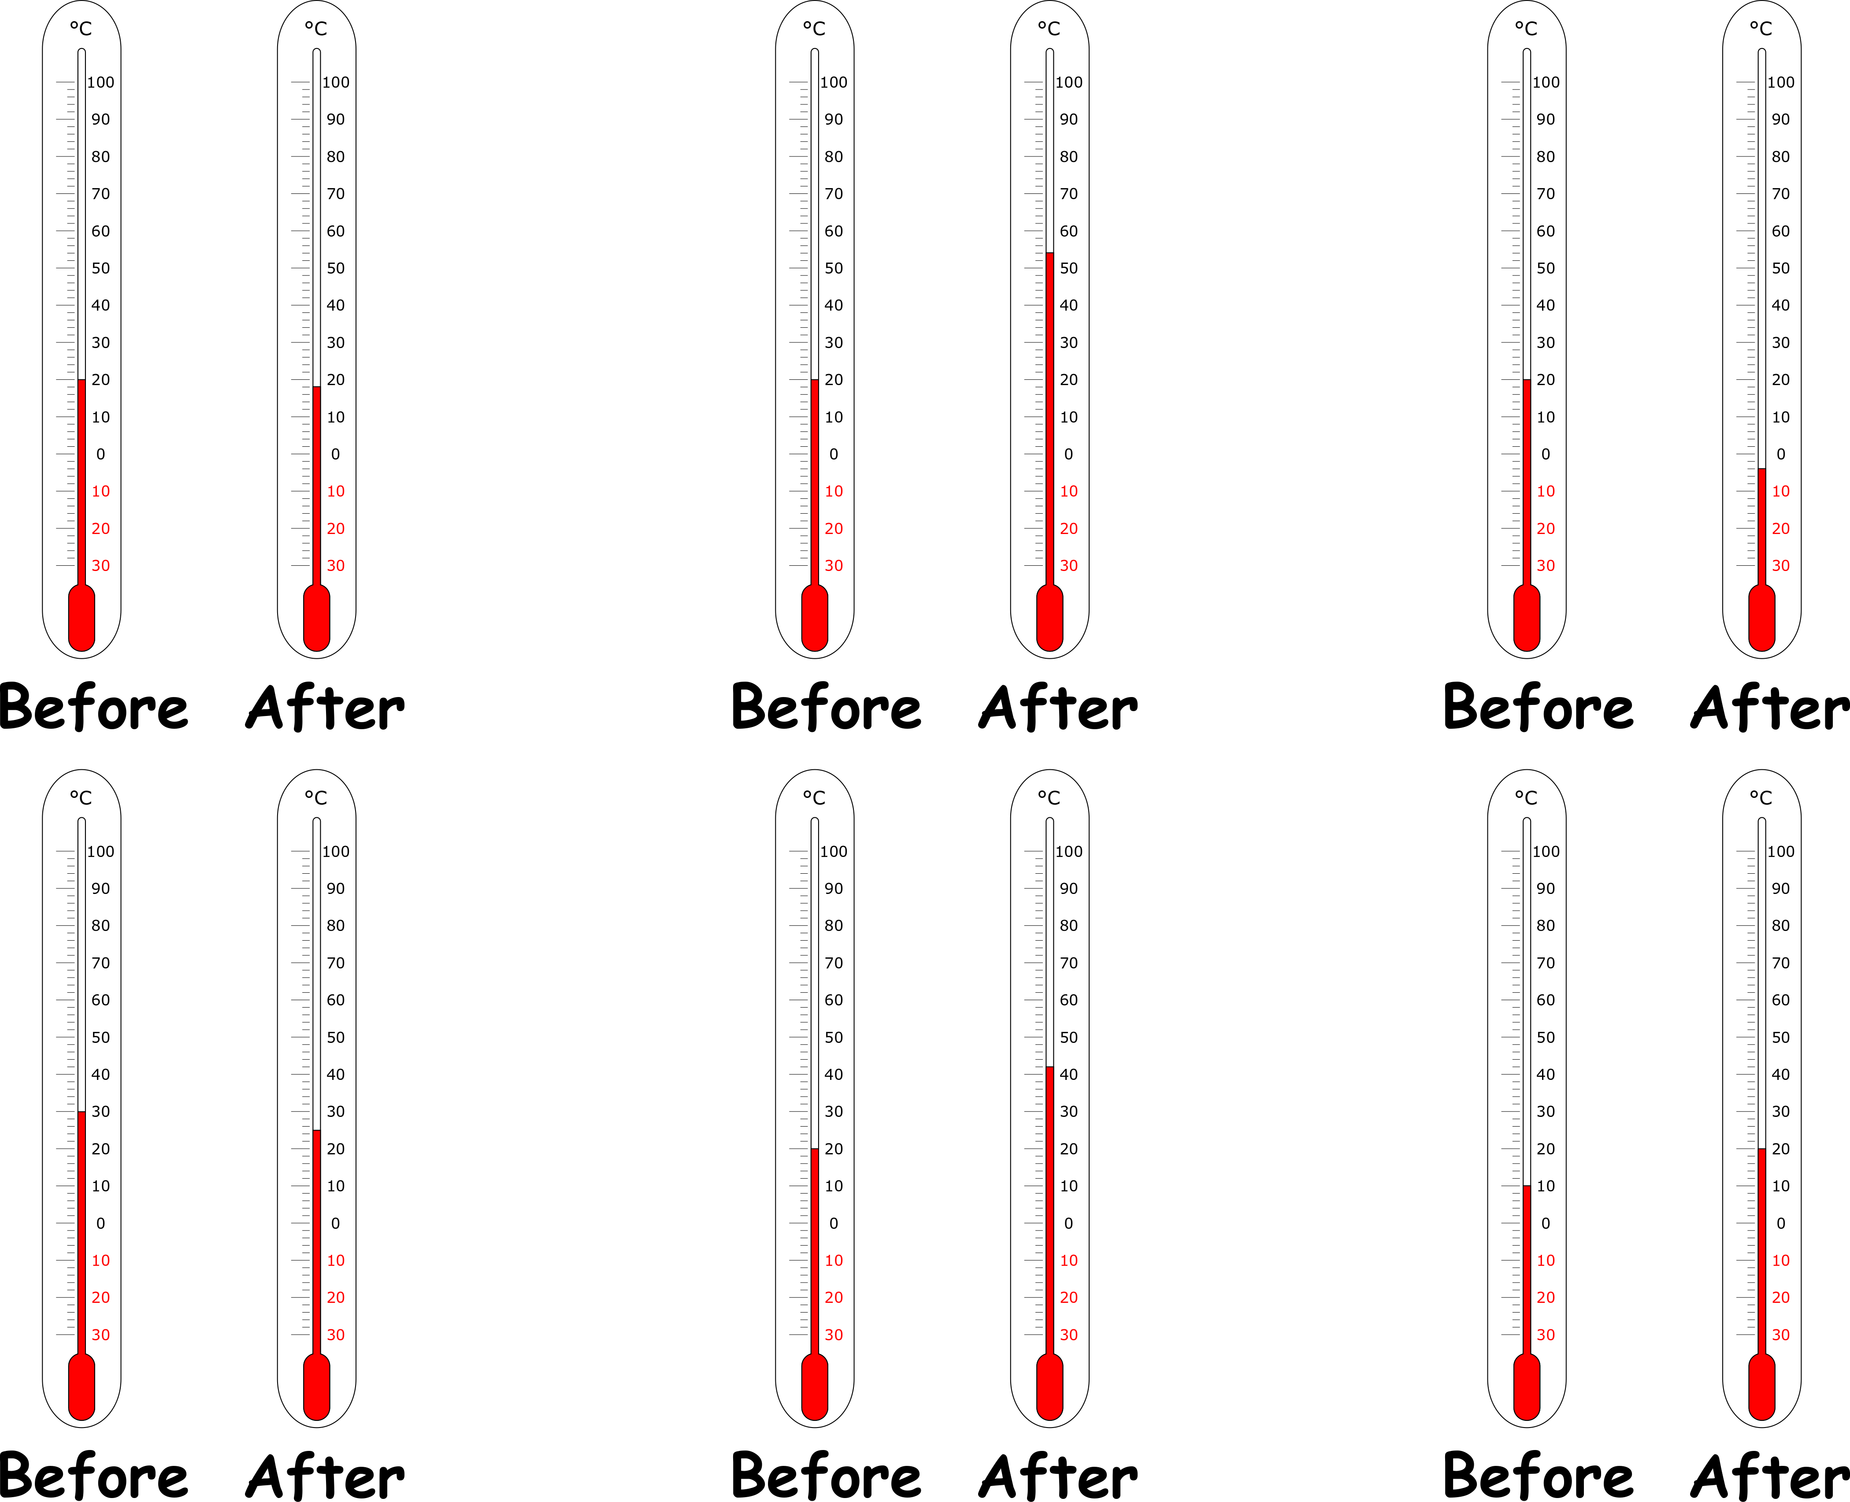
Write down the date and today’s title
EXOTHERMIC AND ENDOTHERMIC CHEMICAL REACTIONS
DO IT NOW; In exothermic reactions the temperature rises, in endothermic reaction the temperature decreases. Decide if A to F are for endothermic or exothermic reactions.
A
B
C
Endo
Exo
Endo
Use zoom function in slide show.
Sequence on click
in slide show.
D
E
F
Endo
Exo
Exo
Stretch
Can you think of an example reaction where heat is released?
What are ‘cold packs’ used for and what type of reaction must they be?
Stretch
Can you think of an example reaction where heat is released?
What are ‘cold packs’ used for and what type of reaction must they be? Sports injuries, they are endothermic
Notes:
Use zoom function in slide show.

Slide 2
SUMMARY
Exothermic reactions release heat and we see a temperature rise.
Endothermic reactions absorb heat and we see a temperature drop.
Energy level diagrams show us the change in chemical energy for an exothermic and endothermic reaction. Exothermic reactions have less chemical energy afterwards and endothermic more.
Exothermic reactions include burning, explosions, neutralisations and adding acid to metals.
Endothermic reactions include certain salts dissolving, thermal decomposition and photosynthesis.

