Slide 1
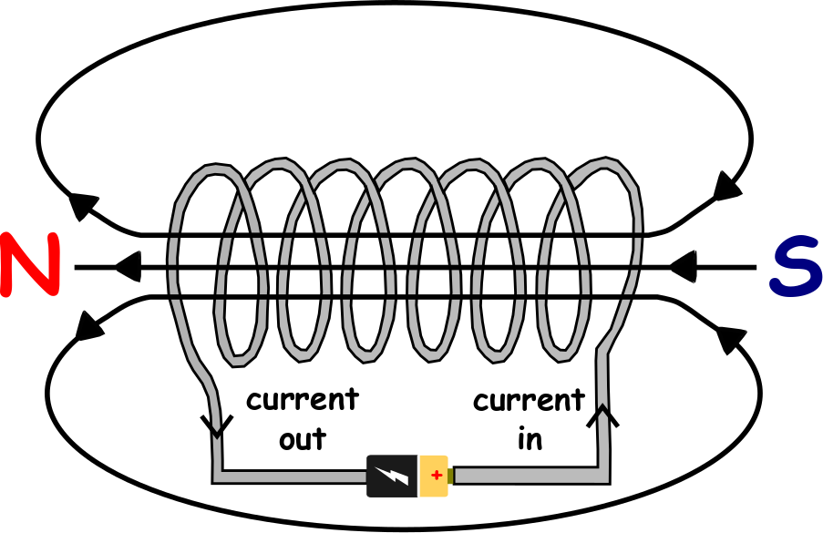
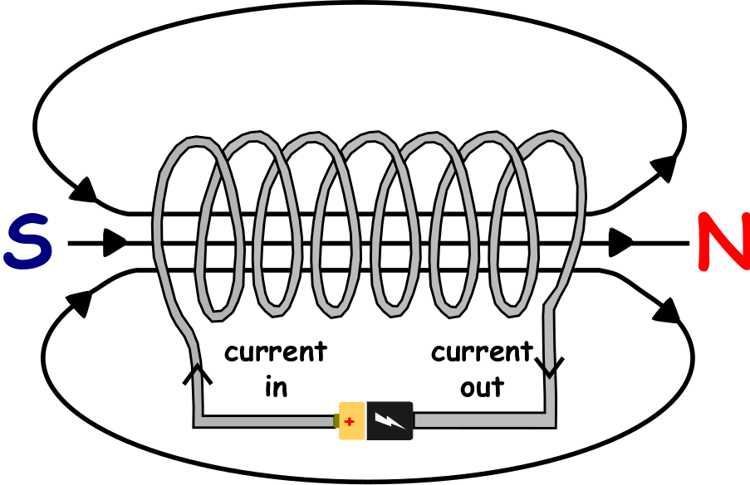
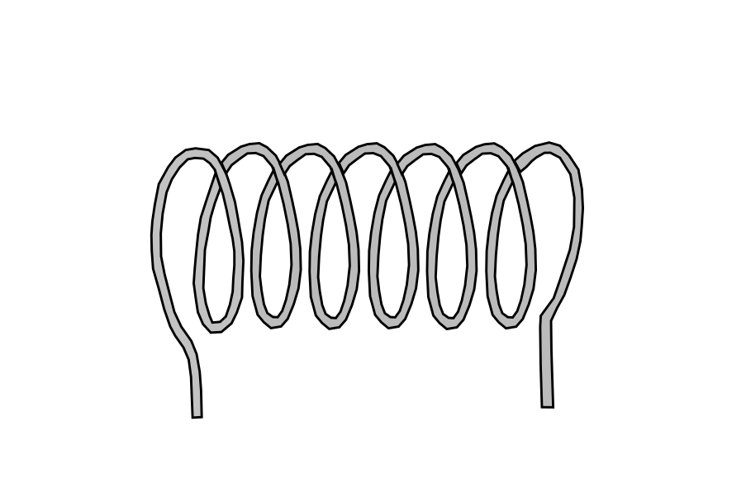
Write down the date and today’s title
ELECTROMAGNETISM
DO IT NOW; Below is a coil of wire called a solenoid. Watch the series of images and write down what you notice.
Sequence on click
in slide show.
Stretch
Solve the following clues. Solenoids are used in LTROECMETAGNSE.
Solenoids are used in LDSPOUEERSAK. Solenoids are used in ECTLERIC LLBES.
Stretch
Solve the following clues. Solenoids are used in ELECTROMAGNETS.
Solenoids are used in LDSPOUEERSAK. Solenoids are used in ECTLERIC LLBES.
Stretch
Solve the following clues. Solenoids are used in ELECTROMAGNETS.
Solenoids are used in LOUDSPEAKERS. Solenoids are used in ECTLERIC LLBES.
Stretch
Solve the following clues. Solenoids are used in ELECTROMAGNETS.
Solenoids are used in LOUDSPEAKERS. Solenoids are used in ELECTRIC BELLS.
Notes:
Questions appears in slide show.

Slide 2
SUMMARY
An electric current produces a magnetic field.
A coil of wire called a solenoid produces a magnetic field with a shape like a bar magnet’s field.
If the direction of the current is changed the north and south pole swap over.
The magnetic field can be made stronger by;
Having more coils closer together
A larger current
Adding an iron core to the solenoid
A changing north and south pole of a solenoid is used to keep an electric motor turning and make a loudspeaker vibrate.

