Slide 1
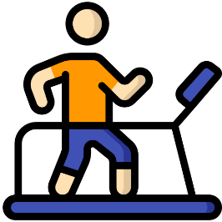
Write down the date and today’s title
EXERCISE, ASTHMA AND SMOKING
DO IT NOW; Write out and complete the sentences below on the benefits of exercise.
Benefits
Improves b _ _ _ d circulation and heart s _ _ _ _ _ t h.
Reduces s _ _ _ _ s.
Helps us to s _ _ _ p better.
Puts us in a better m _ _ d.
Increases s _ _ _ _ _ a.
Benefits
Improves b l o o d circulation and heart s t r e n g t h.
Reduces s t r e s s.
Helps us to s l e e p better.
Puts us in a better m o o d.
Increases s t a m i n a.
Sequence on click
in slide show.
Stretch
Can you think of any other benefits?
How much exercise do you think we should get a day?
Why aren’t most of us getting enough?
Stretch
Can you think of any other benefits?
How much exercise do you think we should get a day? 1hr
Why aren’t most of us getting enough?
Notes:
Answers appear in slide show.

Slide 2
SUMMARY
Exercise benefits us in many ways such as better mood, stronger heart and muscles, increased stamina, improved energy levels and it helps us deal with stress better.
Asthma is a chronic condition of the airways which can cause breathlessness. Sufferers manage their condition with inhalers but in a severe attack an ambulance should be called.
Smoking is addictive because of the drug nicotine. It is linked to many diseases such as heart problems, breathing problems and cancer.

