Slide 1
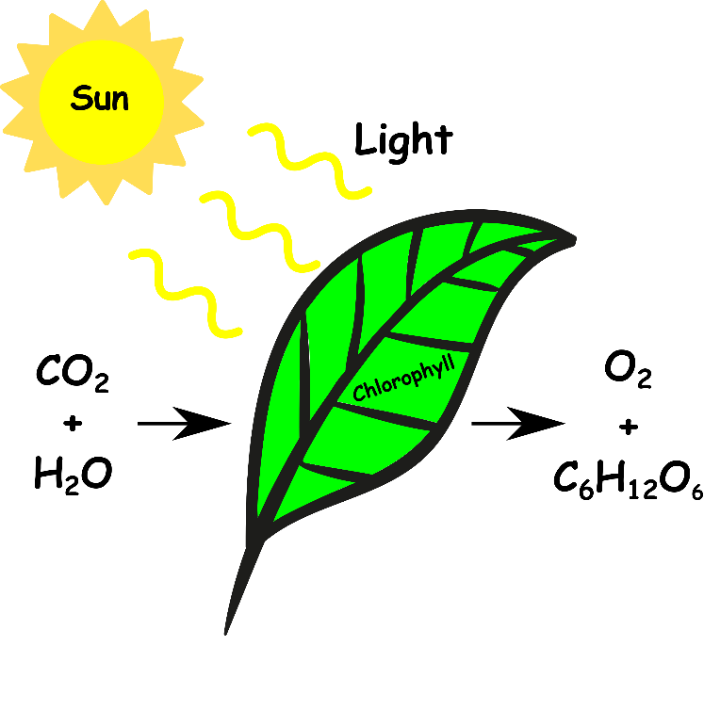
Write down the date and today’s title
PHOTOSYNTHESIS
DO IT NOW; The chemical equation for photosynthesis below has gaps. Choose from the four words below to write in the correct place.
(Clues; without plants breathing would be difficult and all plants get thirsty!)
Photosynthesis equation
_ _ _ _ _ _ _ _ _ _ _ _ + _ _ _ _ _ _ _ _ _ _ _ + _ _ _ _
C a r b o n d i o x i d e
W a t e r
O x y g e n
F o o d
Sequence on click
in slide show.
Used by plant
Made by plant
Words to use
Food (glucose)
Oxygen
Carbon dioxide
Water
Stretch
What else is needed for plants to make food?
Why are plants green?
Notes:
Use zoom function in slide show.

Slide 2
SUMMARY
Photosynthesis is the name given to the reaction by which plants use light to make food.
The reactants are carbon dioxide and water and the products are oxygen and glucose.
Leaves are adapted to photosynthesise.
Leaves contain chlorophyll in palisade cells to capture the energy of sunlight and make food.
They have air holes (stomata) on their underside to allow gases in and out.
Planting more trees helps reduce global warming.

