Slide 1
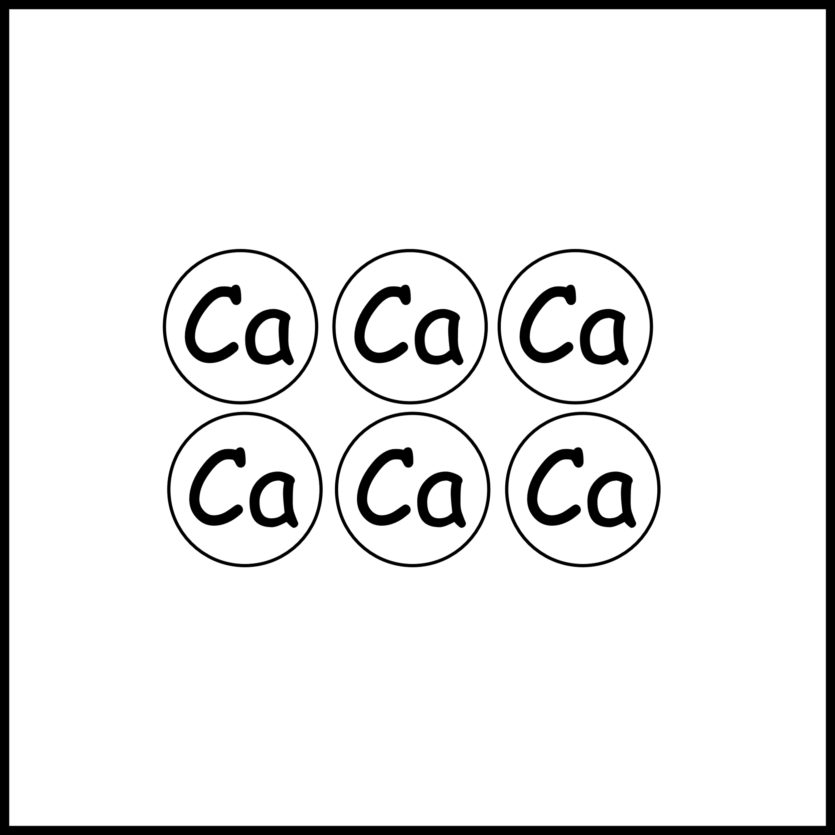
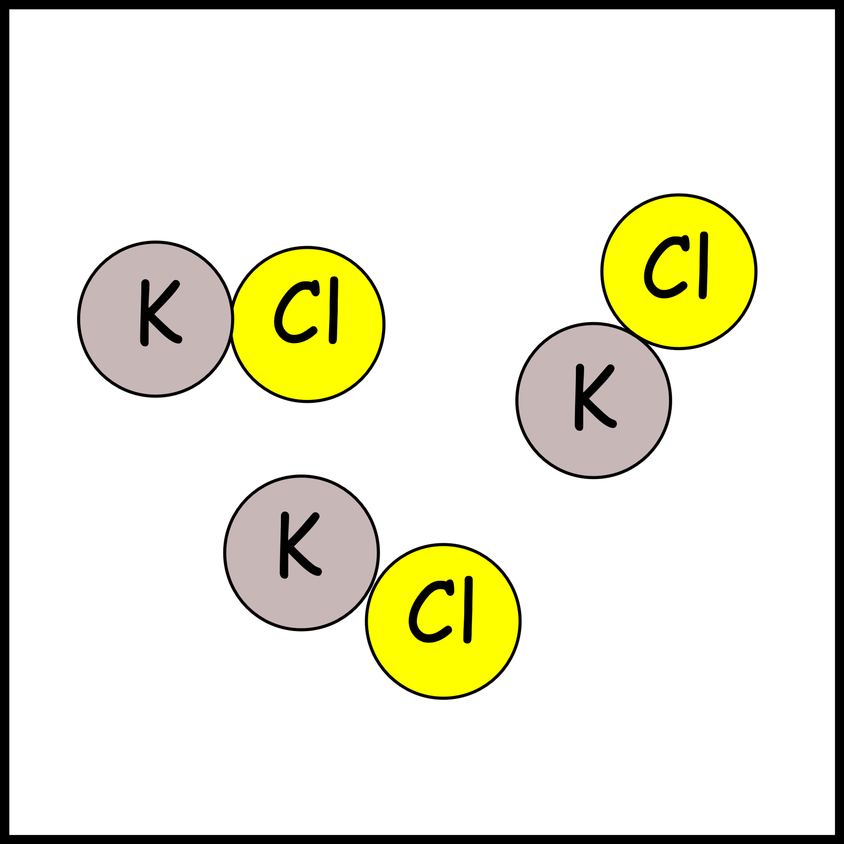
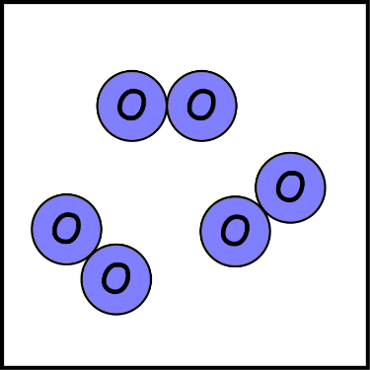
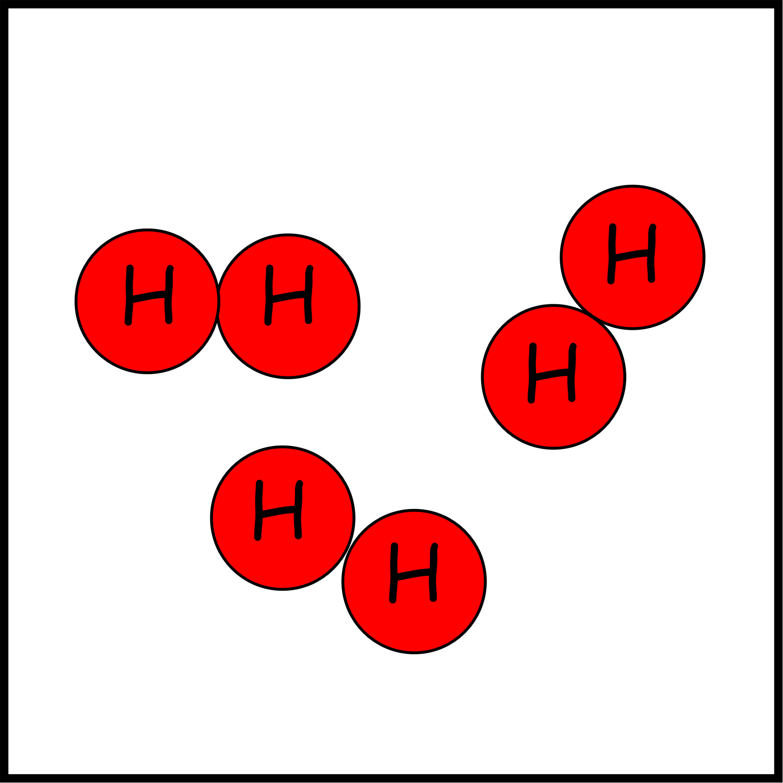
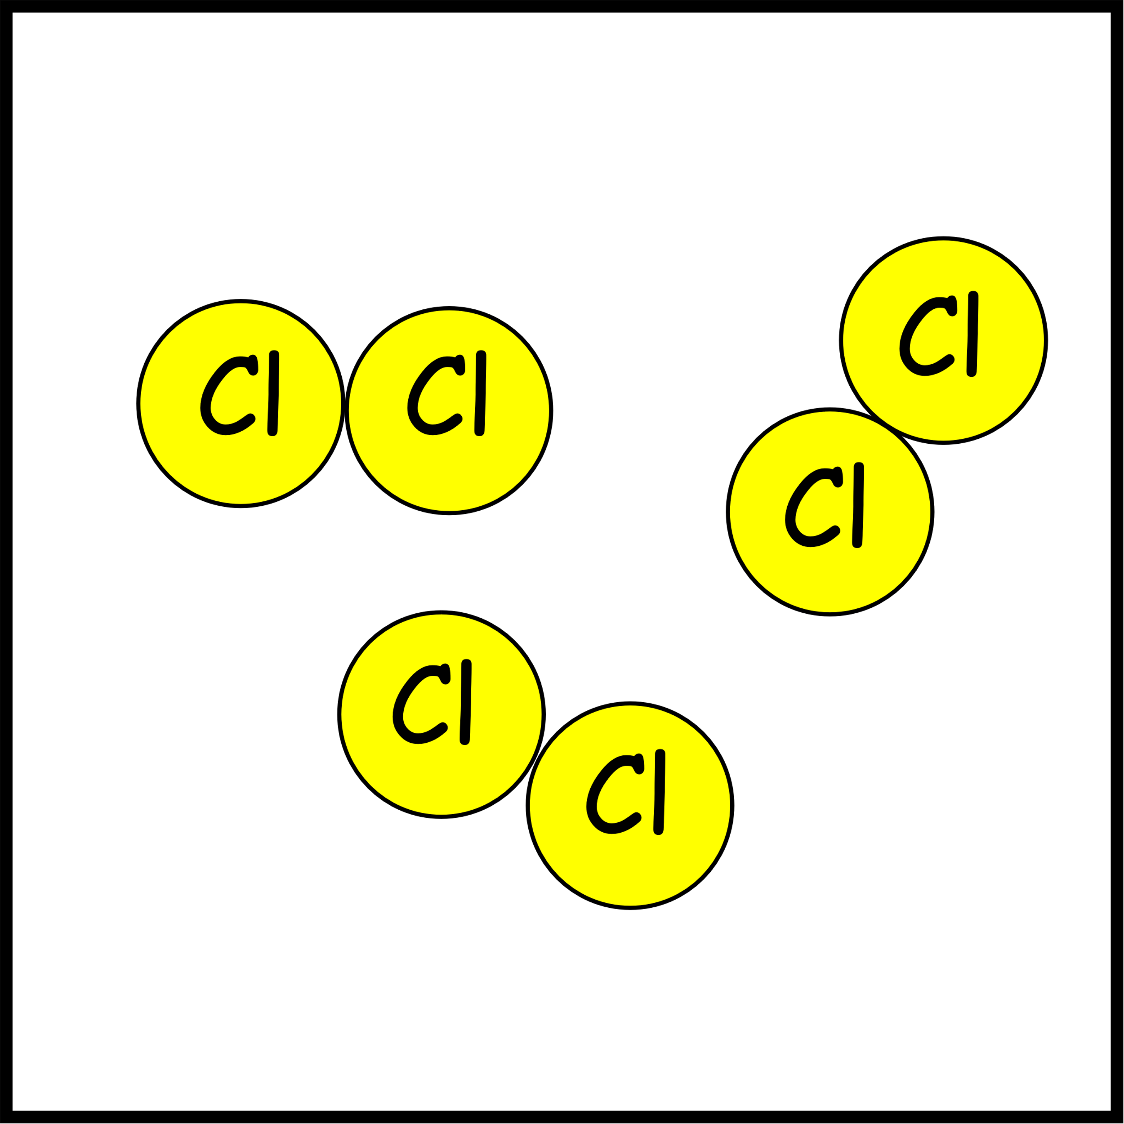
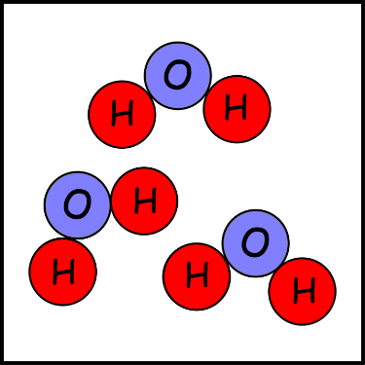
Write down the date and today’s title
ATOMS, ELEMENTS, COMPOUNDS AND MOLECULES
DO IT NOW; The images below show elements and compounds all made from atoms. Write down what differences and similarities you can spot?
A.
B.
C.
D.
E.
F.
Stretch
How many of the above can you name?
Do you know what any of them are used for?
Are any of them harmful?

Slide 2
SUMMARY
All elements, molecules and compounds are made from atoms.
Elements are made from only one type of atom.
Compounds are formed from two or more different atoms bonded together.
Molecules are two or more atoms bonded together, they can be the same or different.
Molecules are the smallest complete unit of a substance e.g. O₂ in the gas oxygen or H₂O in water.

