Slide 1
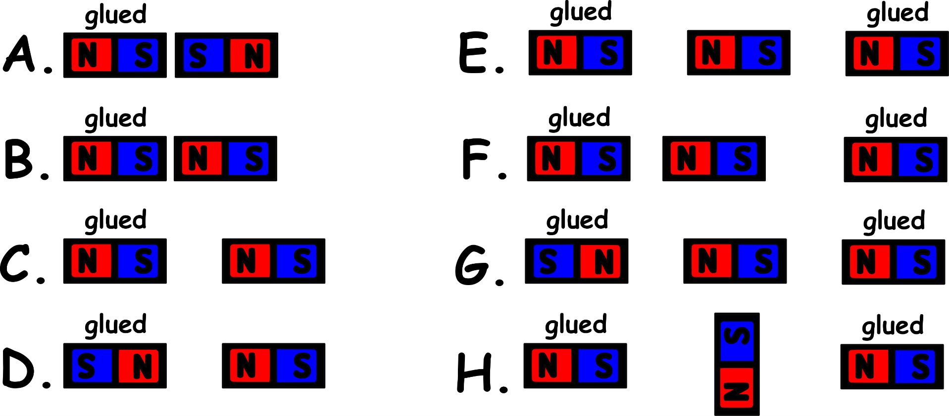
Write down the date and today’s title
MAGNETS AND MAGNETIC FIELDS
DO IT NOW; Use the words below to describe what happens in A to H below. The magnets labelled glued can’t move.
forced right, forced left, nothing, rotates
forced right
nothing
Sequence on click
in slide show.
forced left
forced left
forced left
forced right
forced right
rotates
Stretch
What happens to the force when the magnets are closer?
Why does nothing happen in E?
What device makes use of what happens in H?
Stretch
What happens to the force when the magnets are closer? Force is stronger.
Why does nothing happen in E? Pulled equally both sides.
What device makes use of what happens in H?
Stretch
What happens to the force when the magnets are closer? Force is stronger.
Why does nothing happen in E? Pulled equally both sides.
What device makes use of what happens in H? An electric motor.
Stretch
What happens to the force when the magnets are closer? Force is stronger.
Why does nothing happen in E?
What device makes use of what happens in H?
Notes:
Questions appears in slide show.

Slide 2
SUMMARY
Iron nickel and cobalt are the magnetic metals.
Permanent magnets can attract these metals by making them induced magnets.
Opposite poles attract (north-south) and alike poles repel (south-south and north-north).
A plotting compass can be used to show the shape of a magnetic field around a bar magnet.
The earth’s magnetic field makes plotting compasses line up with earth’s magnetic field so they point in a north-south direction.

