Slide 1
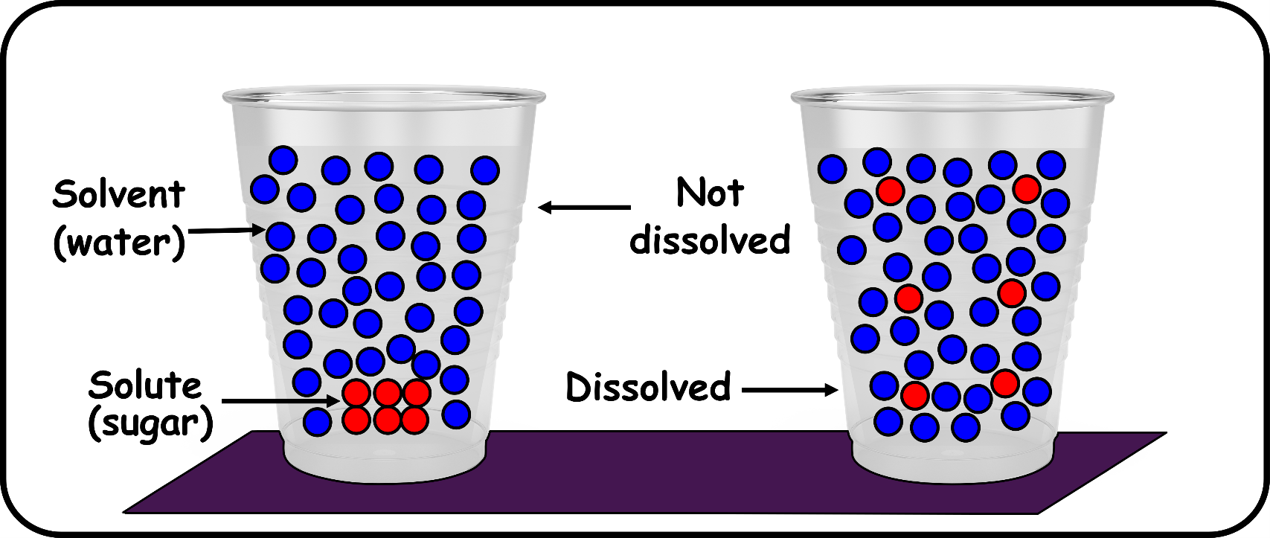
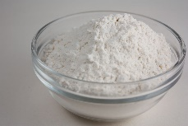
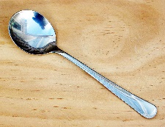
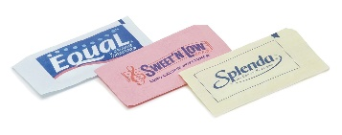
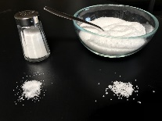
Write down the date and today’s title
DISSOLVING
DO IT NOW; Write down whether you think the following solids will dissolve in water.
Sand
Sugar
Wood
Coffee
no
yes
no
yes
Sequence on click
in slide show.
Flour
Metal Spoon
Sweeteners
Salt
no
no
yes
yes
Stretch
Solve the jumbled up words to reveal other liquids that we can dissolve into; COALHOL CDAI LOI
What happens to the substance that is dissolved?
Stretch
Solve the jumbled up words to reveal other liquids that we can dissolve into; ALCOHOL ACID OIL
What happens to the substance that is dissolved?

Slide 2
SUMMARY
A solution is made from a solid (or gas) called a solute dissolved into a solvent (often water).
Solids dissolve better at higher temperatures.
Different solvents dissolve different substances, e.g. oil does not dissolve in water but does dissolve in alcohol.
When a solute e.g. salt is dissolved into a solvent it is still there even though it appears to have disappeared, e.g. 100g of water plus 10g of salt will weigh 110g

