Slide 1
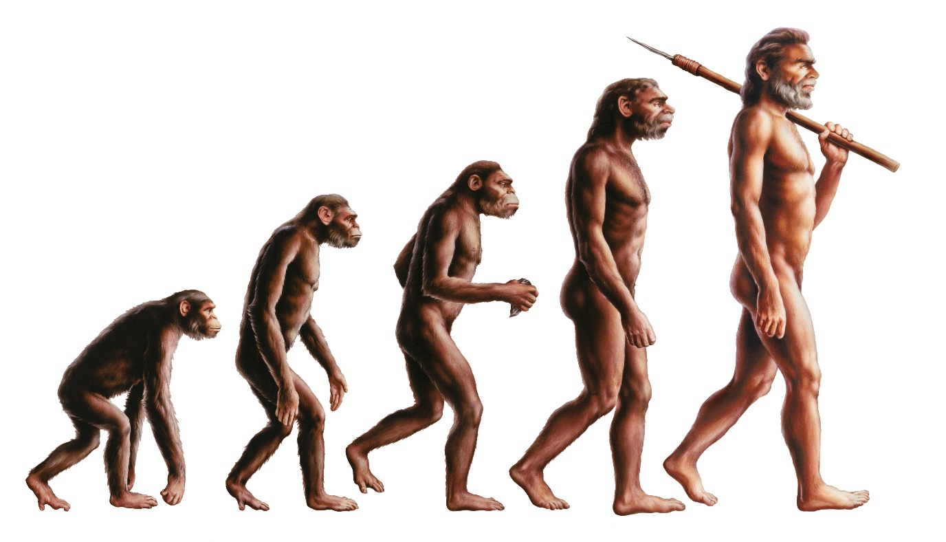
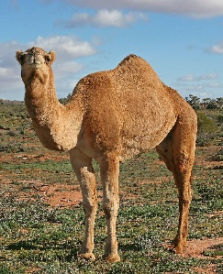
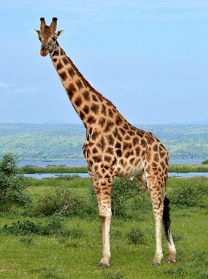
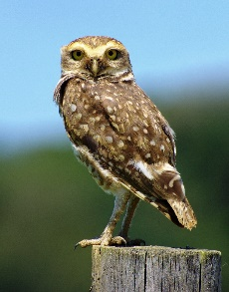
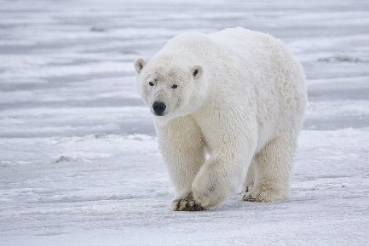
Write down the date and today’s title
EVOLUTION AND NATURAL SELECTION
DO IT NOW; Write down what you think the picture below shows.
Sequence on click
in slide show.
Stretch
How long do you think it took for the change above to happen? Choose from: 6 years 6,000 years, 6,000,000 years, 600,000 years.
What is the name given to slow change over time?
Why does it happen?
Stretch
How long do you think it took for the change above to happen? Choose from: 6,000,000 years (6 million years)
What is the name given to slow change over time?
Why does it happen?
Stretch
How long do you think it took for the change above to happen? Choose from: 6,000,000 years (6 million years)
What is the name given to slow change over time? Evolution
Why does it happen?
Stretch
How long do you think it took for the change above to happen? Choose from: 6,000,000 years (6 million years)
What is the name given to slow change over time? Evolution
Why does it happen? Changes in genes cause new traits that help a species to survive.
Notes:
Use zoom function in slide show to make visible. Questions appear in slide show.

Slide 2
SUMMARY
To evolve means to change gradually over time.
It happens due to changes in our genes that lead to new traits.
If the new trait makes it easier for the animal to survive it becomes more common and those that have it pass it on.
‘Survival of the fittest’ means that those best adapted to the environment are most likely to survive.
This means that species less well adapted to an environment die out. This is the cause of extinction.
Evolution is still happening now.

