Slide 1
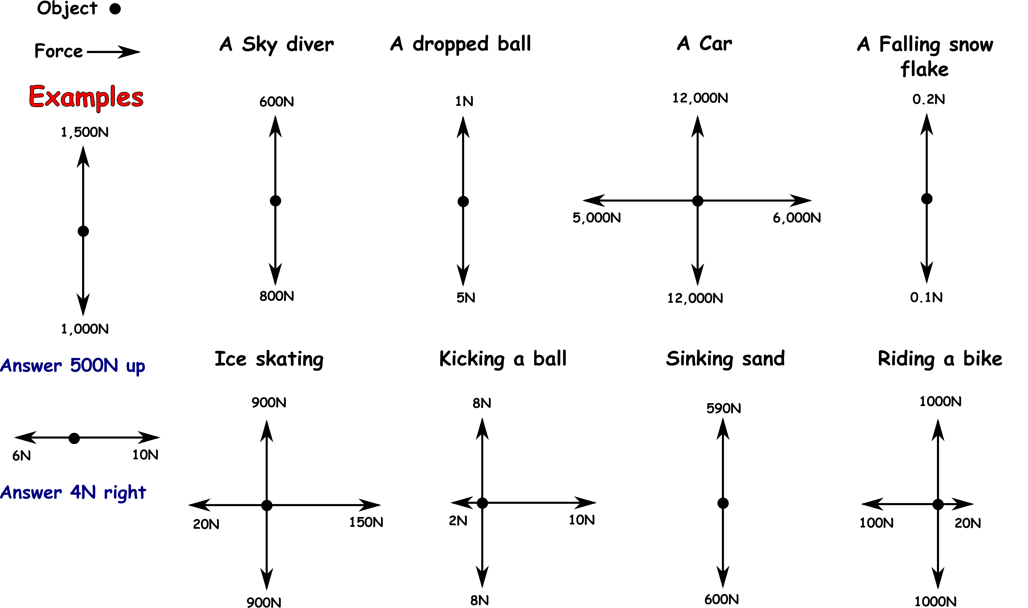
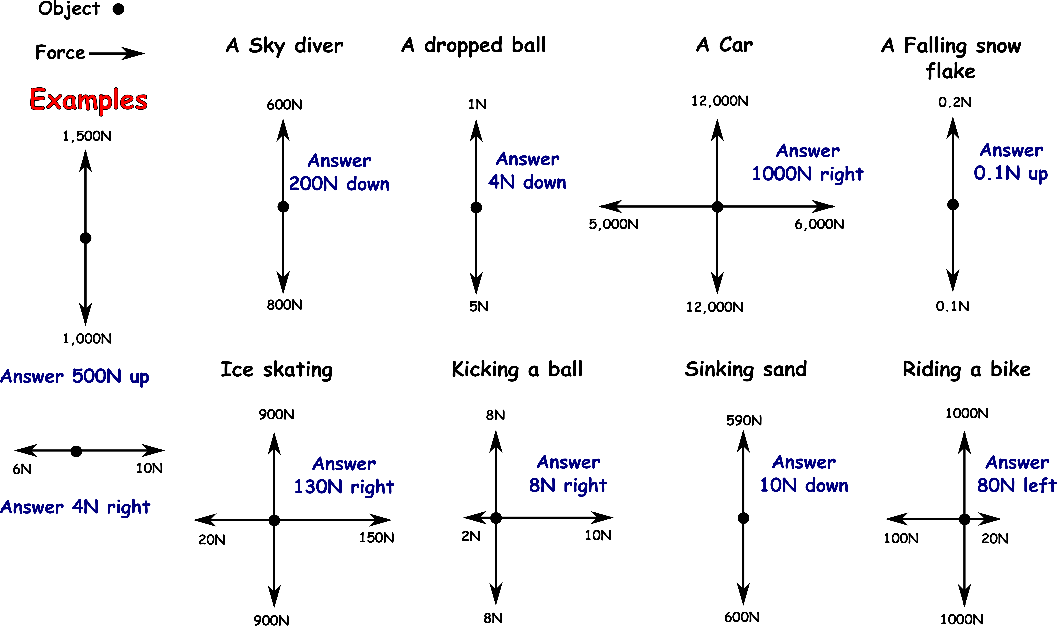
Write down the date and today’s title
UNBALANCED FORCES
DO IT NOW; Take away the up and down forces and the left and right forces to work out the size of the unbalanced forces below.
Use zoom function in slide show.
Sequence on click
in slide show.
Question
Solve the jumbled words to reveal three things that unbalanced forces can do to objects.
EESPD PU SWLO WNDO CNGEHA ECTIDIRON
Question
Solve the jumbled words to reveal three things that unbalanced forces can do to objects.
SPEED UP SWLO WNDO CNGEHA ECTIDIRON
Question
Solve the jumbled words to reveal three things that unbalanced forces can do to objects.
SPEED UP SLOW DOWN CNGEHA ECTIDIRON
Question
Solve the jumbled words to reveal three things that unbalanced forces can do to objects.
SPEED UP SLOW DOWN CHANGE DIRECTION
Notes:
Use zoom function in slide show to make visible. Questions appear in slide show.

Slide 2
SUMMARY
Unbalanced forces cause objects to speed up (accelerate), slow down (decelerate) or change direction. The unbalanced force is called a resultant force.
We can calculate resultant forces by taking away the forces that act in opposite directions. The bigger the resultant force the bigger the change in motion. (bigger acceleration or deceleration).
This is called Newton’s 2nd law.
Newton’s 3rd law tells us that forces come in pairs. Push against the wall and the wall pushes back, this is called the reaction force.

