Slide 1
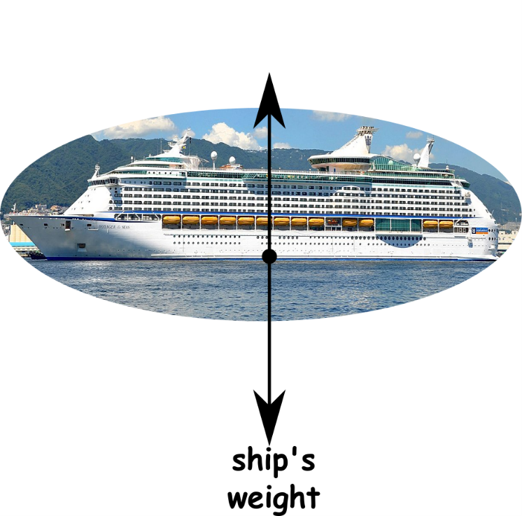
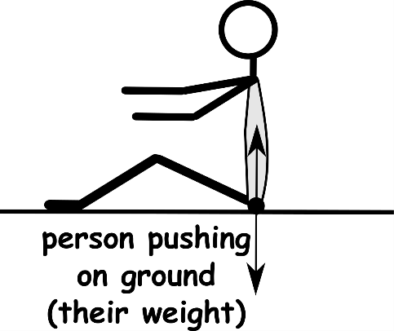
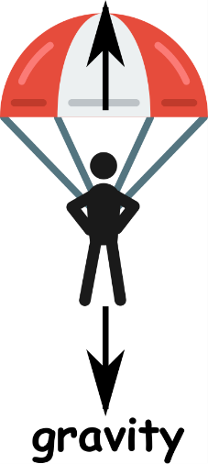
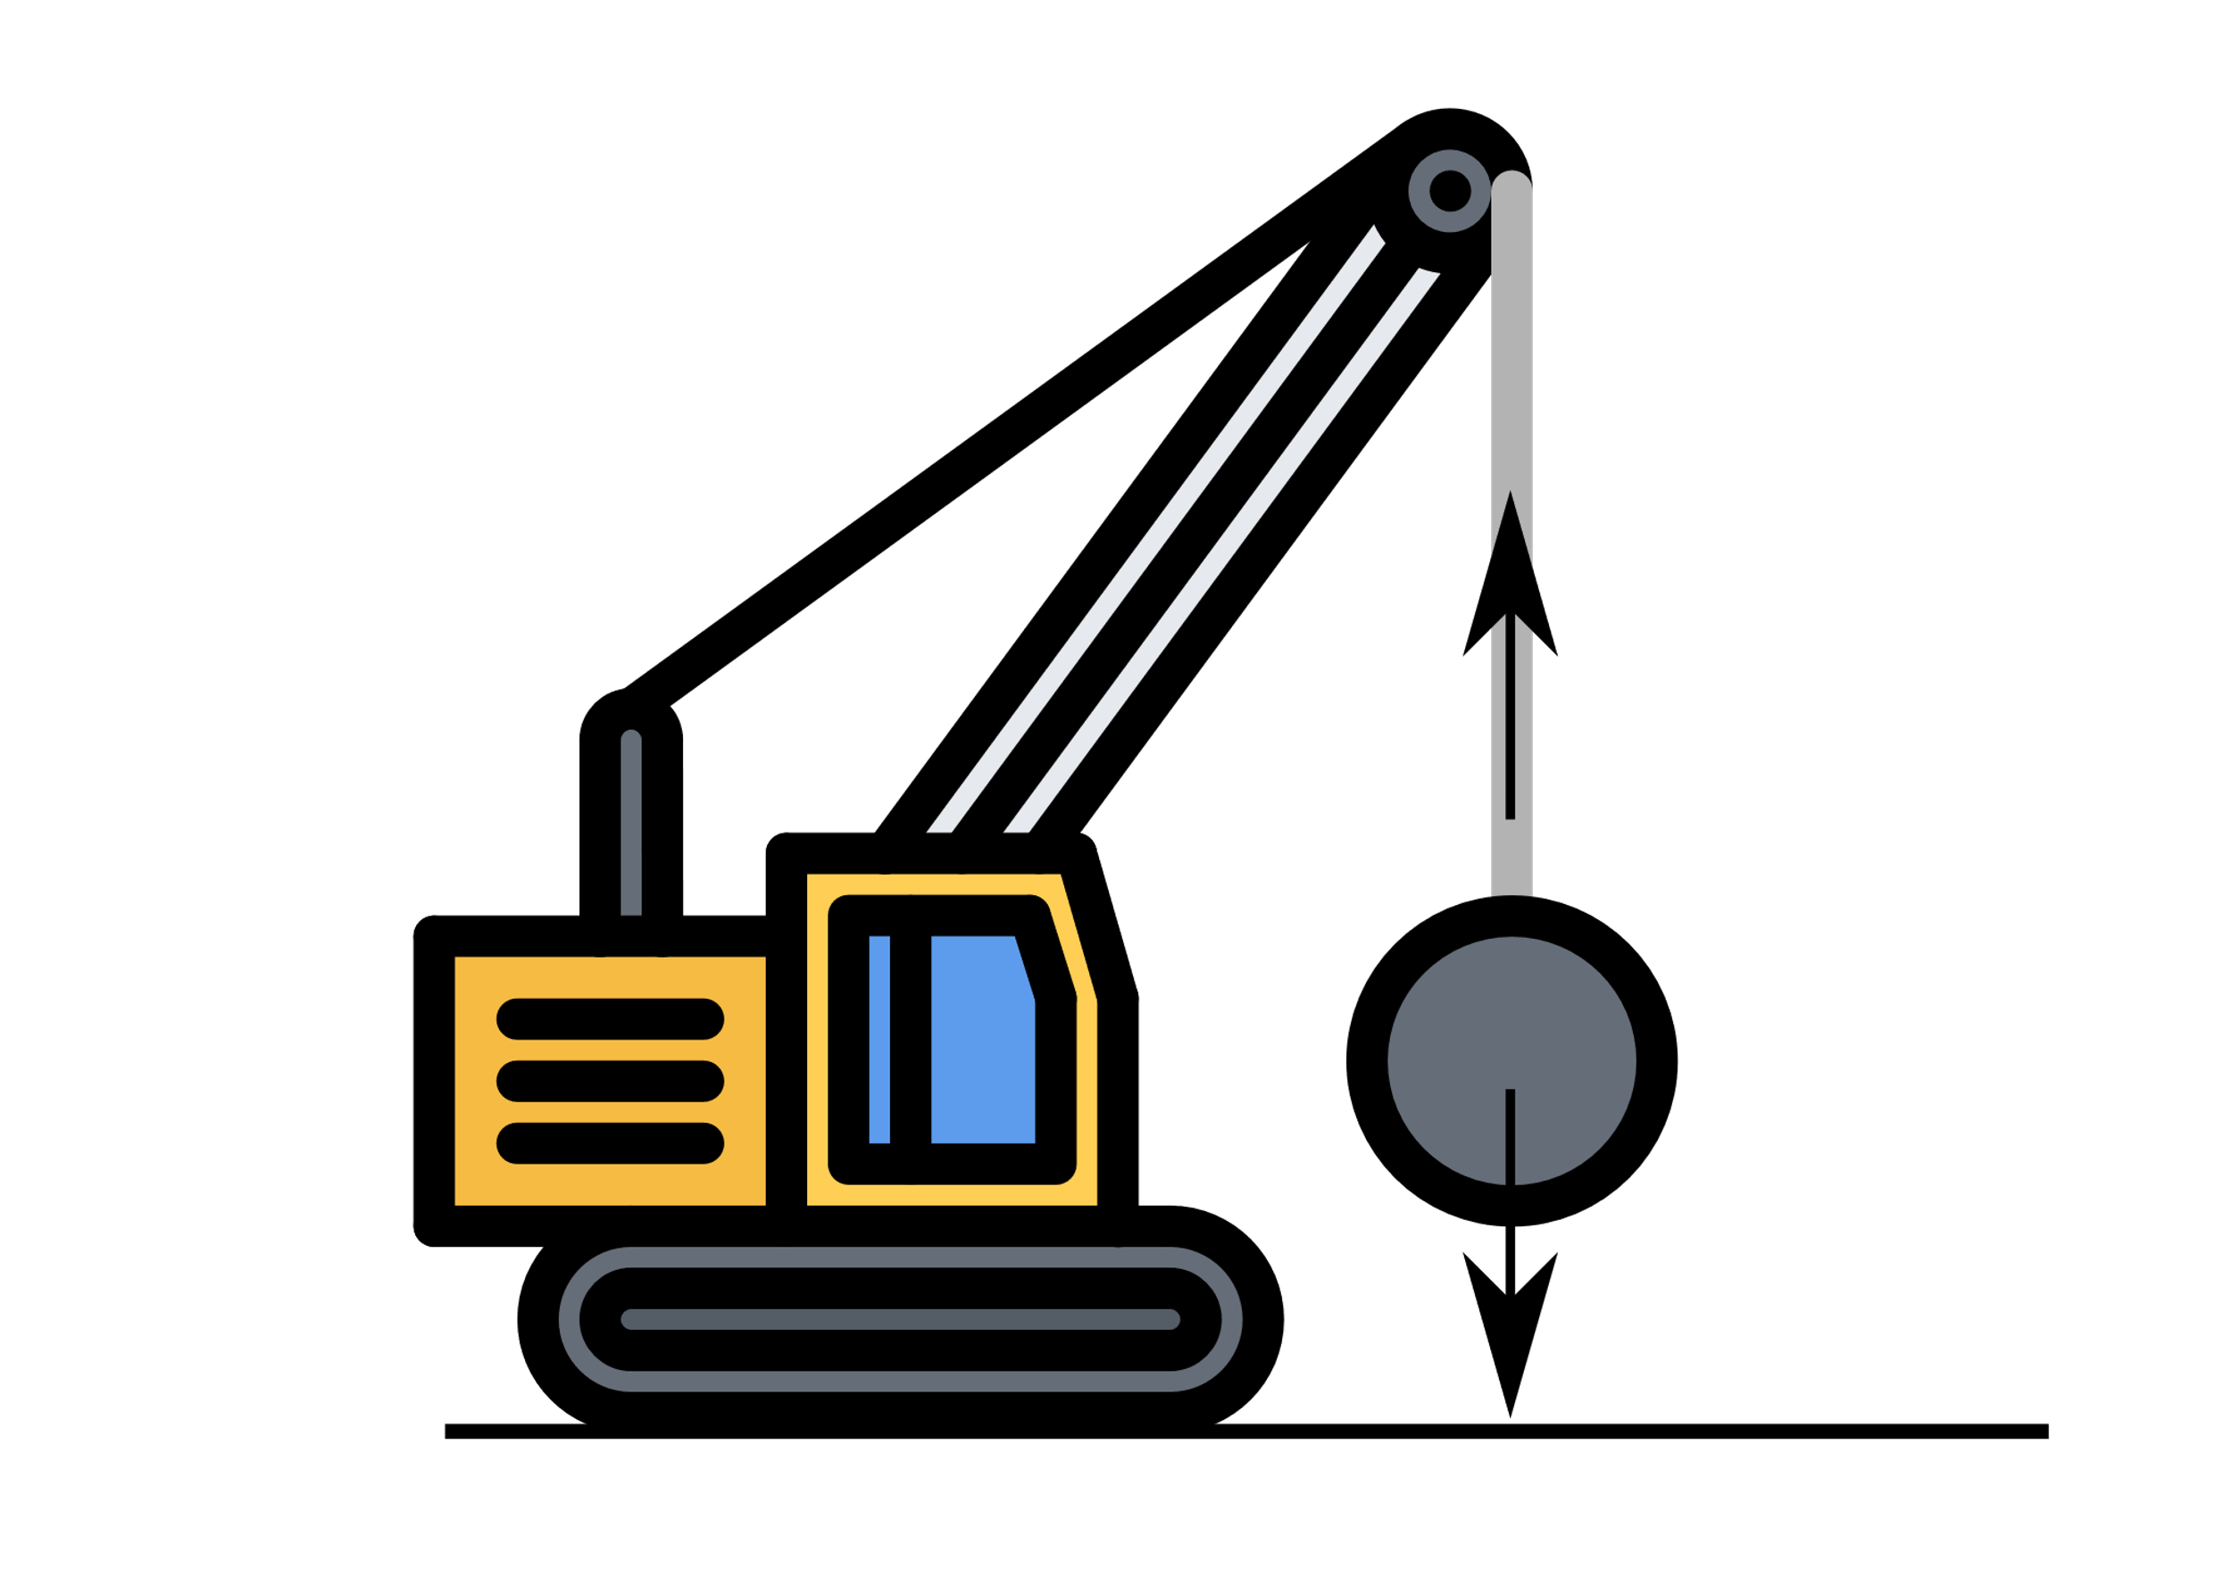
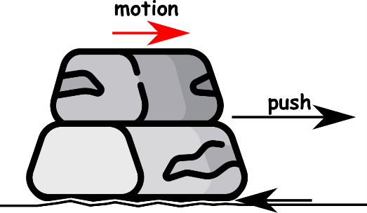
Write down the date and today’s title
CONTACT FORCES
DO IT NOW; Use the following words to try and label the forces A to E. Air resistance, upthrust, tension, friction and reaction.
B
upthrust
air resistance
C
A
Sequence on click
in slide show.
reaction
E
tension
friction
D
weight
Stretch
Why do you think they are called contact forces?
Can you think of another one? (clue; in diagram c when the ship moves)
How could you reduce the friction in diagram D?
Stretch
Why do you think they are called contact forces? The objects touch
Can you think of another one? (clue; in diagram c when the ship moves)
How could you reduce the friction in diagram D?
Stretch
Why do you think they are called contact forces? The objects touch
Can you think of another one? (clue; in diagram c when the ship moves) Water resistance
How could you reduce the friction in diagram D?
Stretch
Why do you think they are called contact forces? The objects touch
Can you think of another one? (clue; in diagram c when the ship moves) Water resistance
How could you reduce the friction in diagram D? Oil/lubrication

Slide 2
SUMMARY
Contact forces exist between things that touch each other.
Examples include;
A reaction force, when things push back
Upthrust, the force objects experience in or on water
Friction, the force that acts in the opposite direction to motion between surfaces that touch
Air resistance, like the friction of air, acts in the opposite direction to movement through air
Tension, the force created when we pull or stretch an object

