Slide 1
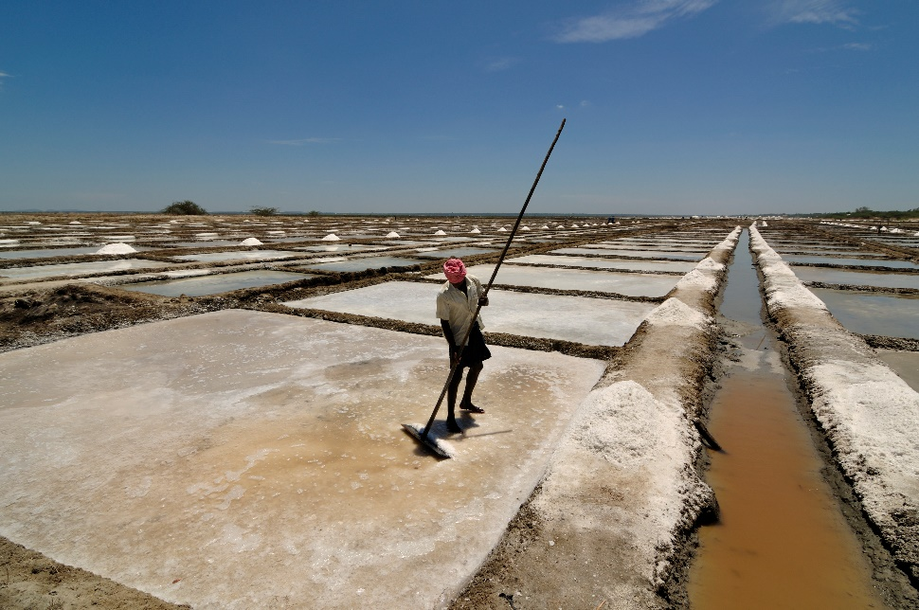
Write down the date and today’s title
EVAPORATION AND DISTILLATION
DO IT NOW; The image shows a man scraping salt into piles on a salt farm. Try to answer the questions on the left hand side.
Questions
What sort of water is pumped into the pools?
Why is the salt left behind?
Why does salt farming work faster in hotter countries?
What would happen if we did this with lemonade?!
Answers
Sea water. ……………………………………
Why is the salt left behind?
Why does salt farming work faster in hotter countries?
What would happen if we did this with lemonade?!
Answers
Sea water. ……………………………………
The water evaporates.
Why does salt farming work faster in hotter countries?
What would happen if we did this with lemonade?!
Answers
Sea water. ……………………………………
The water evaporates.
Water evaporates quicker at higher temperatures.
We would be left with sugar after the water evaporates.
Answers
Sea water. ……………………………………
The water evaporates.
Water evaporates quicker at higher temperatures.
What would happen if we did this with lemonade?!
Sequence on click
in slide show.
Stretch
Which country do you think the photo was taken in? India.
If we condense the water that evaporates what won’t be in the water any more? Why might this be useful?
Stretch
Which country do you think the photo was taken in?
If we condense the water that evaporates what won’t be in the water any more? Why might this be useful?
Stretch
Which country do you think the photo was taken in? India.
If we condense the water that evaporates what won’t be in the water any more? Salt. Why might this be useful?
Stretch
Which country do you think the photo was taken in? India.
If we condense the water that evaporates what won’t be in the water any more? Salt. Why might this be useful? Obtain drinking water from salt water.
Notes:
Sequence see slide show.

Slide 2
SUMMARY
We can separate a solid dissolved in water by evaporating the water to leave the solid behind e.g. obtaining salt from sea water.
The water evaporated from sea water can be condensed to obtain drinking water.
A mixture of liquids can be separated when they have different boiling points. The liquid with the lower boiling point can be evaporated and then condensed in a condenser leaving behind the liquid with a higher boiling point. E.g. separating alcohol from water.

