Slide 1
Write down the date and today’s title
PRESSURE ON SOLID SURFACES
DO IT NOW; Pressure is force (N) $÷$ area (cm²). Work out the pressure (divide force by area) below to decide what is worst to have standing on your foot!
Use zoom function.
Sequence on click
in slide show.
Stretch
Bigger area means a lower pressure, can you think of any examples of where areas are made deliberately big? (clue; snow)
Smaller area means a higher pressure, can you think of any examples of where areas are deliberately small? (clue; cut, sharp)
Notes:
Questions appears in slide show.

Slide 2
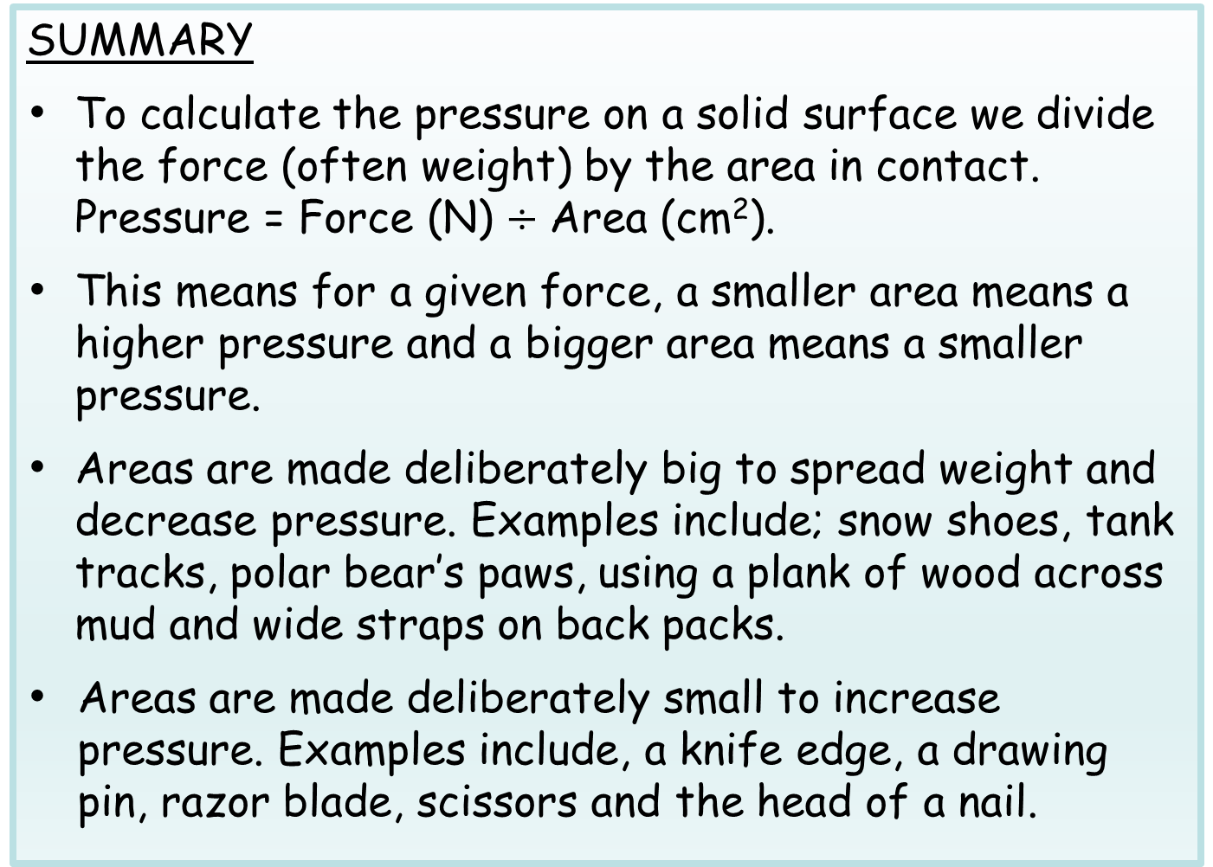
SUMMARY
To calculate the pressure on a solid surface we divide the force (often weight) by the area in contact. Pressure = Force (N) $÷$ Area (cm²).
This means for a given force, a smaller area means a higher pressure and a bigger area means a smaller pressure.
Areas are made deliberately big to spread weight and decrease pressure. Examples include; snow shoes, tank tracks, polar bear’s paws, using a plank of wood across mud and wide straps on back packs.
Areas are made deliberately small to increase pressure. Examples include, a knife edge, a drawing pin, razor blade, scissors and the head of a nail.

