Slide 1
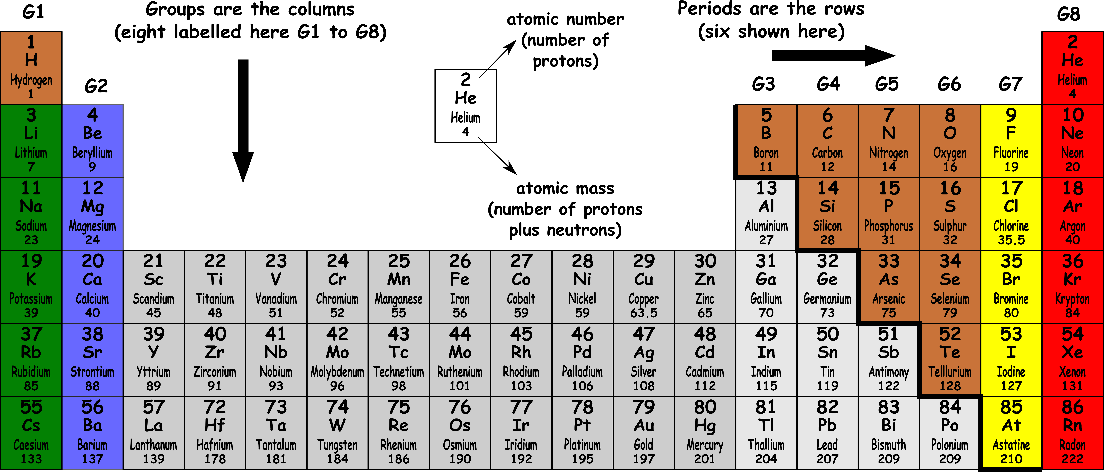
Write down the date and today’s title
THE PERIODIC TABLE OF ELEMENTS
DO IT NOW; Use the periodic table to answer in full sentences.
Sequence on click
in slide show.
Questions
The columns are called…
The rows are called…
The atomic number is the number of…
The atomic mass is the number of…
Questions
The columns are called groups.
The rows are called…
The atomic number is the number of…
The atomic mass is the number of…
Questions
The columns are called groups.
The rows are called periods.
The atomic number is the number of…
The atomic mass is the number of…
Questions
The columns are called groups.
The rows are called periods.
The atomic number is the number of protons.
The atomic mass is the number of…
Questions
The columns are called groups.
The rows are called periods.
The atomic number is the number of protons.
The atomic mass is the number of protons plus neutrons.
Notes:
Use zoom function in slide show to make visible.

Slide 2
SUMMARY
The periodic table contains the known 118 elements. Dimitri Mendeleev is credited with developing the modern table.
Each element is made from a different atom. The atomic number and atomic mass of that atom can be found on the table.
The columns are called groups and the rows are called periods.
Atoms have the same number of protons as electrons so are neutral.

