Slide 1
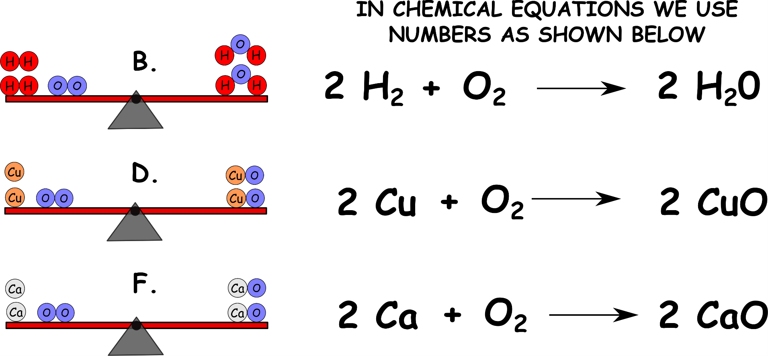
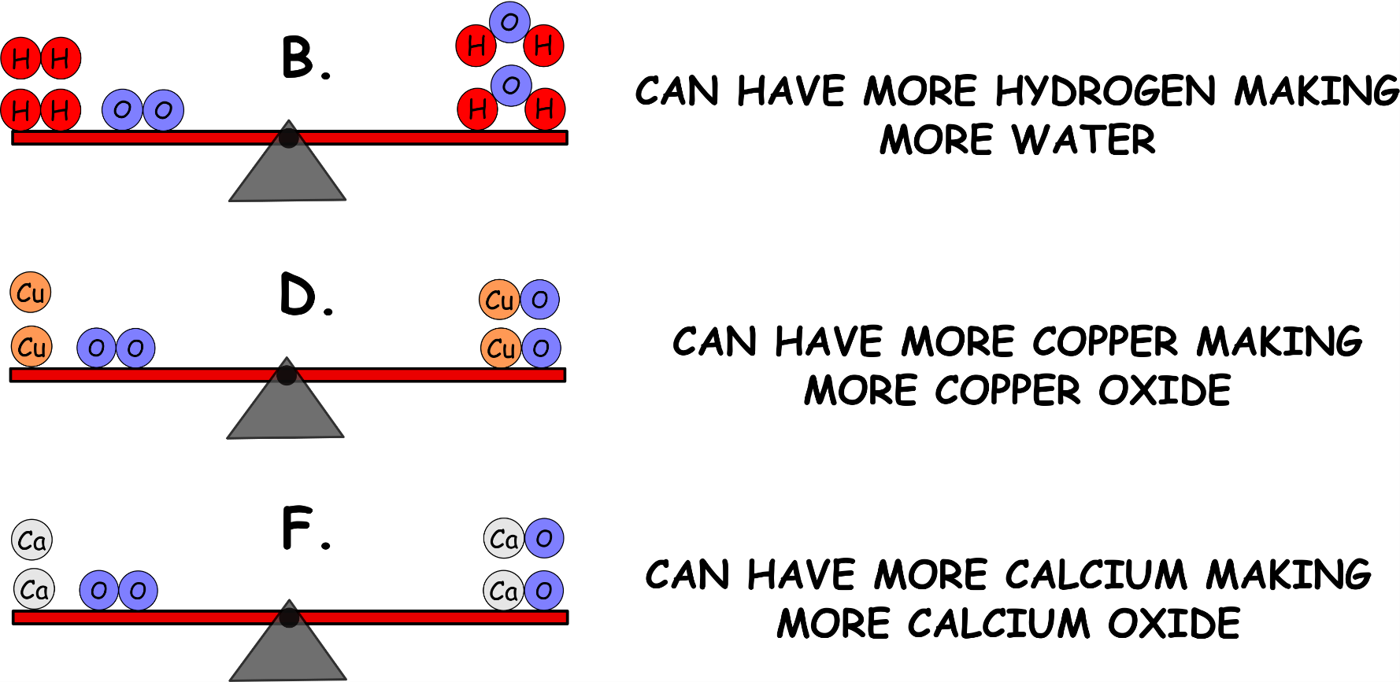
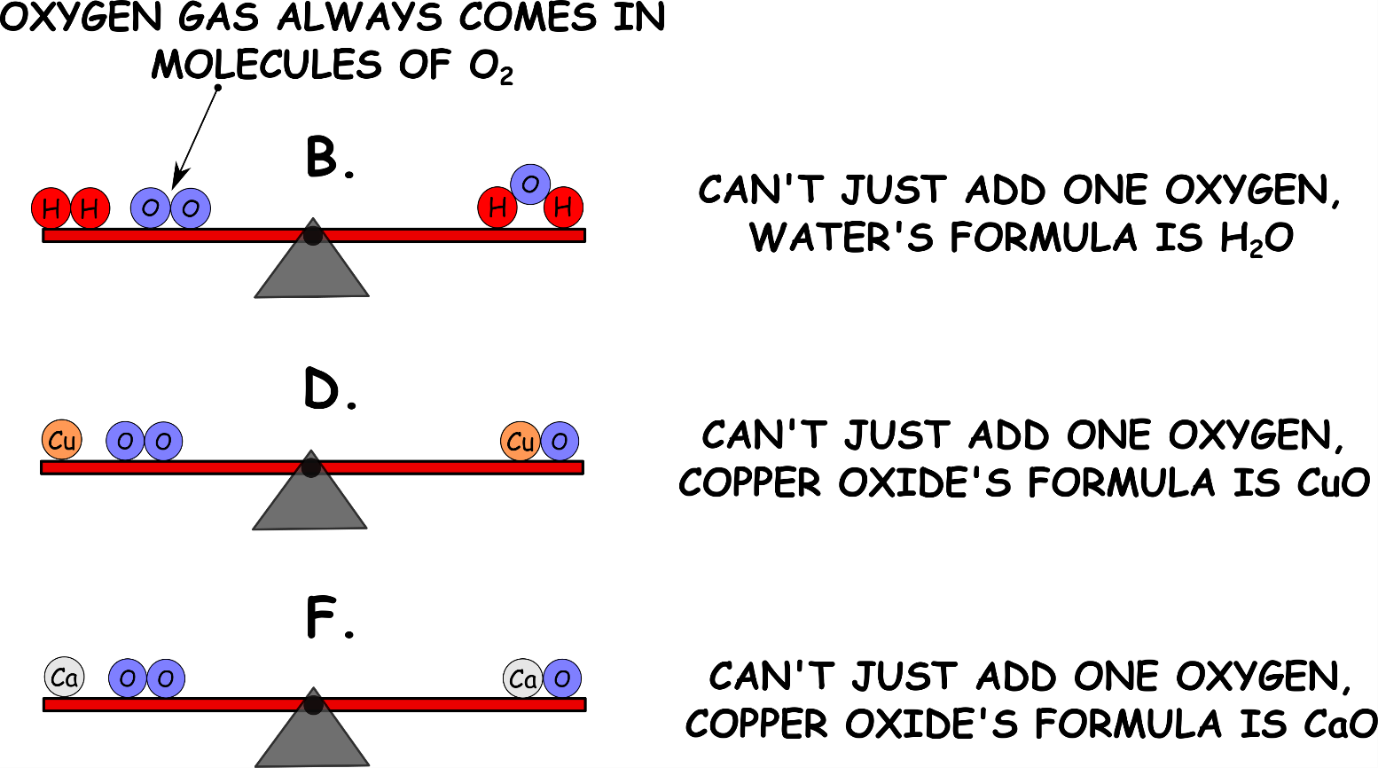
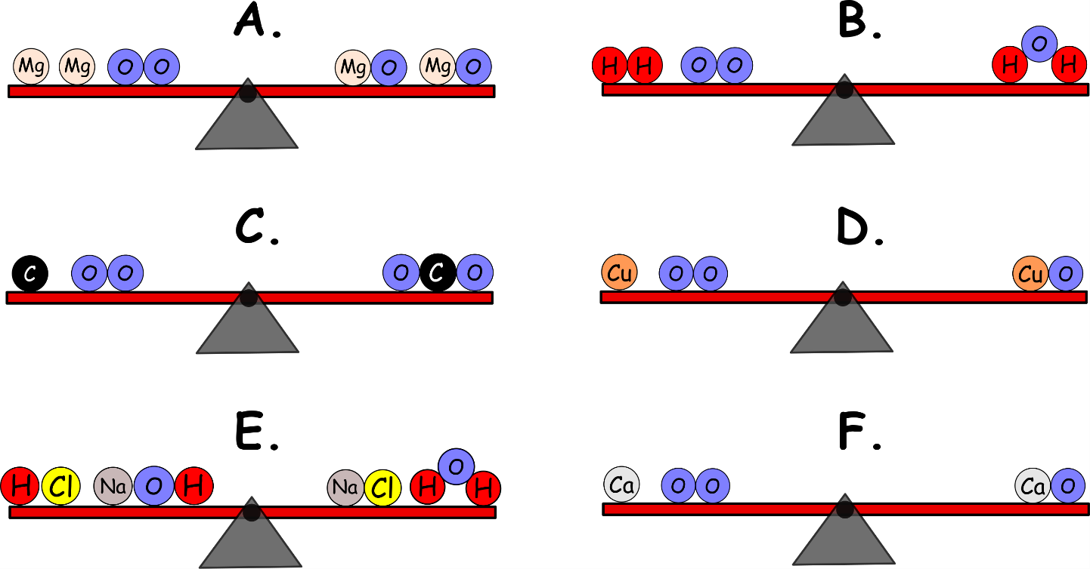
Write down the date and today’s title
CONSERVATION OF MASS AND BALANCING EQUATIONS
DO IT NOW; Decide which of the seesaws A to F are balanced or not.
Use zoom function in slide show to make clearer.
Sequence on click
in slide show.
balanced
unbalanced
balanced
unbalanced
balanced
unbalanced
Stretch
How could you balance any of the unbalanced seesaws?
What do you think it means when the circles (atoms) are touching?
Why do you think oxygen is drawn in pairs when it’s on its own?

Slide 2
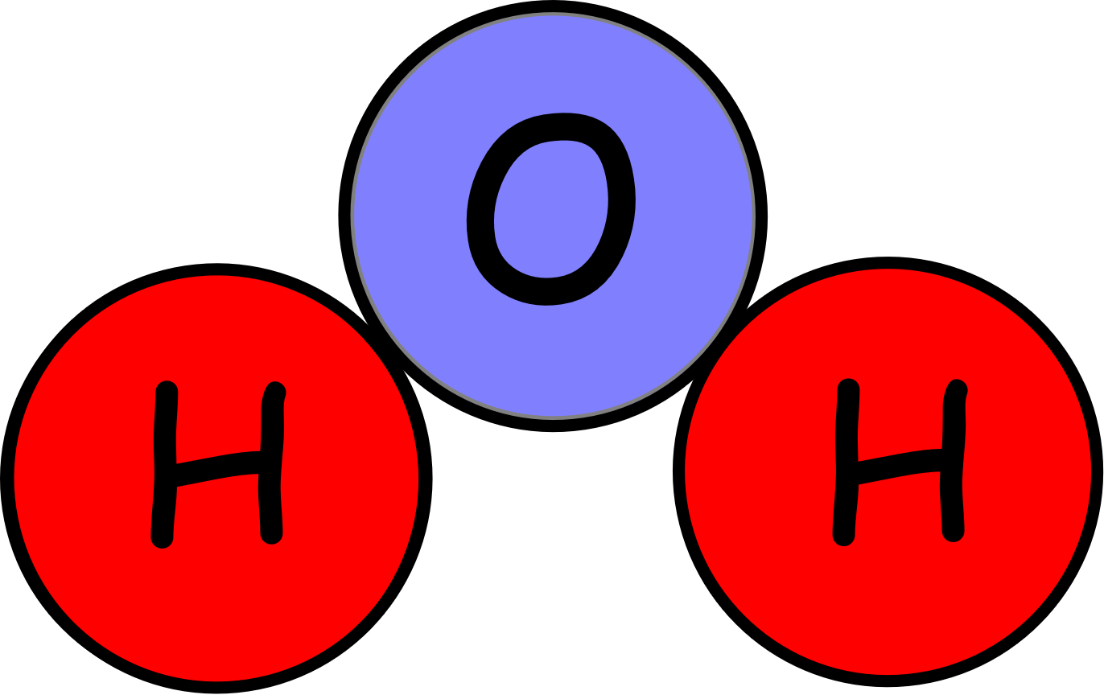
SUMMARY
Conservation of mass tells us that the total mass of chemicals we start with is equal to the total mass of chemicals we end up with.
We can show this by balancing equations.
Putting numbers in front of the molecules multiplies them.
2 H₂0 means two molecules of water which means four hydrogen atoms and two oxygen atoms.

