Slide 1
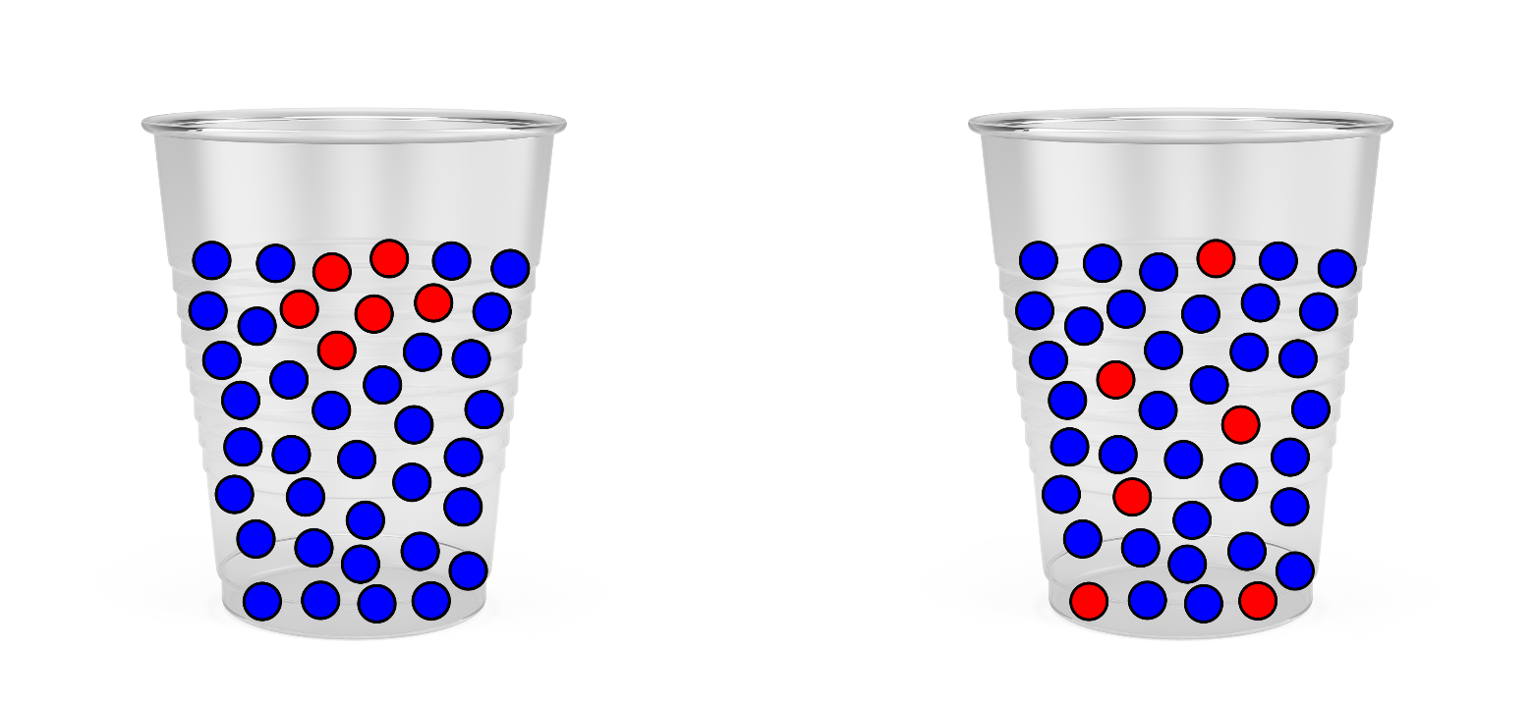
Write down the date and today’s title
DIFFUSION
DO IT NOW; Describe how the red circles are arranged in A. and B. below.
Sequence on click
in slide show.
A.
B.
Stretch
Where might you see the above happening?
Can you think of any other examples of ‘things’ spreading out on their own?
Where might this be useful?
Stretch
Where might you see the above happening? Adding squash to water
Can you think of any other examples of ‘things’ spreading out on their own?
Where might this be useful?
Stretch
Where might you see the above happening? Adding squash to water
Can you think of any other examples of ‘things’ spreading out on their own? Smells/tea from a tea bag/perfume/bubble bath/food colouring
Where might this be useful?
Stretch
Where might you see the above happening? Adding squash to water
Can you think of any other examples of ‘things’ spreading out on their own? Smells/tea from a tea bag/perfume/bubble bath/food colouring
Where might this be useful? Breathing/digestion/in plants

Slide 2
SUMMARY
Diffusion happens in gases and liquids.
It is the spreading out of particles from a region of high concentration to low concentration.
It happens due to the random motion of the particles.
Examples of diffusion are;
Smells spreading out
Food particles being absorbed into the blood
Absorbing oxygen into our blood
Plants absorbing nutrients through their roots

