Slide 1
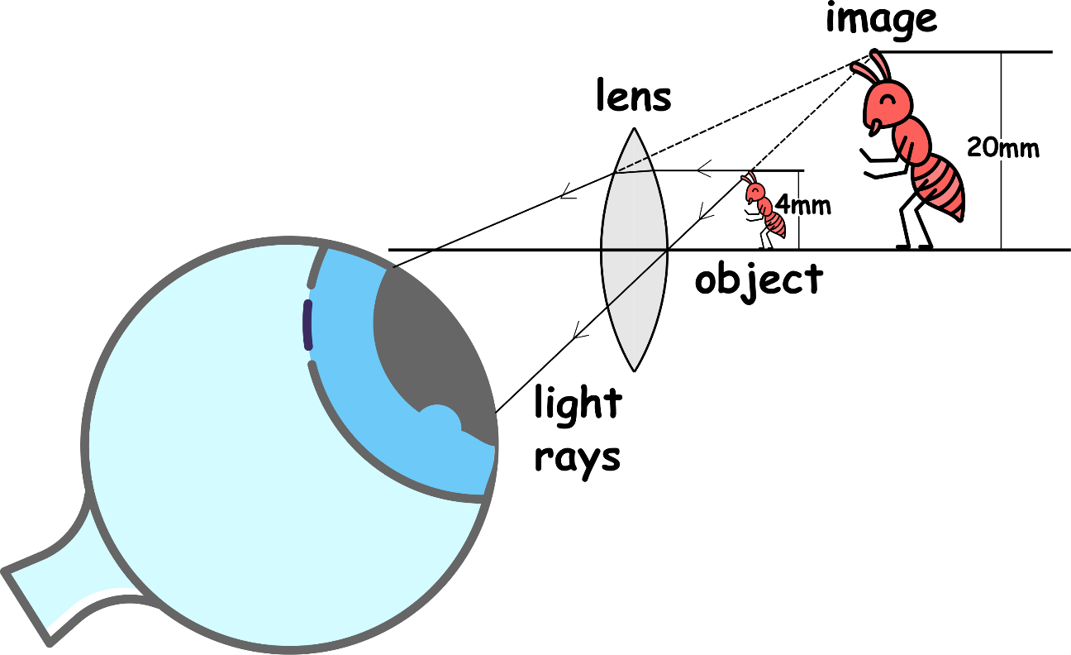
Write down the date and today’s title
THE LIGHT MICROSCOPE
DO IT NOW; Write down what you think the picture below is showing.
Sequence on click
in slide show.
Stretch; complete the sentences below into your books
If we divide the size of the i _ _ _ _ by the size of the o _ _ _ _ _ we get the number f _ _ _ .
This is called the m _ _ _ _ _ _ _ _ _ _ _ n.
Stretch; complete the sentences below into your books
If we divide the size of the i m a g e by the size of the o b j e c t we get the number f i v e.
This is called the m a g n i f i c a t i o n.
Notes:
The stretch question lies underneath the answer. See slide show.

Slide 2
SUMMARY
The smallest objects that humans could see before lenses was limited by the naked eye.
Lenses can be used to magnify so humans can see smaller objects.
Magnification is image size divided by object size.
Compound microscopes use two lenses to magnify objects even more than a single lens.
The total magnification of a compound microscope is found by multiplying the eyepiece lens magnification by the objective lens magnification.

