Slide 1
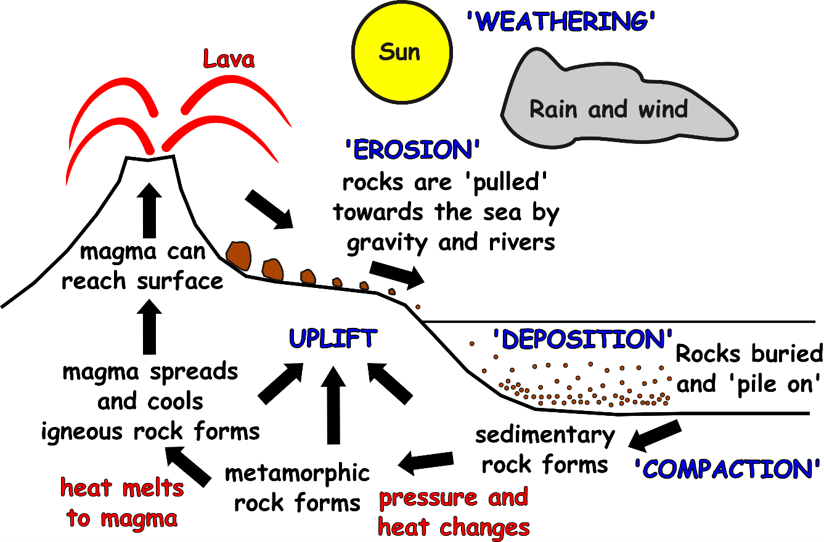
Write down the date and today’s title
THE ROCK CYCLE
DO IT NOW; Use the rock cycle below to answer the following questions.
1. Where do the rocks on the side of the volcano come from?
2. What makes them move towards the sea?
3. What happens to the smaller rocks when they get to the sea?
DO IT NOW; Use the rock cycle below to answer the following questions.
1. The lava (molten rock that cools and solidifies)
2. What makes them move towards the sea?
3. What happens to the smaller rocks when they get to the sea?
DO IT NOW; Use the rock cycle below to answer the following questions.
1. The lava (molten rock that cools and solidifies)
2. Pulled by gravity and carried by rivers
3. What happens to the smaller rocks when they get to the sea?
DO IT NOW; Use the rock cycle below to answer the following questions.
1. The lava (molten rock that cools and solidifies)
2. Pulled by gravity and carried by rivers
3. They get buried and pile on top of each other
Sequence on click
in slide show.
Stretch
They wear down (abrasion) as they roll and water flows over them.
Stretch
Why do the rocks get smaller and rounder?
Notes:
Questions appear in slide show.

Slide 2
SUMMARY
There are three types of rock, sedimentary, metamorphic and igneous.
The rock cycle shows us how rocks change over time.
The burying and compacting of small pieces of rock forms sedimentary rock.
Heat and pressure causes sedimentary rock to change into metamorphic rock.
Igneous rock is formed when metamorphic rock melts to form magma and then cools.

