Slide 1
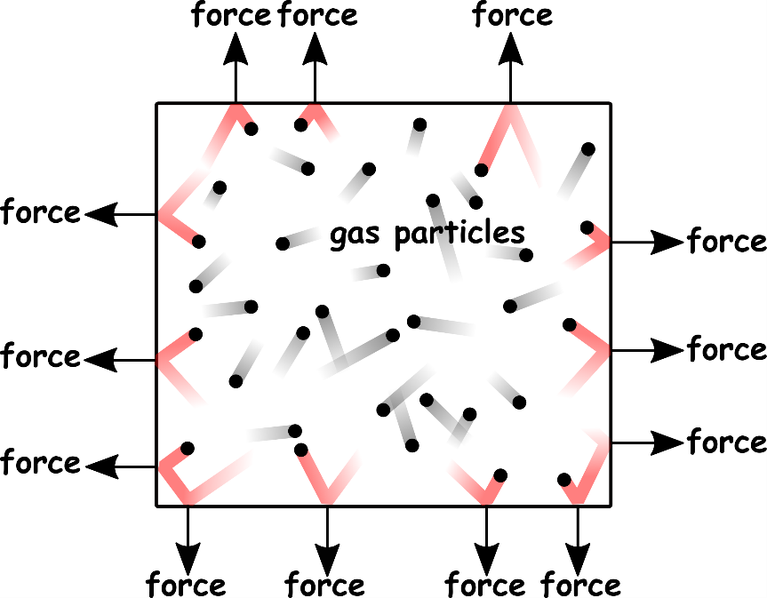
Write down the date and today’s title
GAS PRESSURE
DO IT NOW; Choose from the following words to complete the sentences describing a ‘gas in a box’. high, particles, force, bump, pressure, area
Gas in a box
The gas ________ whizz around at _____ speed and _____ into the walls exerting a ______. This force is spread over an _____ giving us a ________.
The gas particles whizz around at high speed and bump into the walls exerting a force. This force is spread over an area giving us a pressure.
Sequence on click
in slide show.
Stretch
How could the pressure inside the box be increased? Here are some clues; ºC SPACE NUMBER
Stretch
How could the pressure inside the box be increased? Here are some clues; Heat the gas (increase temperature). Squash the gas (reduce the volume). Add more gas particles.
Notes:
See slide show for sequence.

Slide 2
SUMMARY
Gas pressure is due to the particles of the gas hitting an area and exerting a force.
The greater the number of collisions the greater the force.
Heating a gas means the particles move faster, collisions are more frequent leading to a greater force and pressure.
Reducing the volume of a gas increases the pressure, less space for the particles to move and collisions with the wall are more frequent.
Adding more particles (like pumping up a tyre) increases the pressure because collisions with the wall are more frequent.

