Slide 1
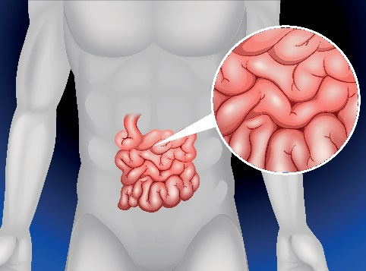
Write down the date and today’s title
ENZYMES, THEIR ROLE IN DIGESTION AND OTHER USES
DO IT NOW; Write out the bullet points and try to match them to what the picture shows opposite. Leave a space if unsure.
In the body enzymes help us to……
Enzymes are in ………..….. to help break down stains
Enzymes thicken milk in……..
Enzymes in yeast……..
Sequence on click
in slide show.
digest food
washing powders
cheese making
make alcohol
Stretch
Where might enzymes be made in the body?
They speed up reactions, another name for this is a c _ _ _ _ _ _ _ .
We can’t digest grass like cows because we don’t make the right?
Stretch
Where might enzymes be made in the body? Mouth, stomach, pancreas, small intestines
They speed up reactions, another name for this is a c _ _ _ _ _ _ _ .
We can’t digest grass like cows because we don’t make the right?
Stretch
Where might enzymes be made in the body? Mouth, stomach, pancreas, small intestines
They speed up reactions, another name for this is a c a t a l y s t .
We can’t digest grass like cows because we don’t make the right?
Stretch
Where might enzymes be made in the body? Mouth, stomach, pancreas, small intestines
They speed up reactions, another name for this is a c a t a l y s t .
We can’t digest grass like cows because we don’t make the right? Enzyme

Slide 2
SUMMARY
Enzymes are biological catalysts. They speed up chemical reactions in living organisms.
Enzymes are not ‘used up’.
Protease breaks down proteins in our digestive system, carbohydrase breaks down carbohydrates and lipase breaks down fats.
Other uses of enzymes include;
Enzymes in yeast for making alcohol
Enzymes in washing powders to break down stains
Rennet used in cheese making
Invertase for making the centre of chocolates soft

