Slide 1
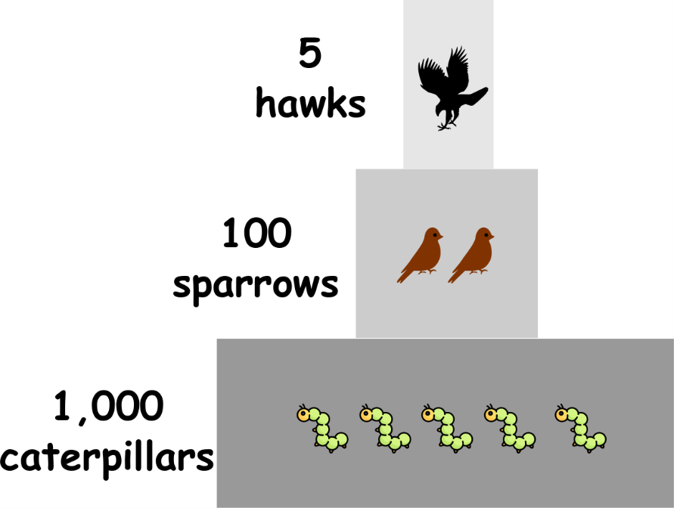
Write down the date and today’s title
PYRAMIDS OF NUMBERS AND TOXINS IN FOOD CHAINS
DO IT NOW; Draw the two ‘pyramids’ below and write the correct organisms at the the correct level. The example helps.
1.
Example
2 Eagles
Sequence on click
in slide show.
8 Minnows
10 Lions
2.
4 Pike
20 Zebra
40 bushes
Stretch
What happens to the pike and eagles if the minnows are poisoned?
Stretch
They also get poisoned but the poison becomes more concentrated.
Notes:
Questions appear in slide show.

Slide 2
SUMMARY
Pyramids of numbers show us the number of organisms at each trophic level in a food chain.
Toxins such as pesticides and mercury can enter food chains from farming and factories.
Toxins accumulate and become more concentrated as they move up a food chain.
This can lead to organisms higher up the food chain becoming poisoned and dying.

