Slide 1
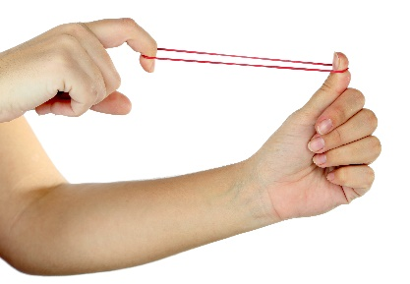
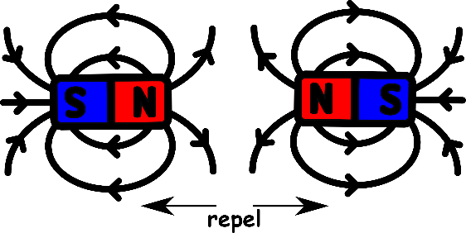
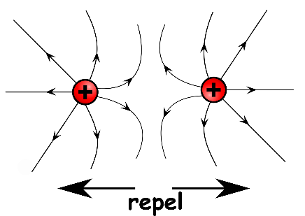
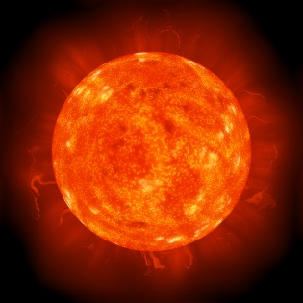
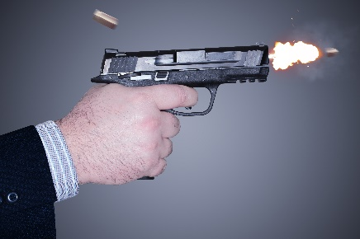
Write down the date and today’s title
ENERGY STORES
Sequence on click
in slide show.
DO IT NOW; Write down then match the following energy stores to the pictures. Magnetic potential energy, chemical potential energy, gravitational potential energy, elastic potential energy, nuclear energy, thermal (heat) energy, kinetic energy and electric potential energy.
Gravitational potential energy
A.
B.
C.
D.
Magnetic potential energy
Thermal (heat) energy
Elastic potential energy
E.
F.
G.
H.
Electric potential energy
Nuclear energy
Chemical potential energy
Propane gas
Kinetic energy
Stretch
What sort of energy is needed to keep the fire going?
Before the bullet leaves the gun at high speed what sort of energy store was inside the bullet?
Where did the energy come from to stretch the elastic band?
Stretch
What sort of energy is needed to keep the fire going? Chemical
Before the bullet leaves the gun at high speed what sort of energy store was inside the bullet?
Where did the energy come from to stretch the elastic band?
Stretch
What sort of energy is needed to keep the fire going? Chemical
Before the bullet leaves the gun at high speed what sort of energy store was inside the bullet? Chemical
Where did the energy come from to stretch the elastic band?
Stretch
What sort of energy is needed to keep the fire going? Chemical
Before the bullet leaves the gun at high speed what sort of energy store was inside the bullet? Chemical
Where did the energy come from to stretch the elastic band? Chemical

Slide 2
SUMMARY
Energy can be stored in eight different ways.
The eight energy stores are;
GPE short for? Objects have GPE due to their?
CPE short for? This store is due to?
EPE short for? This is stored by?
Nuclear energy is the energy stored by?
MPE short for? This comes from magnets a _ _ _ _ _ _ _ _ g or r _ _ _ _ _ _ _ g.
Electric potential energy. This comes from charges a _ _ _ _ _ _ _ _ g or r _ _ _ _ _ _ _ g.
Thermal energy is increased by making objects?
Kinetic energy is the energy objects posses due to their?

