Slide 1
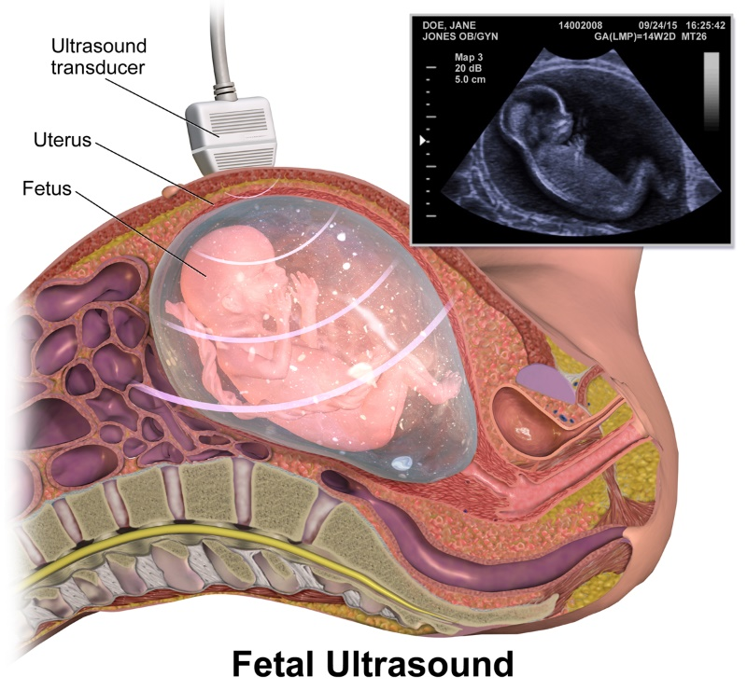
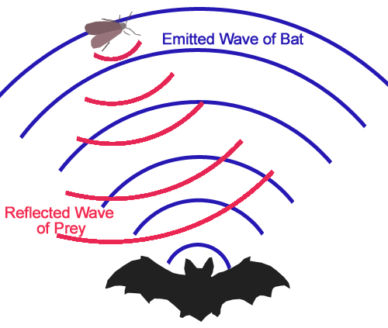
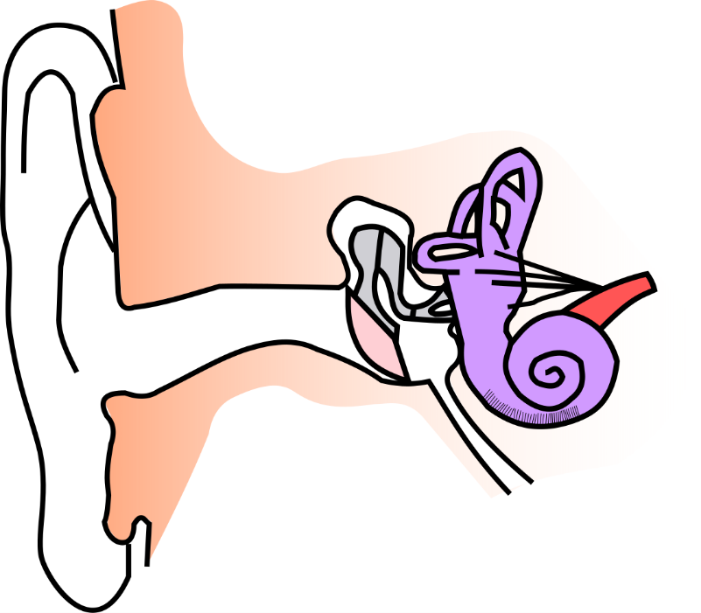
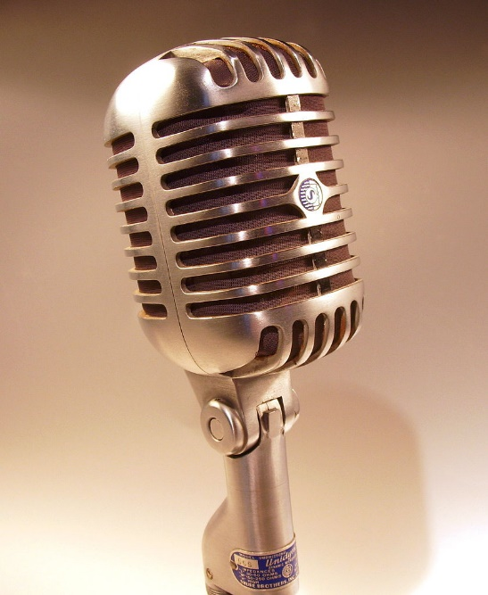
Write down the date and today’s title
HEARING AND USING SOUND
DO IT NOW; Write down in your own words what you think the images on the right and left are showing.
(blue)
Sequence on click
in slide show.
(red)
Stretch
The two images that follow show the way that we usually detect sound. What do they both convert the sound into? Electrical impulse
Where does this short burst of electricity go in each case? A human it goes to the brain. A microphone it goes to a speaker.
Stretch
The two images that follow show the way that we usually detect sound. What do they both convert the sound into?
Where does this short burst of electricity go in each case?
Stretch
The two images that follow show the way that we usually detect sound. What do they both convert the sound into? Electrical impulse
Where does this short burst of electricity go in each case?
Notes:
Questions appears in slide show.

Slide 2
SUMMARY
We can detect sounds with our ears or a microphone.
The energy of the sound wave is converted into an electrical impulse. This is sent to our brains (from the ear) or a loud speaker from a microphone.
Humans and animals have different audible frequency ranges.
Frequencies above 20,000Hz are called ultrasound and humans cannot hear them.
Ultrasound is used in;
Echolocation by animals like bats for finding prey
SONAR by ships and submarines
Scanning unborn babies in pregnant women
In physiotherapy to promote healing

