Slide 1
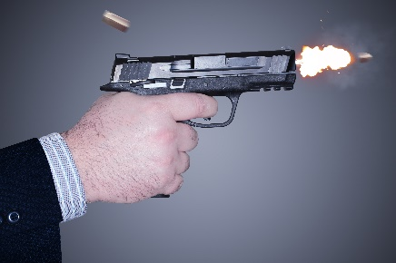
Write down the date and today’s title
ENERGY TRANSFERS (FLOWS)
DO IT NOW; Write out the energy flows on the left hand side and then decide which picture they match to.
Energy flows
A chemical reaction forces an object to be stretched
Gravity forces an increase in speed
A chemical reaction forces the emission of heat and light
An explosion (heat) forces an object to move quickly
Energy flows
A chemical reaction forces an object to be stretched D
Gravity forces an increase in speed A
A chemical reaction forces the emission of heat and light B
An explosion (heat) forces an object to move quickly C
Energy flows
D the energy flows from chemical to elastic potential
A the energy flows from GPE to kinetic energy
B the energy flows from chemical to heat (and light)
C the energy flows from chemical to heat to kinetic
A.
B.
Sequence on click
in slide show.
C.
D.
Stretch
Can you say what the energy changes are i.e. from what to what?
Which word is common in each energy flow?
Can you think of any more examples?
Stretch
Can you say what the energy changes are i.e. from what to what?
Which word is common in each energy flow? Forces are always involved
Can you think of any more examples?

Slide 2
SUMMARY
Energy can flow from one store to another.
Forces are involved in energy transfers.
As one store decreases another store increases.
We can draw energy transfer diagrams which use arrows to show the energy flow.
Examples include;
Gravitational potential energy to kinetic energy for a falling object.
Chemical potential energy to elastic potential for a stretched object.
Electric potential energy to heat and light (through the flow of an electric current) for a torch.
Chemical potential energy to kinetic energy for a bike or car speeding up.

