Slide 1
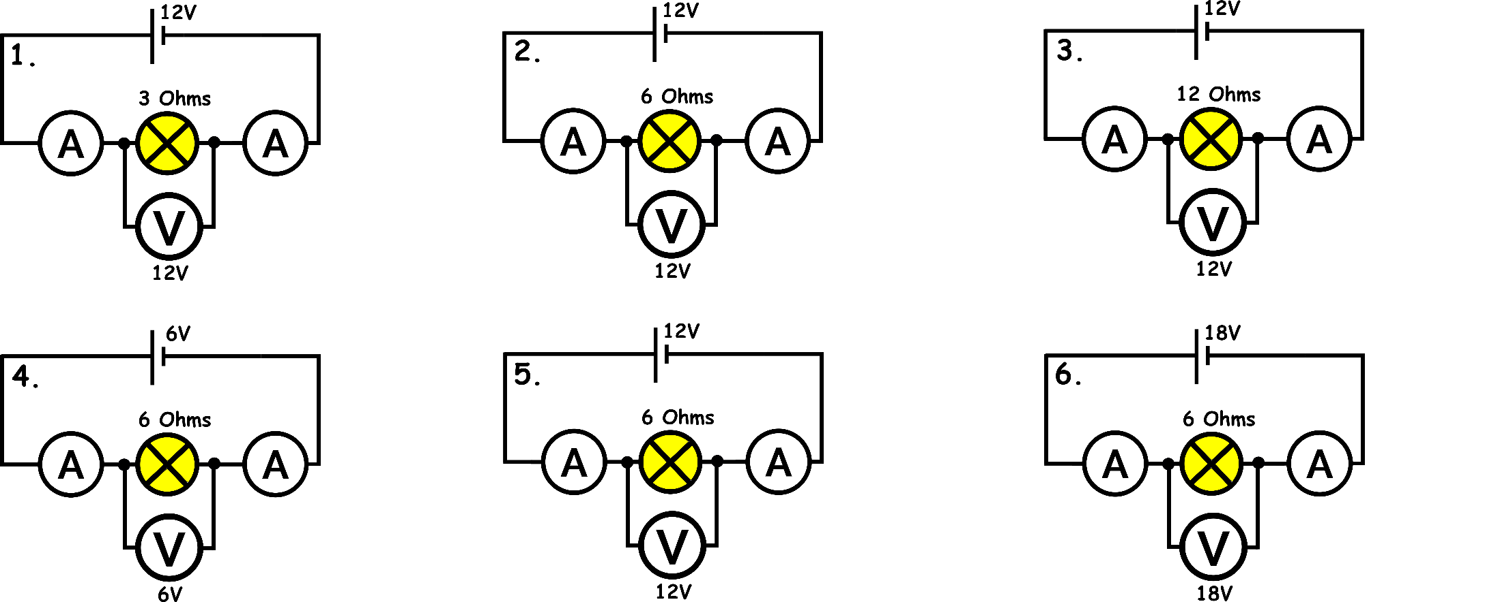
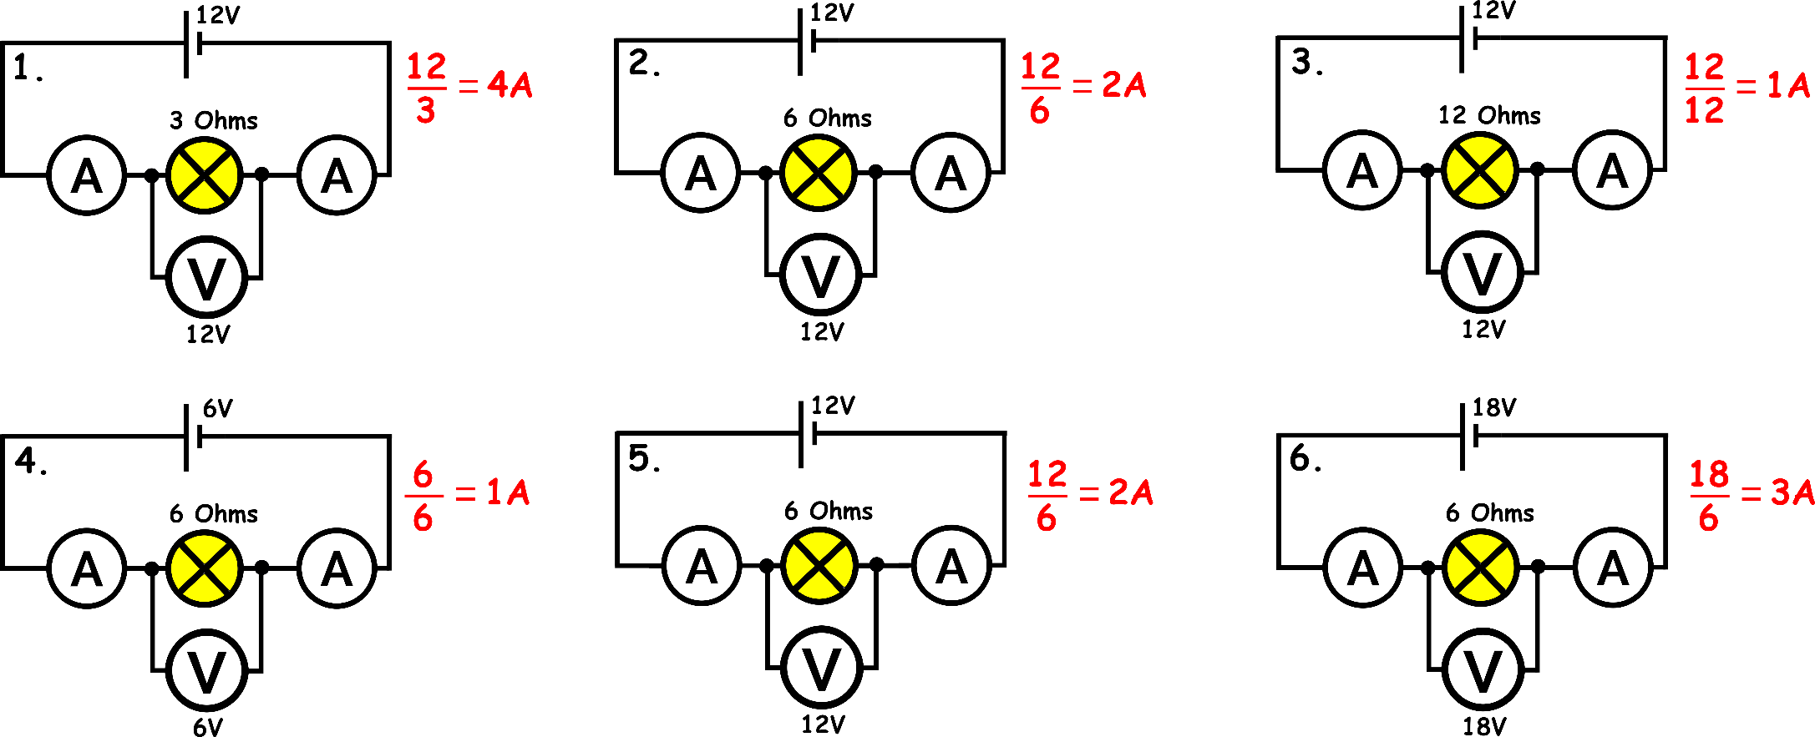
Write down the date and today’s title
SERIES CIRCUITS
DO IT NOW; Current is calculated by dividing voltage by resistance. Calculate the currents in circuits 1 to 6 below.
Sequence on click
in slide show.
Stretch
What patterns can you spot by looking at circuits 1 to 6?
Look at the three series circuits above, what things do you notice?
Notes:
Questions appears in slide show.

Slide 2
SUMMARY
In a series circuit components are connected one after another.
There is only one path for the current to flow along, if this path is broken (a component fails or connection breaks) the circuit stops working.
The voltage is shared between components in a series circuit.
The total resistance is found by adding up the resistances.
The current is the same through out the circuit.

