Slide 1
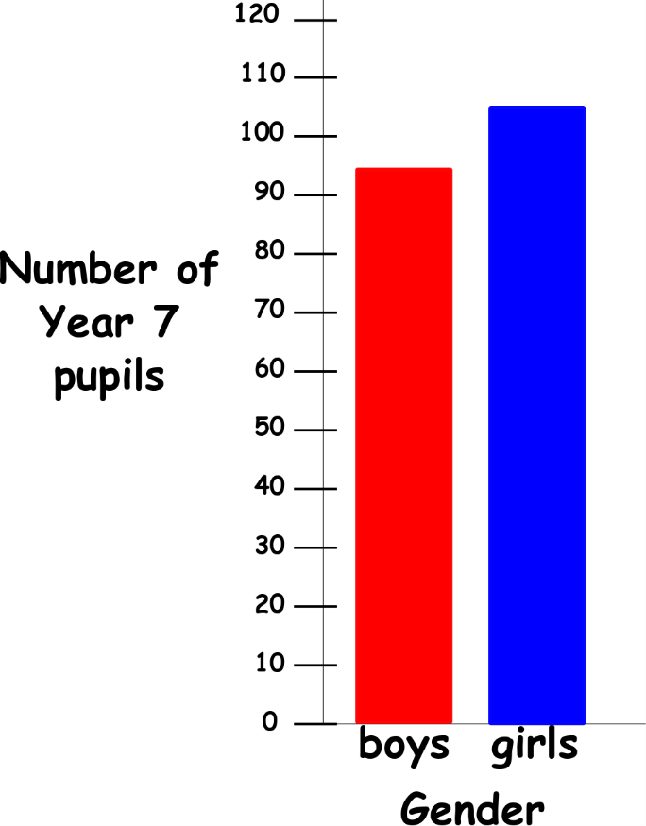
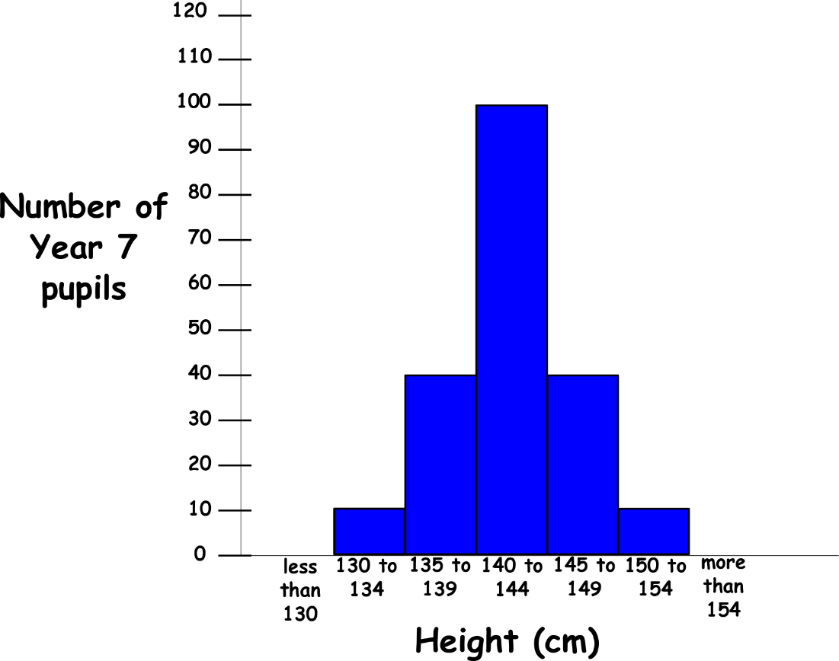
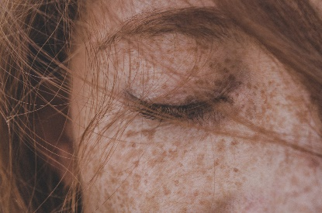
Write down the date and today’s title
VARIATION
DO IT NOW; Write down as many differences between humans that you can think of. The pictures below help.
?
Sequence on click
in slide show.
Stretch
If we plot a bar char of how many males and females there are in the room how many bars would be on the chart?
If we plot a bar char of each person’s height what would it look like?
Notes:
Questions appear in slide show.

Slide 2
SUMMARY
Variation (differences) exist within a species.
The variation can be classified as discontinuous (or categoric). These are characteristics where you can only be one or the other e.g. male female, blood group or eye colour. This sort of variation is plotted on a bar chart.
Continuous variation such as height, weight or foot size can take any value within a certain range. This sort of variation is plotted on a histogram.
Both our genes and the environment affect our characteristics. How much is still debated. This is called nature Vs nurture.

