Slide 1
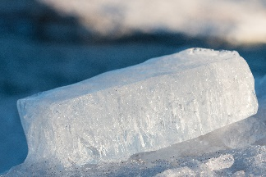
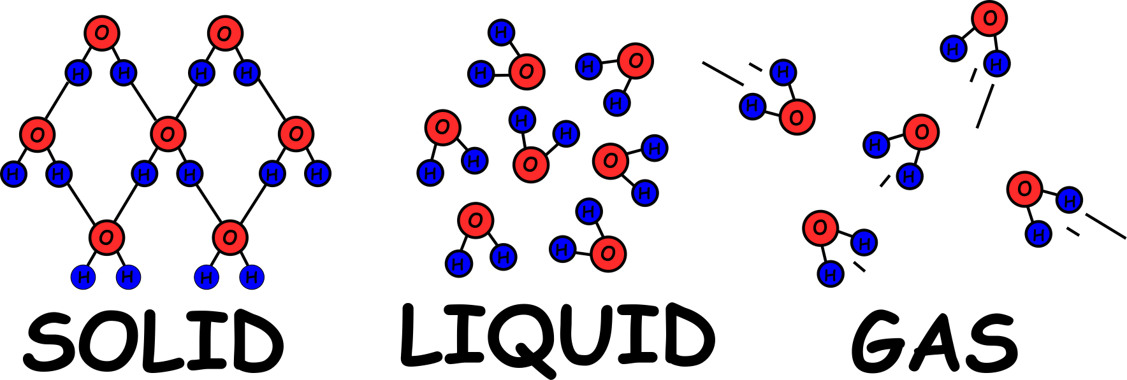
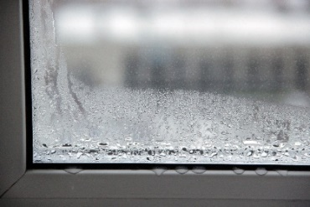
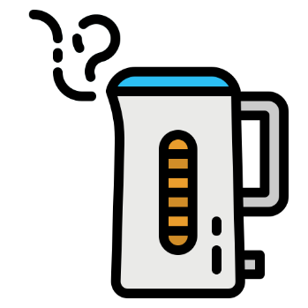
Write down the date and today’s title
CHANGES OF STATE; SOLIDS LIQUIDS AND GASES
DO IT NOW; Write out the statements below and next to them write true or false.
Ice is always zero degrees (0ºC)
Condensation heats things up
You can’t make steam hotter
4. You can supply heat without making
things hotter
Sequence on click
in slide show.
False
True
False
True
Stretch
Complete the sentence below.
When a kettle is b o i l i n g the water doesn’t get any h o t t e r it just changes from a l i q u i d to a g a s.
Stretch
Complete the sentence below.
When a kettle is b _ _ _ _ _ _ the water doesn’t get any h _ _ _ _ _ it just changes from a l _ _ _ _ _ to a g _ _.

Slide 2
SUMMARY
The three states of matter are solid, liquid and gas.
Heating a solid at its melting point doesn’t change the temperature. The heat energy breaks bonds causing a change of state. Melting.
Heating a liquid at its boiling point doesn’t change the temperature. The heat energy breaks bonds causing a change of state. Vaporisation.
Removing heat from a gas can change it back to a liquid. Condensing.
Removing heat from a liquid can change it back to a solid. Freezing.

