Slide 1
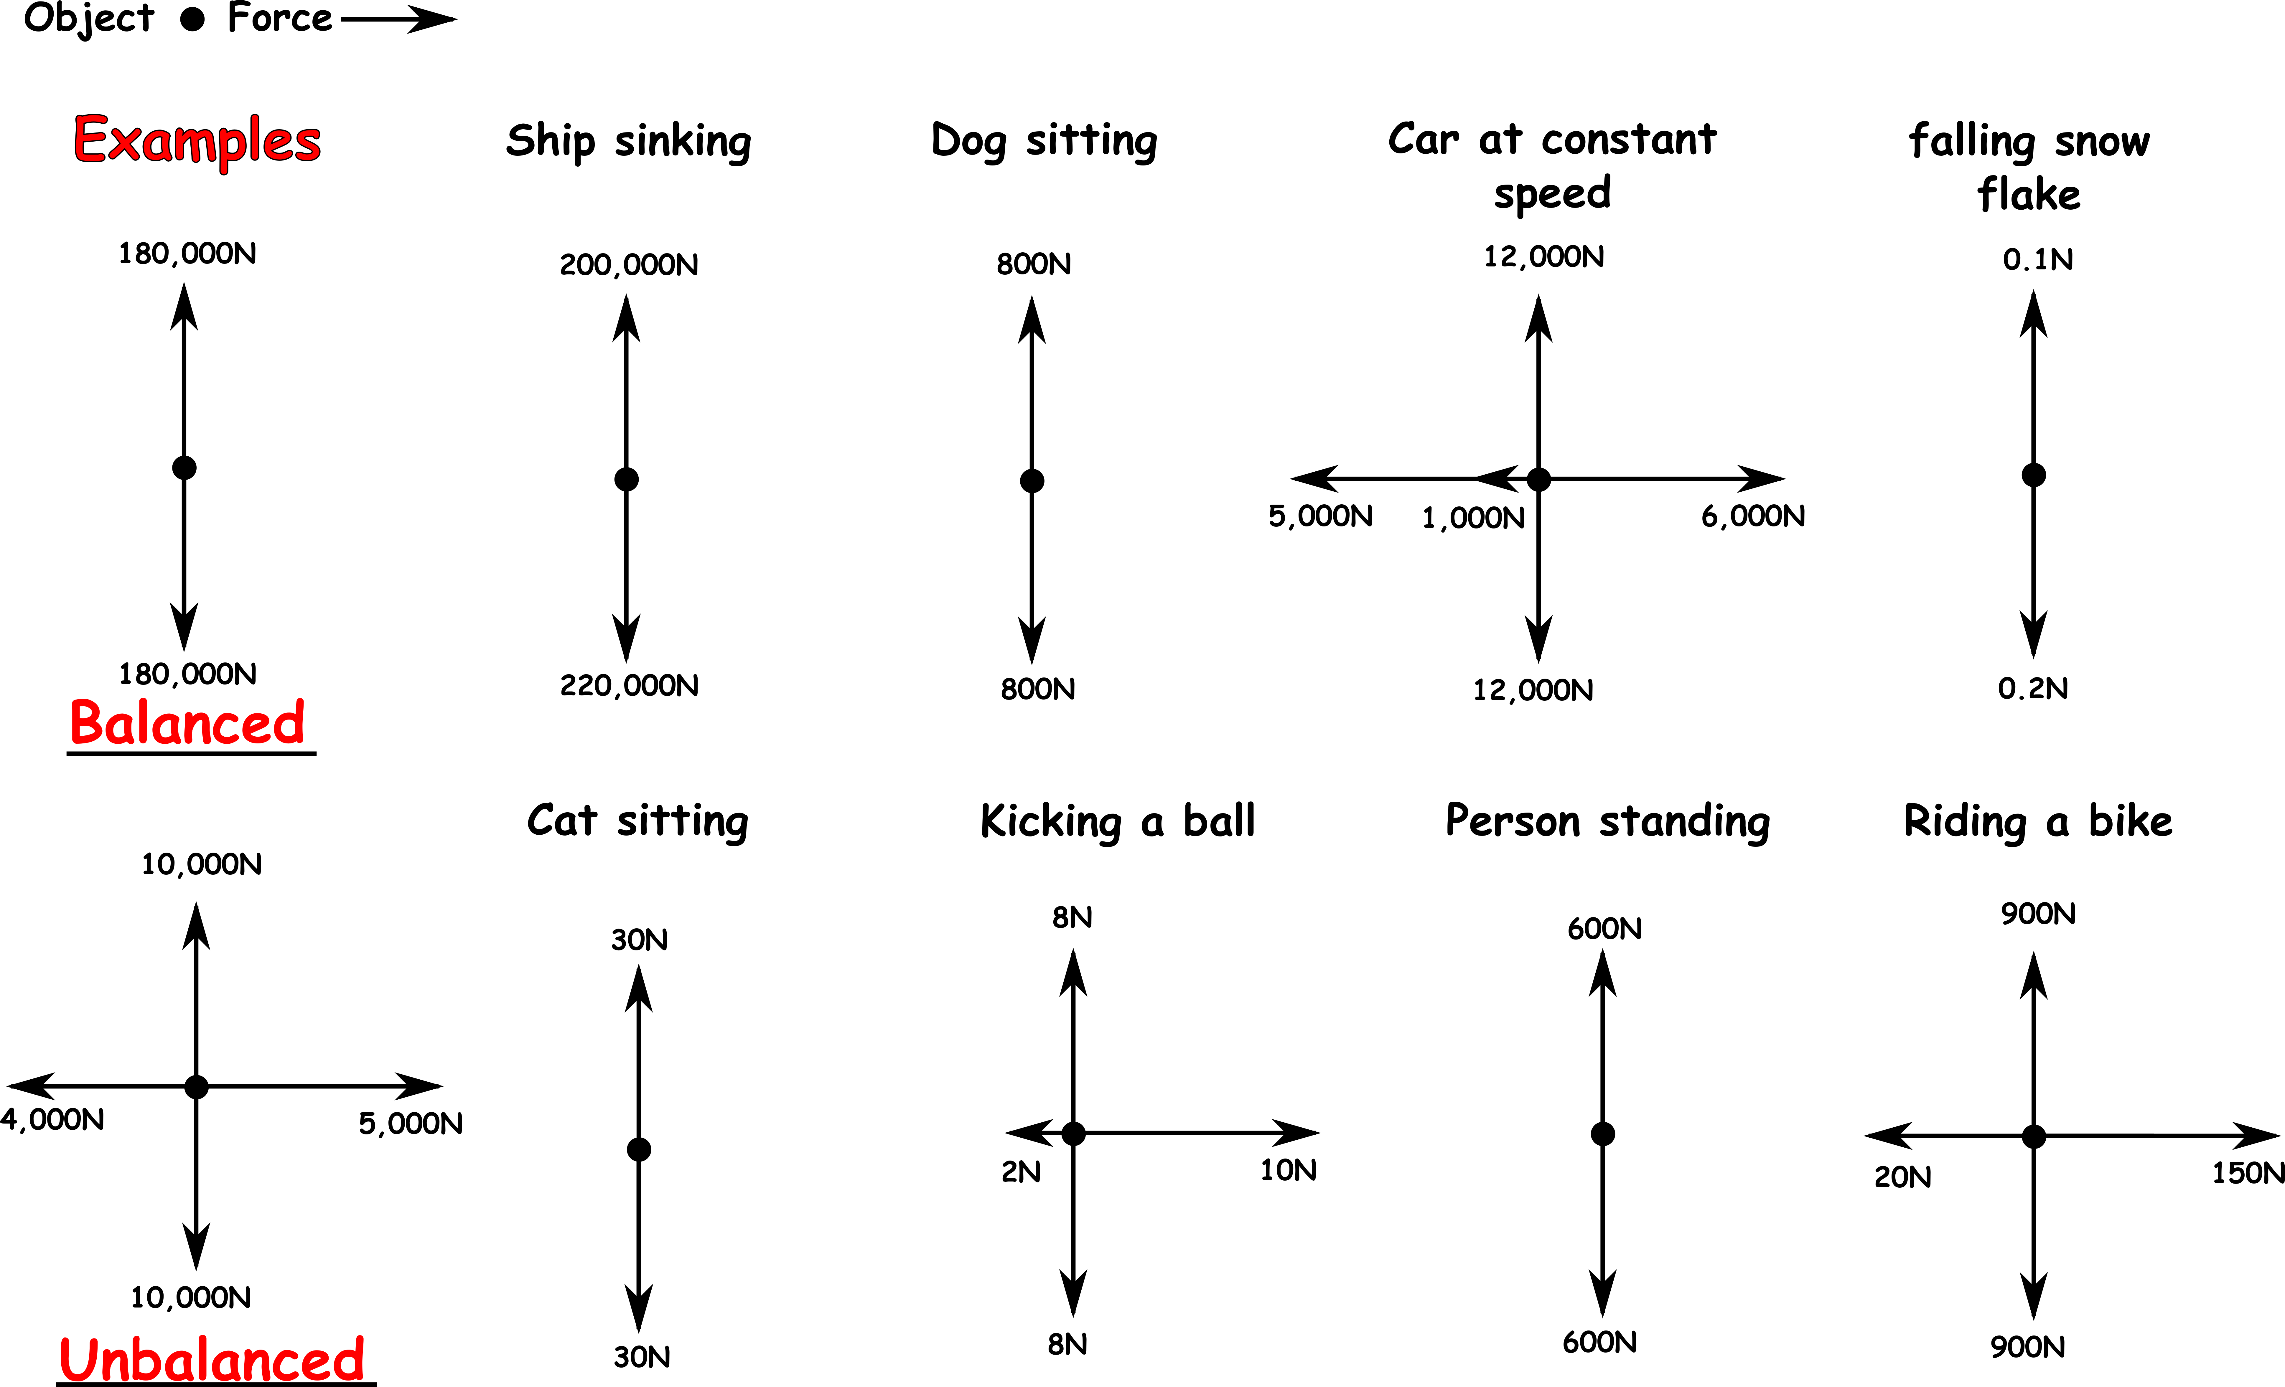
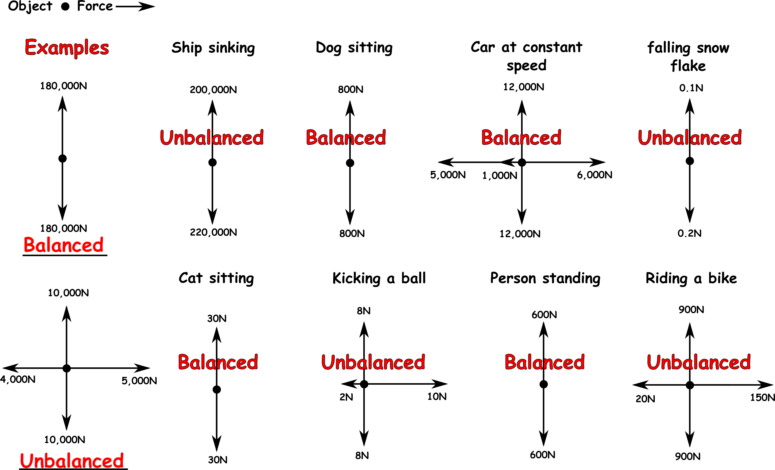
Write down the date and today’s title
BALANCED FORCES
DO IT NOW; If the forces up are the same size as the forces down and the forces to the left are the same size as the forces to the right, the forces are balanced. Write the name of the example and next to it balanced or unbalanced.
Use zoom function in slide show to make clearer.
Sequence on click
in slide show.
Stretch
What do you think the force acting down is in each case?
What do you think the three horizontal forces are acting on the car?
Stretch
What do you think the force acting down is in each case? Weight/gravity
What do you think the three horizontal forces are acting on the car?
Stretch
What do you think the force acting down is in each case? Weight/gravity
What do you think the three horizontal forces are acting on the car?
Driving force right and left air resistance and friction

Slide 2
SUMMARY
We use arrows to show the size and direction of the forces acting on objects.
If the forces up equal the forces down and the forces to the left equal the forces to the right then they are balanced.
If the forces acting on an object are balanced the object will either be stationary or move at a constant speed, e.g. a car or bike at constant speed or sitting on a chair.
This is called Newton’s 1st law.

