Slide 1
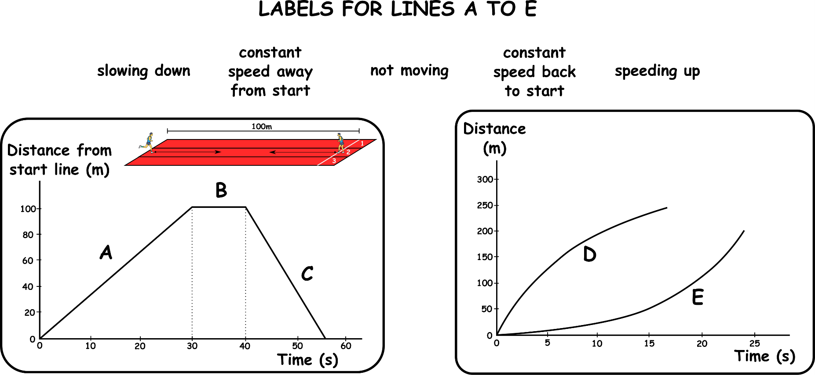
Write down the date and today’s title
RELATIVE SPEED AND MORE DISTANCE TIME GRAPHS
DO IT NOW; In which of the following examples will the cars hit first?
A.
10mph
0mph
1 hr later
10 miles
Sequence on click
in slide show.
B.
5mph
5mph
1 hr later
10 miles
C.
10mph
10mph
1/2hr later
10 miles
Stretch
How long does it take for cars A, B and C to hit?
How fast are the cars in A, B and C moving compared to each other?
Stretch
How long does it take for cars A, B and C to hit?
How fast are the cars in A, B and C moving compared to each other?
10mph B. 10mph C. 20mph
Look at the ‘new’ Distance Time graphs. Can you match the labels?
Notes:
Answers appear in slide show.

Slide 2
SUMMARY
Relative speed is when we compare our motion to other objects.
Distance time graphs can be used to show our speed moving away from a start point and back towards a start point.
Moving away from a start point the line is like…
Moving towards a start point the line is like…
Curves getting steeper mean speeding up….
Curves getting shallower mean slowing down...

