Slide 1
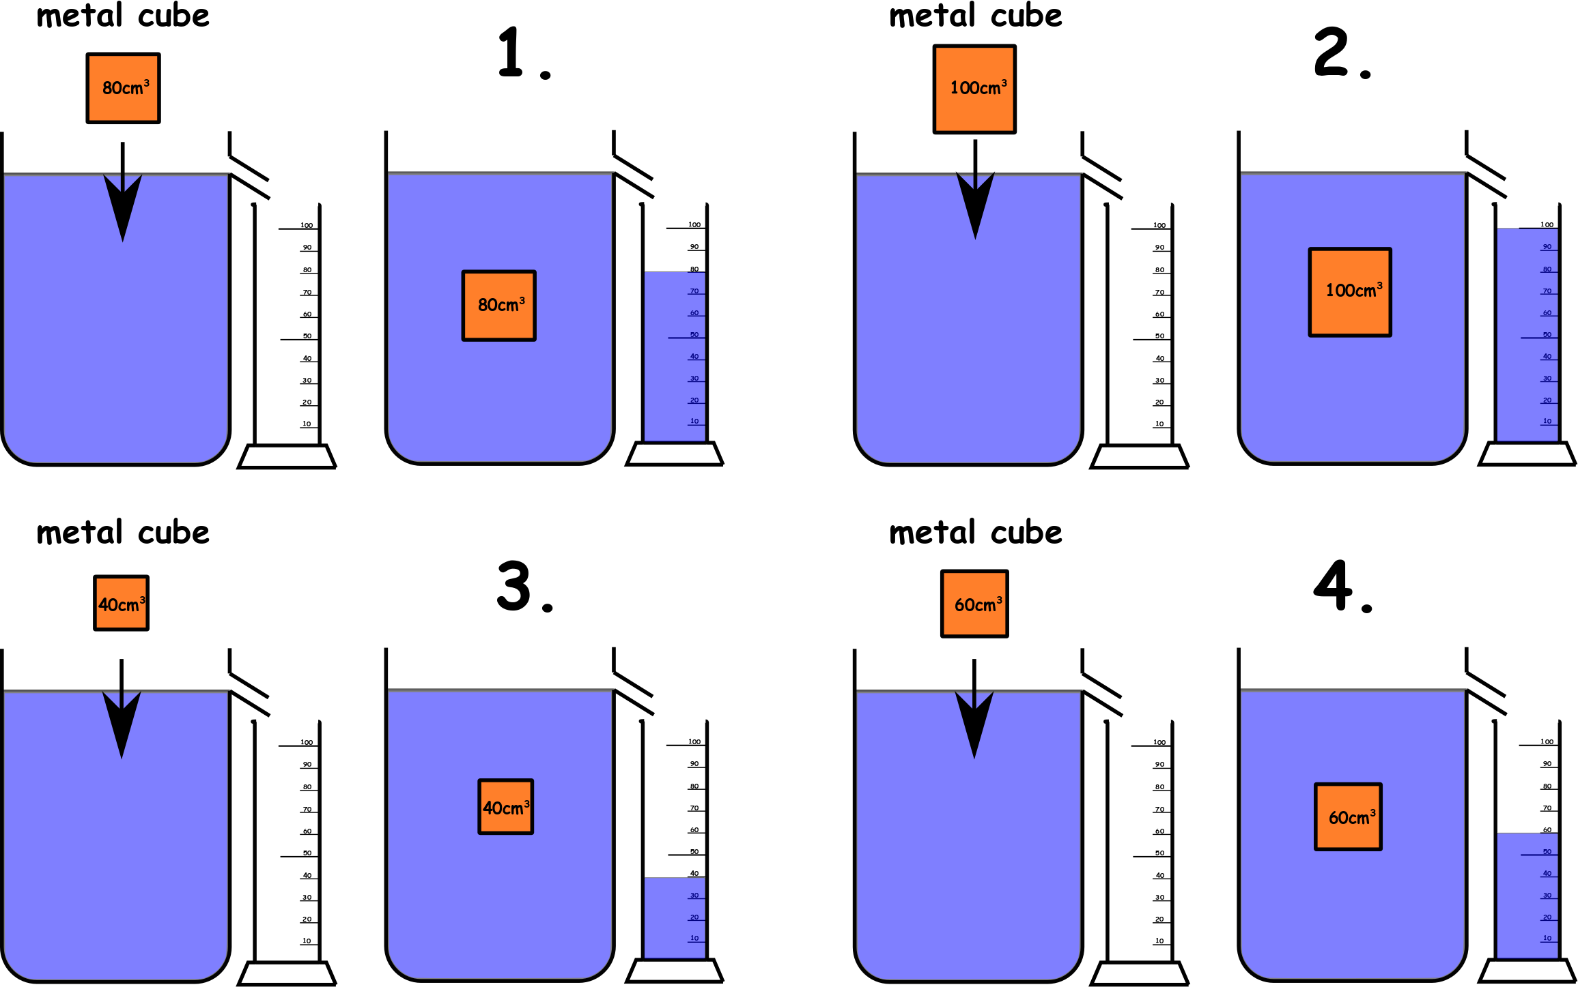
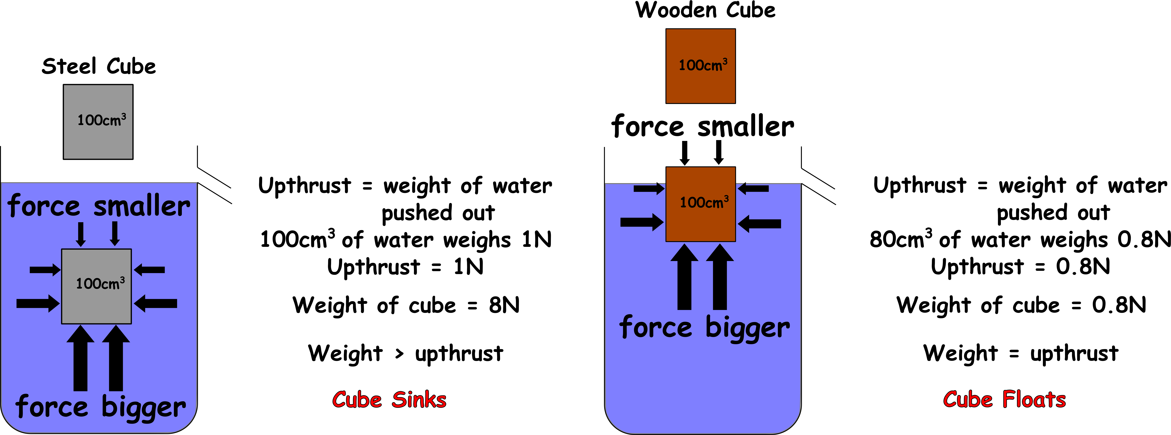
Write down the date and today’s title
PRESSURE IN WATER
DO IT NOW; Write down in your own words what the diagrams below show.
Use zoom function.
Sequence on click
in slide show.
Stretch
The push on the bottom of the cube from the water is greater than the push on the top. This leads to? USPHRTUT
Why does the wooden cube only displace 80cm³?
Why does the wooden cube weigh less?
Stretch
The push on the bottom of the cube from the water is greater than the push on the top. This leads to? UPTHRUST
Why does the wooden cube only displace 80cm³?
Why does the wooden cube weigh less?
Stretch
The push on the bottom of the cube from the water is greater than the push on the top. This leads to? UPTHRUST
Why does the wooden cube only displace 80cm³?NOT SUBMERGED
Why does the wooden cube weigh less?
Stretch
The push on the bottom of the cube from the water is greater than the push on the top. This leads to? UPTHRUST
Why does the wooden cube only displace 80cm³?NOT SUBMERGED
Why does the wooden cube weigh less? LESS DENSE THAN STEEL
Notes:
Use the zoom function for clarity. See slide show for sequence.

Slide 2
SUMMARY
Pressure in water increases with increased depth.
The difference in pressure on the top and bottom of an object creates upthrust.
Archimedes noticed that the size of the upthrust is always equal to the weight of water displaced.
If the weight of water displaced is equal to the weight of the object, it floats. If it is less than the object, it sinks.
Any object less dense than water will float.

