Slide 1
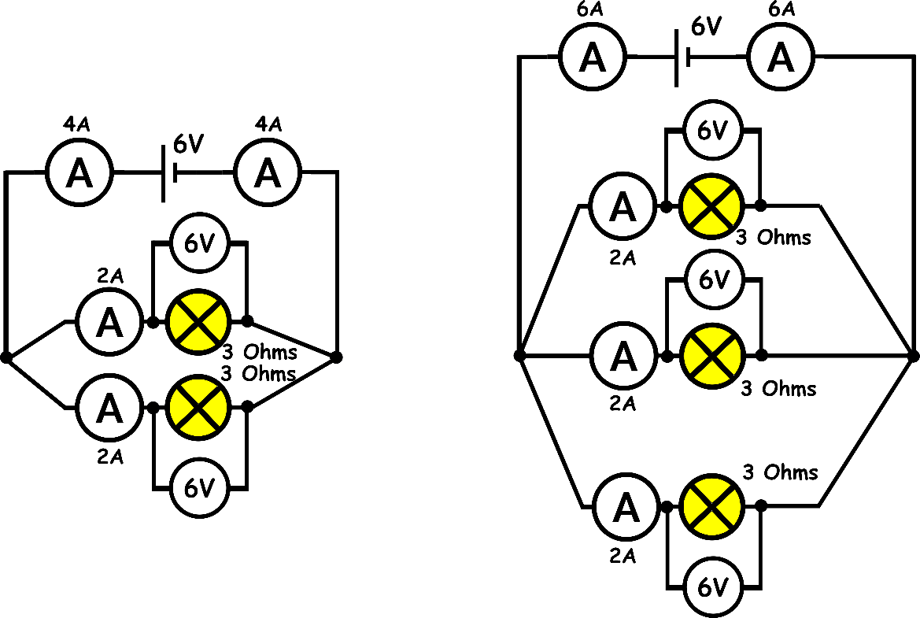
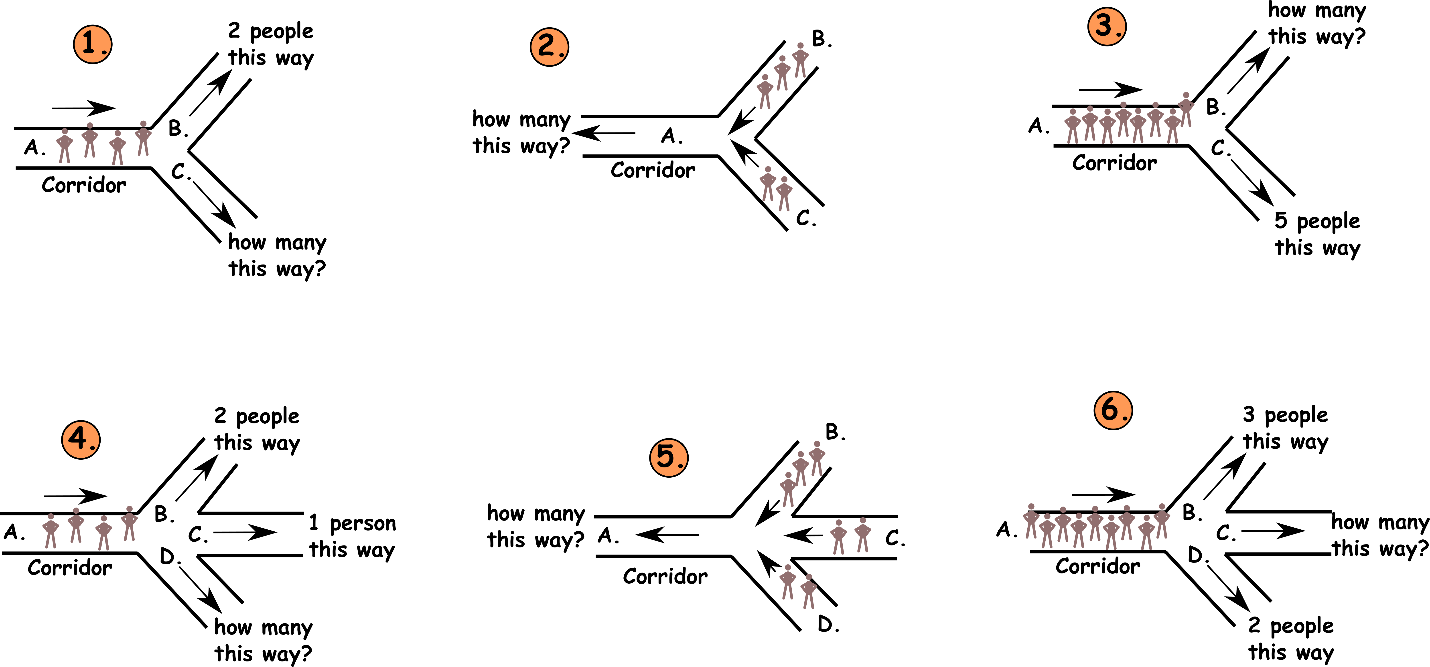
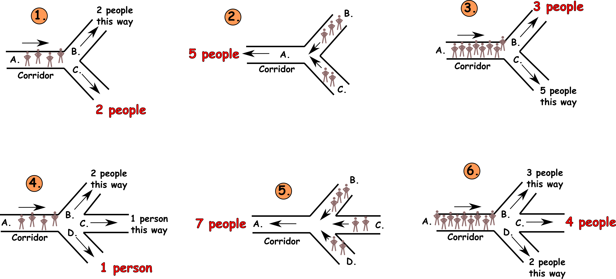
Write down the date and today’s title
PARALLEL CIRCUITS
DO IT NOW; Use logic to work out how many people are walking down the corridors in examples 1 to 6.
Sequence on click
in slide show.
Stretch
In example 1, what would happen if corridor C became blocked?
In example 6, which do you think is the easiest corridor to get down?
Look at the real parallel circuits now shown, what things do you notice?
Stretch
In example 1, what would happen if corridor C became blocked? Go down B instead
In example 6, which do you think is the easiest corridor to get down?
Look at the real parallel circuits now shown, what things do you notice?
Stretch
In example 1, what would happen if corridor C became blocked? Go down B instead
In example 6, which do you think is the easiest corridor to get down? C, most go that way
Look at the real parallel circuits now shown, what things do you notice?
Notes:
Questions appears in slide show.

Slide 2
SUMMARY
Parallel circuits have junctions where the current can split and flow down more than one branch.
This means if one branch fails the others still work.
The current into a junction is the same as the current out of a junction.
The total current is the sum (addition) of the currents along each branch.
Each component in a parallel branch gets the same voltage. This means bulbs are equally bright, or motors run equally fast or buzzers buzz equally loud.

