Slide 1
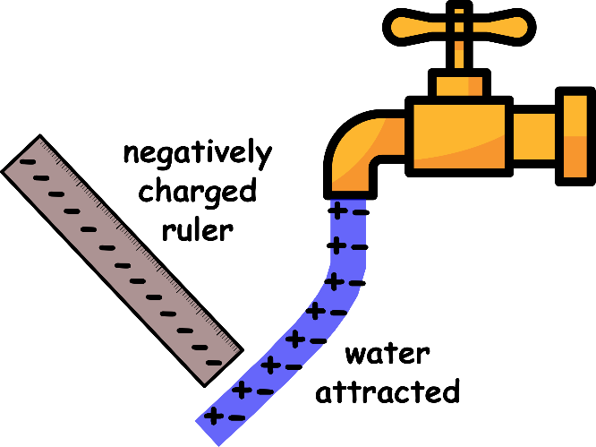
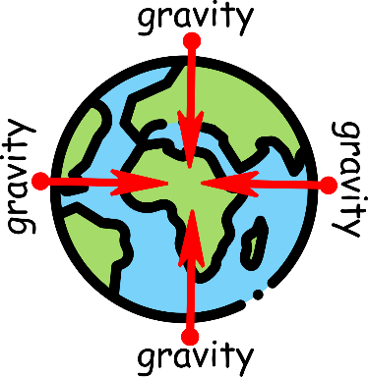
Write down the date and today’s title
NON-CONTACT FORCES
DO IT NOW; Multiply the strength of gravity by Declan’s mass to calculate Declan’s weight on the five planets. Just write down the planet and his weight, you can use a calculator.
Planet | Mercury | Earth | Jupiter | Saturn | Uranus
Strength of gravity | 3.7 | 10 | 25 | 10.5 | 9.0
Declan’s mass (kg) | 60 | 60 | 60 | 60 | 60
Declan’s Weight (N)
Planet | Mercury | Earth | Jupiter | Saturn | Uranus
Strength of gravity | 3.7 | 10 | 25 | 10.5 | 9.0
Declan’s mass (kg) | 60 | 60 | 60 | 60 | 60
Declan’s Weight (N) | 222
Planet | Mercury | Earth | Jupiter | Saturn | Uranus
Strength of gravity | 3.7 | 10 | 25 | 10.5 | 9.0
Declan’s mass (kg) | 60 | 60 | 60 | 60 | 60
Declan’s Weight (N) | 222 | 600
Planet | Mercury | Earth | Jupiter | Saturn | Uranus
Strength of gravity | 3.7 | 10 | 25 | 10.5 | 9.0
Declan’s mass (kg) | 60 | 60 | 60 | 60 | 60
Declan’s Weight (N) | 222 | 600 | 1500
Planet | Mercury | Earth | Jupiter | Saturn | Uranus
Strength of gravity | 3.7 | 10 | 25 | 10.5 | 9.0
Declan’s mass (kg) | 60 | 60 | 60 | 60 | 60
Declan’s Weight (N) | 222 | 600 | 1500 | 630
Planet | Mercury | Earth | Jupiter | Saturn | Uranus
Strength of gravity | 3.7 | 10 | 25 | 10.5 | 9.0
Declan’s mass (kg) | 60 | 60 | 60 | 60 | 60
Declan’s Weight (N) | 222 | 600 | 1500 | 630 | 540
Sequence on click
in slide show.
Stretch
What doesn’t change in the calculation?
What does N and kg stand for?
Why is Declan’s weight different from planet to planet?
Which planets are missing from the table?
Stretch
What doesn’t change in the calculation? His mass.
What does N and kg stand for?
Why is Declan’s weight different from planet to planet?
Which planets are missing from the table?
Stretch
What doesn’t change in the calculation? His mass.
What does N and kg stand for? Newtons and kilograms.
Why is Declan’s weight different from planet to planet?
Which planets are missing from the table?
Stretch
What doesn’t change in the calculation? His mass.
What does N and kg stand for? Newtons and kilograms.
Why is Declan’s weight different from planet to planet? The strength of gravity changes.
Which planets are missing from the table?
Stretch
What doesn’t change in the calculation? His mass.
What does N and kg stand for? Newtons and kilograms.
Why is Declan’s weight different from planet to planet? The strength of gravity changes.
Which planets are missing from the table? Venus, mars, neptune.
Look at the picture clues. What are the other two non-contact forces?
Notes:
Use zoom function in slide show.

Slide 2
SUMMARY
The three non-contact forces are the gravitational force, magnetic force and electrostatic force.
Gravitational fields exert forces on masses, magnetic fields exert forces on magnetic objects and electric fields exert forces on charges.
Weight is due to the force of gravity pulling us down. It depends on our mass (kg) and the strength of gravity (N/kg).
Our weight varies from planet to planet but our mass stays the same. From our mass we can know how many atoms we are made from.

