Slide 1
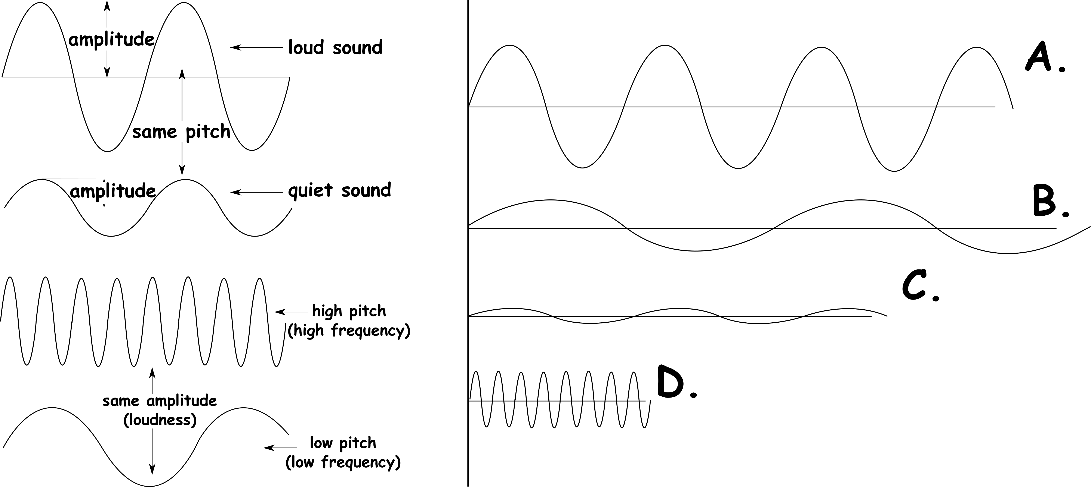
Write down the date and today’s title
PICTURING SOUND
DO IT NOW; Look at the waves on the left that show how loud and quiet sounds look and how high pitched and low pitched sounds look. Choose from LOUDEST, QUIETEST, HIGHEST PITCH, LOWEST PITCH for A to D.
LOUDEST
QUIETEST
HIGHEST PITCH
LOWEST PITCH
Sequence on click
in slide show.
Stretch
Can you think of some examples of high pitched sounds?
Higher pitched sounds have a higher frequency. What happens to the spacing between the tops of the waves as frequency changes?
Notes:
Questions appears in slide show.

Slide 2
SUMMARY
Sound waves are longitudinal waves.
A sound wave can be detected by a microphone and the trace of the wave displayed on an oscilloscope.
Louder sounds have bigger amplitudes, quieter sounds have smaller amplitudes.
High pitched sounds have a high frequency, the peaks are closes together. Low pitched sounds have a low frequency the peaks are more spaced out.
Sounds can bounce off objects which we call an echo. They can also be absorbed by objects or pass through (transmit).

