Slide 1
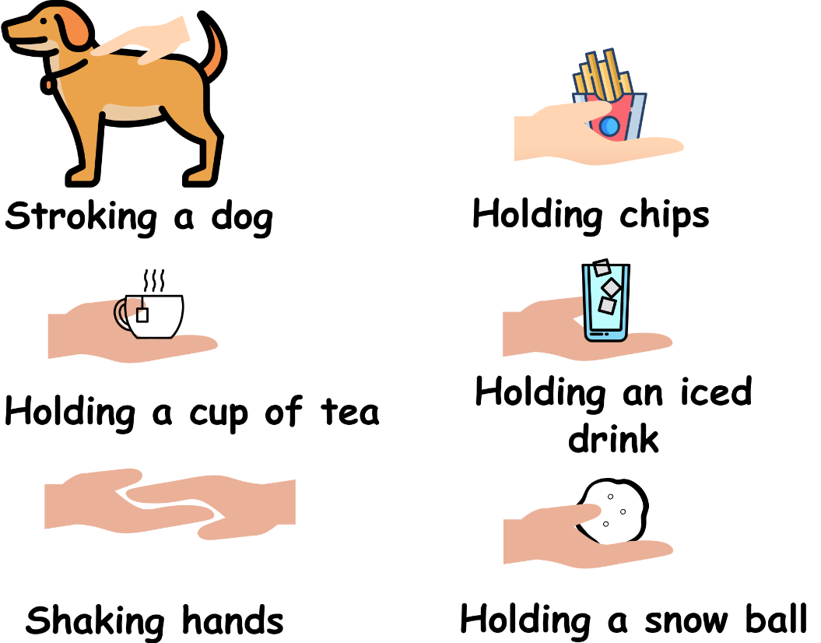
Write down the date and today’s title
HEAT TRANSFER
DO IT NOW; A human’s internal (inside) temperature is 37ºC. Write down whether the hand gets colder, warmer or no change in the following examples.
No change
Warmer
Sequence on click
in slide show.
Warmer
Colder
No change
Colder
Stretch
Using logic which way must heat always flow?
Can you solve the names of the three ways that heat can flow below?
VECONCONTI ONCDTIOUCN ATRAIONDI
Stretch
Using logic which way must heat always flow? From hot to cold.
Can you solve the names of the three ways that heat can flow below?
VECONCONTI ONCDTIOUCN ATRAIONDI
Stretch
Using logic which way must heat always flow? From hot to cold.
Can you solve the names of the three ways that heat can flow below?
CONVECTION CONDUCTION RADIATION
Notes:
Answers appear in slide show.

Slide 2
SUMMARY
Heat always flows from hot to cold
Heat can transfer in three ways;
Conduction, this is the transfer of vibrations from particle to particle. It happens best in solids.
Convection, this happens in liquids and gases. Particles gain energy and the liquid or gas becomes lighter (less dense) as it expands. It rises carrying heat energy with it. As it cools it becomes more dense and falls forming a convection current.
Radiation, this is infrared waves carrying energy away from an object. Hotter objects emit more infrared.
If an object absorbs more infrared (heat radiation) than it emits it gets hotter.

