Slide 1
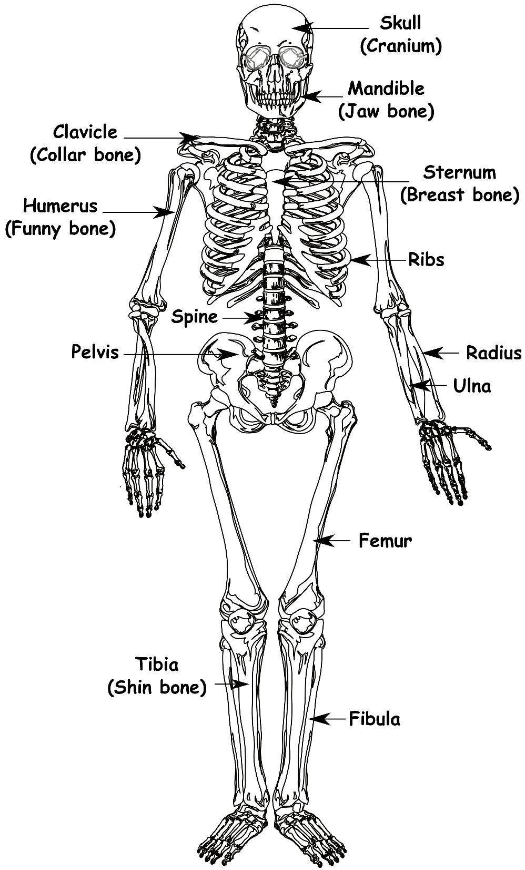
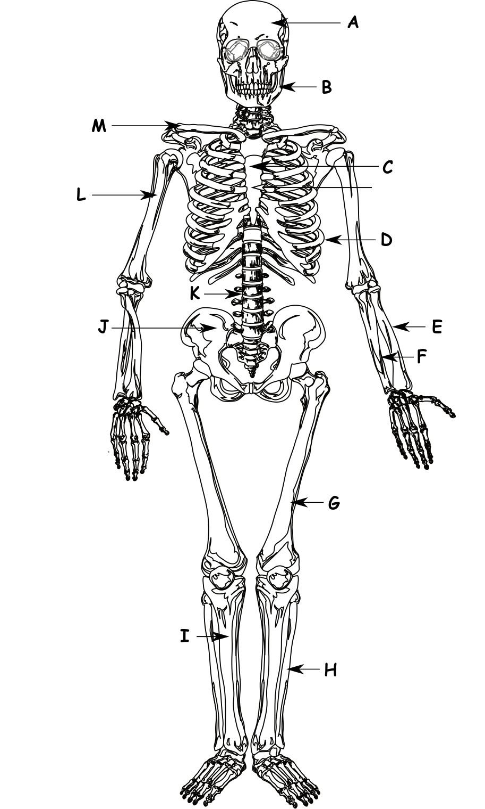
How many of these can you name?
Write down the date and today’s title
THE SKELETON AND MUSCLES
DO IT NOW; Unscramble the words below to reveal some ‘well known’ bones.
1. LUSLK
2. HINSOBEN
3. NENKOBEE
4. AWNJEBO
5. UNNFOYENB
6. ACNBOBEK
7. HINTOHEGB
8. IPNHEBO
SKULL
SHIN BONE
KNEE BONE
JAW BONE
FUNNY BONE
BACK BONE
THIGH BONE
HIP BONE
Sequence on click
in slide show.
Stretch
Below are the jumbled ‘other’ names of the well known bones, can you unscramble any?
1. CRANIUM 2. TIBIA 3. PATELLA 4. MANDIBLE 5. HUMEROUS 6. SPINE 7. FEMUR 8. PELVIS
Stretch
Below are the jumbled ‘other’ names of the well known bones, can you unscramble any?
1. NIUMCRA 2. TIABI 3. ATLPAEL 4. ANLMBIED
5. UMUHORSE 6. SPEIN 7. FERMU 8. PLSEIV
Notes:
Click slide show, the jumbled ‘other’ names are underneath and the answers appear afterwards as does the optional skeleton question.

Slide 2
SUMMARY
A human skeleton has 206 bones. It is an endoskeleton meaning the bones are on the inside of the body.
The skeleton has four main jobs;
to support your body
to protect organs
to allow movement through joints
to make blood
Antagonistic muscles work in pairs to create movement. As one muscle contracts the other relaxes. Biceps and triceps are antagonistic muscles.

