Slide 1
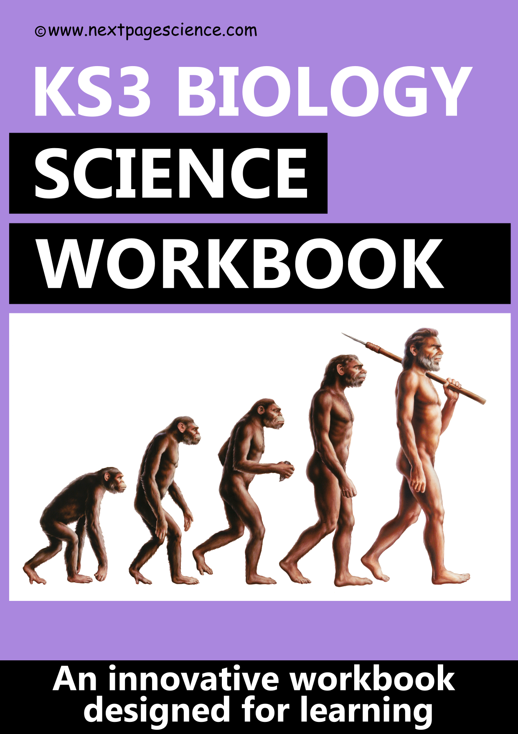
KS3 Biology Workbook: Lesson 1 Suggested Outline The Light Microscope
NB: These are suggestions only and won’t work for all teaching and learning styles
Hand out the Workbook and Student Answer Sheet . Gather the students around a microscope and ask some prompting questions, e.g., what’s it used for? What are the names of the parts? How do we focus?
Explain how the microscope is used.
Introduce magnification using the example on slide 2.
Students complete the workbook questions 1. to 5. onto the pre-printed Student Answer Sheet using the workbook. Assist as necessary. Or, alternatively allow the students to practise using a microscope then complete the workbook questions depending on the group and the time desired for students to practise using a microscope.
Answers projected for checking/self marking before the end of the lesson (www.nextpagescience.com/downloadables). This also provides opportunity to summarise/emphasise the key points you want taken away.

Slide 3
KS3 Biology Workbook: Lesson 2 Suggested Outline Cells
NB: These are suggestions only and won’t work for all teaching and learning styles
Hand out the Workbook and Student Answer Sheets. Introduce the idea that all organisms are made from cells and that there are two main types. Highlight some interesting facts. Use the next slide to ask students to spot similarities / differences between animal and plant cells. Label the organelles and explain their roles.
Use the specialized cells on page 2 to explain that some cells are adapted for a particular function. Start with the obvious sperm cell. Optional clip on specilaised cells Specialised Cells – YouTube .
Return to labelled animal and plant cell, repeat names and functions, ask students to attempt to memorise but not to worry if they can’t!
Students try to complete labelling (Q2) from memory using the workbook labels. Assist students as necessary.
Students then complete Q1 to Q5. Assist students as necessary.
Answers projected for checking/self marking before the end of the lesson (www.nextpagescience.com/downloadables). This also provides opportunity to summarise/emphasise the key points you want taken away.

Slide 4
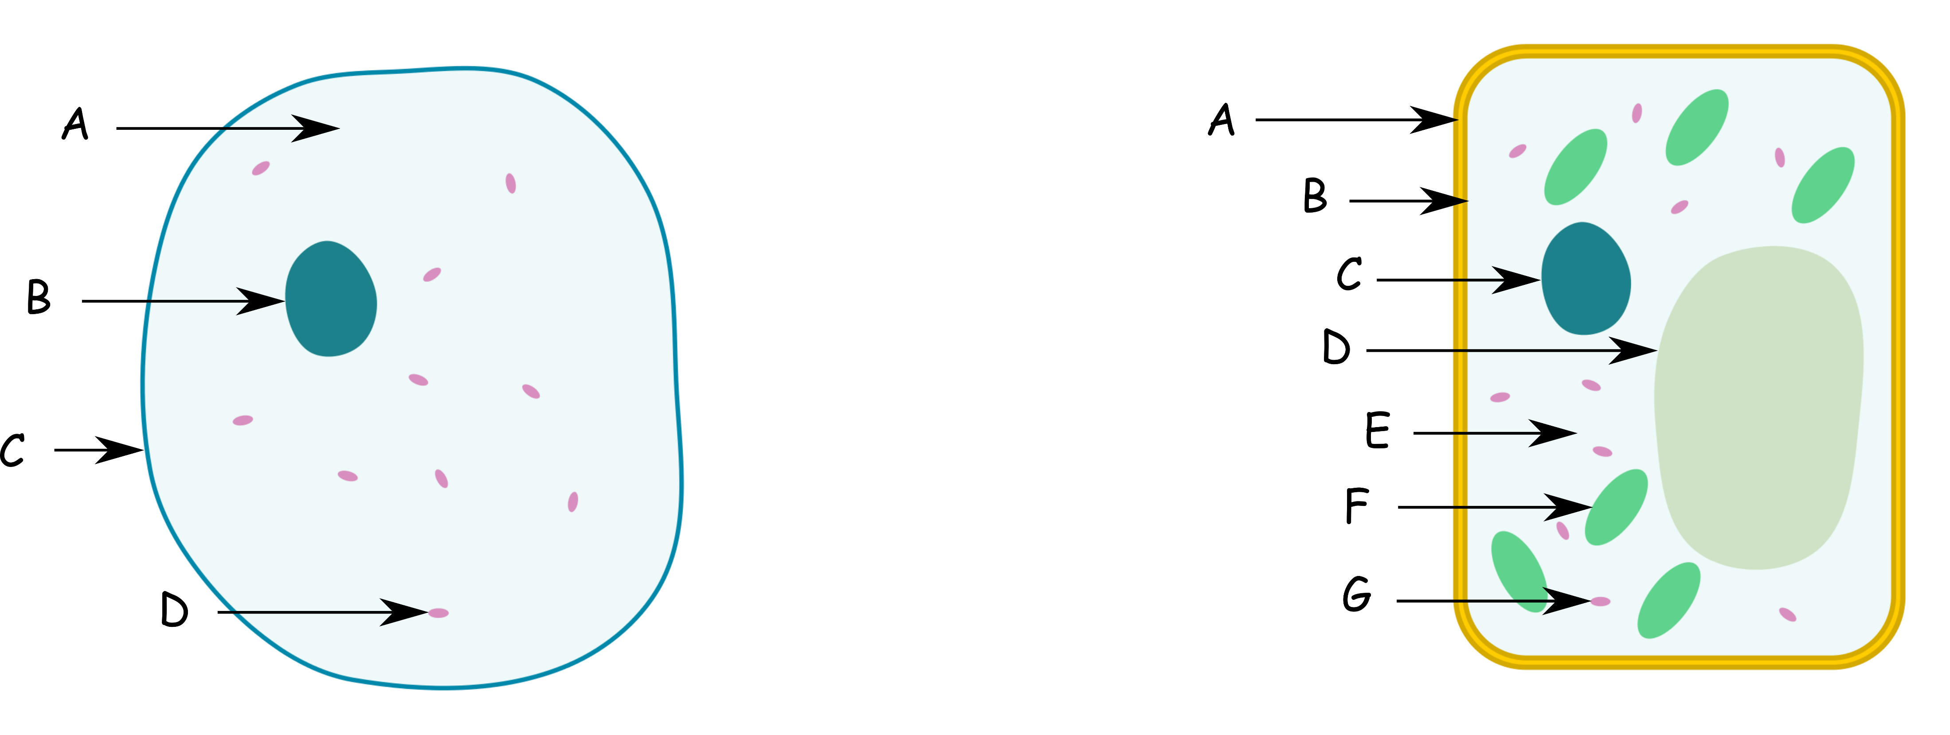

Slide 5
KS3 Biology Workbook: Lesson 3 Suggested Outline The Human Skeleton
NB: These are suggestions only and won’t work for all teaching and learning styles
Hand out the Workbook and Student Answer Sheet. Gather students around a skeleton and discuss what they know, the purpose of the skeleton, the names of bones (a good time to get volunteers up), difference between endoskeleton and exoskeleton (examples too).
Ask students to unjumble the words in Q2 and write underneath the skeleton, assist as necessary. Work through labelling of skeleton bones A to M together.
Students use workbook to complete Q1 to Q5. Assist as necessary.
Answers projected for checking/self marking before the end of the lesson (www.nextpagescience.com/downloadables). This also provides opportunity to summarise/emphasise the key points you want taken away.

Slide 6
KS3 Biology Workbook: Lesson 4 Suggested Outline Muscles and Forces
NB: These are suggestions only and won’t work for all teaching and learning styles
Hand out the Student Answer Sheet and Workbook. Carry out the following exercise: use the palm of hand pushing up under the desk and back of hand pushing down on top of the desk whilst feeling biceps/triceps. What do you notice? Conduct a class mind map on muscles, forces and joints. Ensure the main points are brought in: muscles exert forces, biceps, triceps, relax, contract, antagonistic, hinge joints and ball and socket joints.
Watch video as a follow up How do our muscles and bones work? | BBC Teach – YouTube .
Students use workbook to complete Q1 to Q4 with assistance where necessary. Alternative to Q4 is to use some grip strengtheners with gauges to generate a class set of force results for a histogram.
Answers projected for checking/self marking before the end of the lesson (www.nextpagescience.com/downloadables). This also provides opportunity to summarise/emphasise the key points you want taken away.

Slide 7
KS3 Biology Workbook: Lesson 5 Suggested Outline Respiratory System
NB: These are suggestions only and won’t work for all teaching and learning styles
Hand out the Student Answer Sheet and Workbook. Use the lung diagram and alveoli diagram next slide. Have some starter questions to prompt discussion.
What happens in the lungs? What’s diffusion? What gases do we want to get into our blood and out of our blood? Breathe in/out what do you notice? Discuss the names of the part of the lungs.
GCSE Biology - Gas Exchange and Lungs #26 – YouTube (first 3 mins 18 seconds) as follow up if it suits.
Demo the lung/balloon bell jar. Explain how increased volume reduced pressure pushes air in and vice versa.
Label lung diagram Q3 together.
Students complete Q1 to Q5. Assist as necessary.
Answers projected for checking/self marking before the end of the lesson (www.nextpagescience.com/downloadables). This also provides opportunity to summarise/emphasise the key points you want taken away.

Slide 8
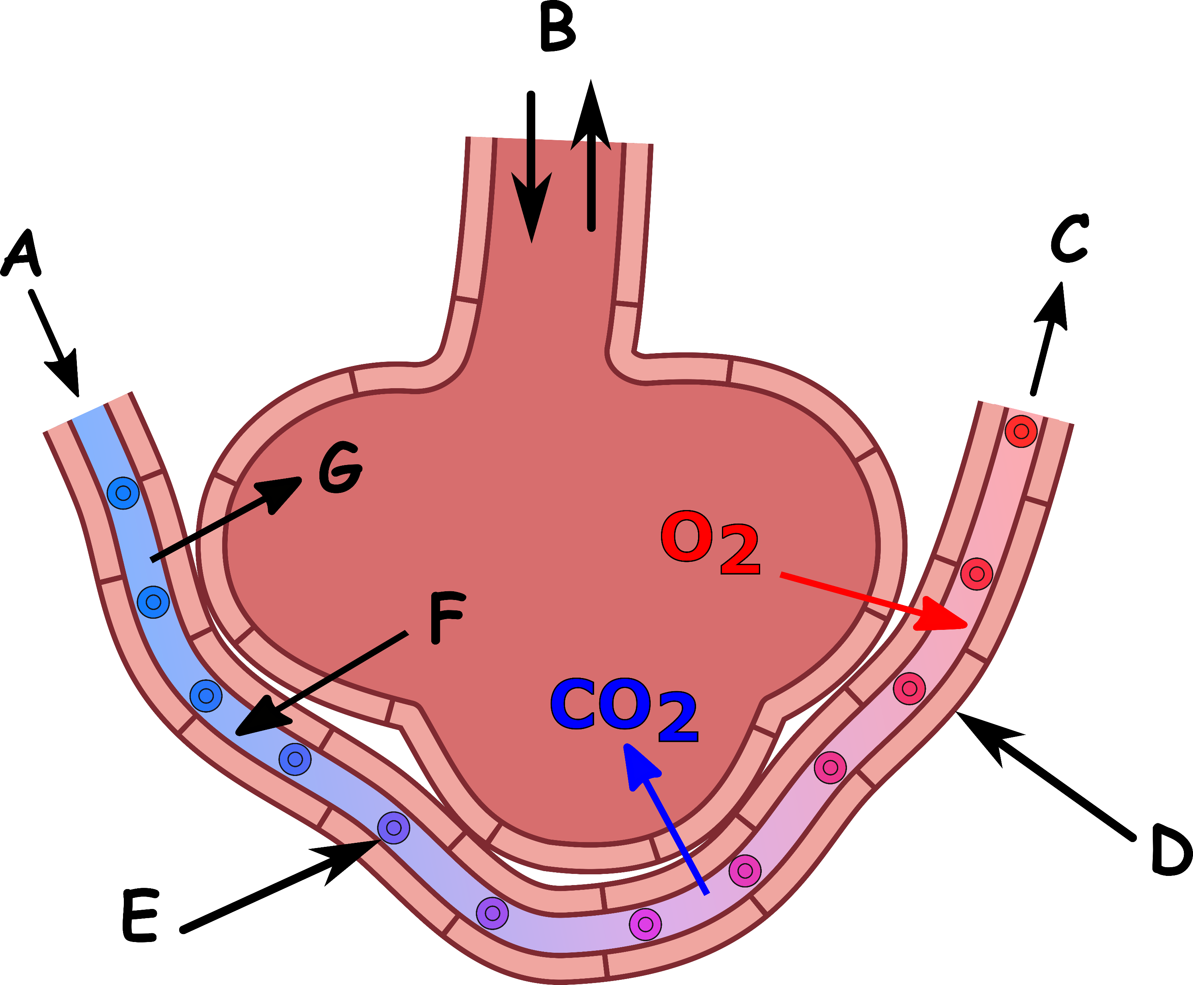
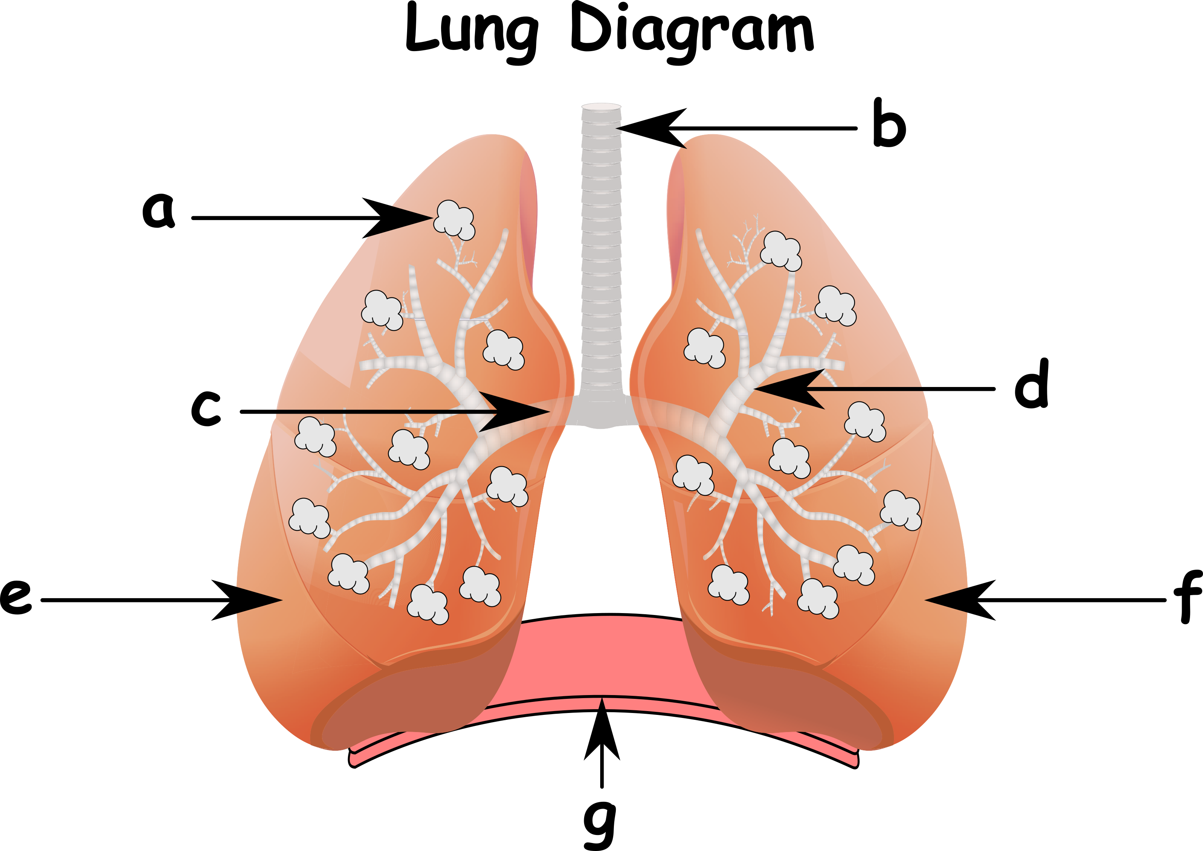

Slide 9
KS3 Biology Workbook: Lesson 6 Suggested Outline Respiration
NB: These are suggestions only and won’t work for all teaching and learning styles
Hand out the Student Answer Sheet and Workbook. Intro: ask the class what two things are needed for the body to have and release energy? Elicit the response food/fuel/glucose and also, (breathe heavily if needed) air/oxygen. Explain that inside the body these two chemicals react releasing energy. This is called aerobic respiration. Chemical reactions have products.
What are the products? Demonstrate (or class try) breathing on glass/condensation for water (H₂O) and blowing through a straw in limewater for carbon dioxide (CO₂).
Ask the class to read Q6 and ask how else can the body release energy? What’s it called and what is the problem?
Summarise again through class questioning. Ask the class what they would write for 3A. and 3B. on LHS and RHS. Repeat for consolidation before students complete Q3.
Students complete Q1 to Q6. Assist as necessary (help:C₆H₁₂O₆=glucose can be given).
Answers projected for checking/self marking before the end of the lesson (www.nextpagescience.com/downloadables). This also provides opportunity to summarise/emphasise the key points you want taken away.

Slide 10
KS3 Biology Workbook: Lesson 7 Suggested Outline Diffusion
NB: These are suggestions only and won’t work for all teaching and learning styles
Hand out the Student Answer Sheet and Workbook. Pose some questions. When someone sprays deodorant in a room why do you smell it not long afterwards? Why do you smell chips passing by a chip shop? Why can we smell the fumes from a car from far away? Discuss answers.
Use image of the two cups to highlight high to low concentration, random motion, collisions and spreading without stirring i.e., diffusion. Discuss what it might look like halfway through.
Watch gif animation slide 3.
Explain examples of where diffusion is useful and what the answers to 4 A. to D. would be.
Optional practical / demo: tea bag diffusion in hot and cold water.
Students use workbook to complete questions Q1 to Q5. Assist as necessary.
Answers projected for checking/self marking before the end of the lesson (www.nextpagescience.com/downloadables). This also provides opportunity to summarise/emphasise the key points you want taken away.

Slide 11
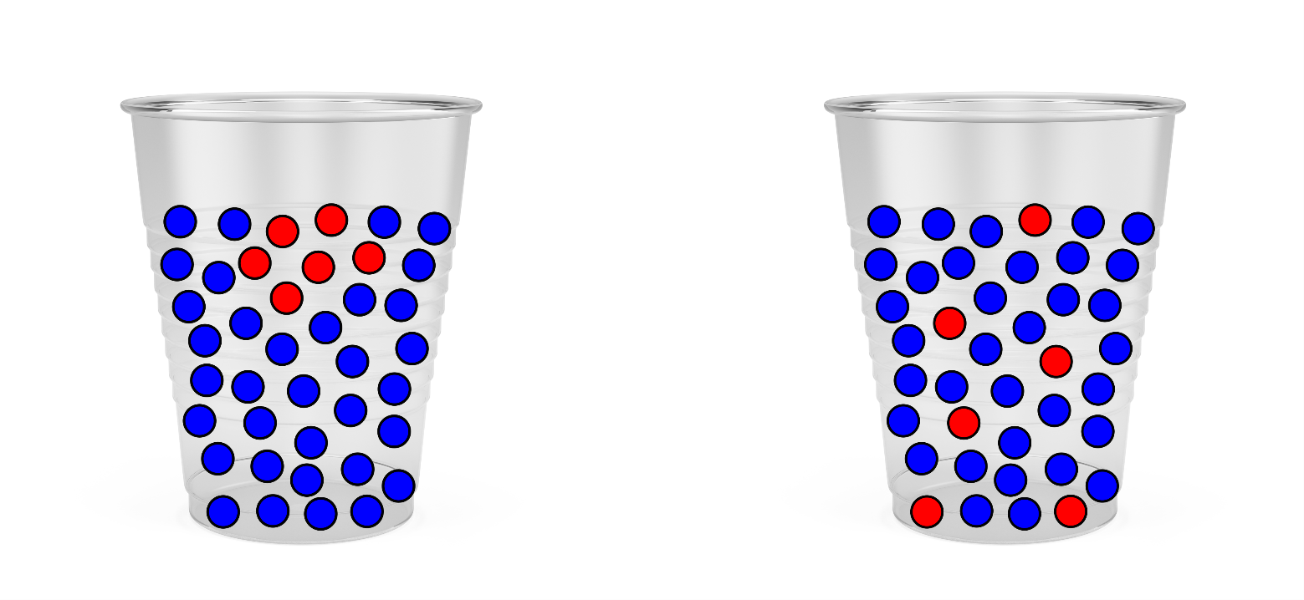

Slide 12
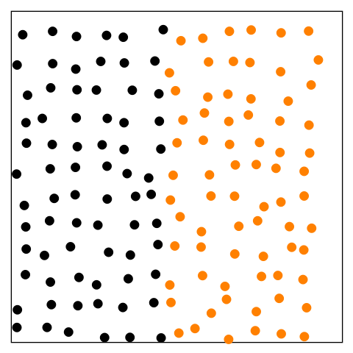

Slide 13
KS3 Biology Workbook: Lesson 8 Suggested Outline Digestive System
NB: These are suggestions only and won’t work for all teaching and learning styles
Hand out the Student Answer Sheet and Workbook. Turn to page 9 so that the digestive system is visible. Use prompts: If I say digestion starts on the plate, what do you think I mean? What’s the purpose of digestion? What parts can you name? What do they do? What’s an enzyme? What happens if the digestive system has a disease?
Label diagram in Q2 together or assist as necessary.
Watch video clip Digestive System | The Dr. Binocs Show | Learn Videos For Kids – YouTube as a part way summary or demo your digestion practical. Use a toothpaste tube for peristalsis.
Students then complete Q1 to Q6. Assist as necessary.
Answers projected for checking/self marking before the end of the lesson (www.nextpagescience.com/downloadables). This also provides opportunity to summarise/emphasise the key points you want taken away.

Slide 14
KS3 Biology Workbook: Lesson 9 Suggested Outline Enzymes
NB: These are suggestions only and won’t work for all teaching and learning styles
Hand out the Student Answer Sheet and Workbook. Use the images of cheese, washing powder, alcohol, soft centred chocolates and the digestive system (slide 2). Ask what do they all have in common? Elicit the words catalyst and enzymes, what do they do? Discuss examples with a focus on digestion: protease (pepsin), carbohydrase (amylase) and lipase. Images here can help depending level required (pg29 has proteins, fat and starch images for what the molecules would break down into).
Ask what else can speed up a reaction? Elicit temperature. Does this work with enzymes? Discuss typical rate Vs temperature enzyme based reaction plot (slide 2). Discuss what it shows. Optimum temperature for human enzymes is 37C. What is a human’s internal body temperature?
Option: first 4mins 50s of Key Stage 3 Science (Biology) - Enzymes in Digestion – YouTube .
Students complete Q1 to Q5. Assist as necessary.
Answers projected for checking/self marking before the end of the lesson (www.nextpagescience.com/downloadables). This also provides opportunity to summarise/emphasise the key points you want taken away.

Slide 15
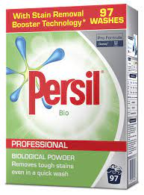
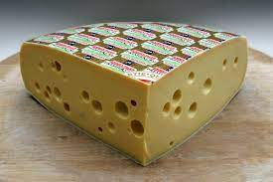
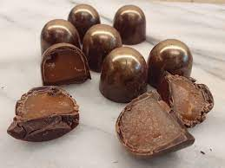
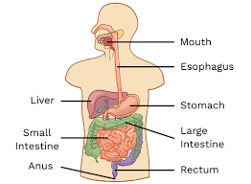

Slide 16
KS3 Biology Workbook: Lesson 10 Suggested Outline Food Fuel
NB: These are suggestions only and won’t work for all teaching and learning styles
Hand out the Student Answer Sheet and Workbook. Project a food label (slide 2) and discuss what they tell us. Explain adult daily maximums are: energy 8400KJ, protein 50g, fat 70g, carbohydrates 260g, fibre 30g and sodium (salt) 6g. What do the food groups do for us? Labels often tell us % Reference intake (%RI) for 100g. E.g., 100g of chocolate biscuits with 1.5g protein means: 1.5/50=3% (%RI).
Highlight that the amount of energy we need varies with our lifestyle and age. Adults with manual jobs may need more than 8400KJ, young children less, teenagers more. Discuss.
Complete Q1 to Q5, for some groups completing the tables together is suitable. Assist as necessary.
Answers projected for checking/self marking before the end of the lesson (www.nextpagescience.com/downloadables). This also provides opportunity to summarise/emphasise the key points you want taken away.

Slide 17
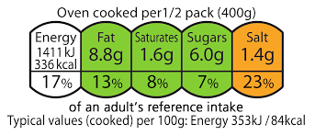
Example food label
%RI calculations

Slide 18
KS3 Biology Workbook: Lesson 11 Suggested Outline Healthy Human Diet
NB: These are suggestions only and won’t work for all teaching and learning styles
Hand out the Student Answer Sheet and Workbook. Project an image of scurvy, rickets, lethargy, obesity and a malnourished person (slide 2). Discuss what might have gone wrong. Discuss what the food groups are and what we need from our food. What carbohydrate, proteins, fats, vitamins, minerals, water and fibre are needed for.
Project and discuss the Eatwell plate (slide 3). What’s it showing us?
Students complete Q1 to Q5. Assist as necessary.
Answers projected for checking/self marking before the end of the lesson (www.nextpagescience.com/downloadables). This also provides opportunity to summarise/emphasise the key points you want taken away.

Slide 19
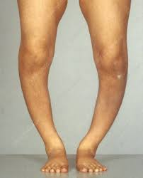
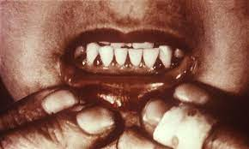
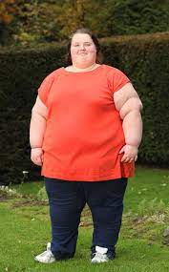
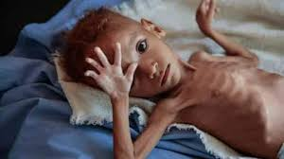

Slide 20
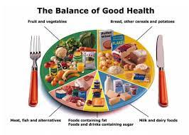
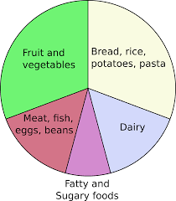

Slide 21
KS3 Biology Workbook: Lesson 12 Suggested Outline Drugs and their Impact
NB: These are suggestions only and won’t work for all teaching and learning styles
Hand out the Student Answer Sheet and Workbook. Mind map drugs. Names? What is a drug? Recreational Vs medicinal. What do they do? What are the names you have heard of? Are they good/bad for you? Do they make you faster (stimulants) or slower (depressants)? Discuss the use of some well known medicines through the mind map, e.g., antibiotics, paracetamol, morphine, aspirin, ibuprofen, chemotherapy medicines, steroids, insulin medicines and antihistamines.
Students complete Q1 to Q6. Assist as necessary.
Answers projected for checking/self marking before the end of the lesson (www.nextpagescience.com/downloadables). This also provides opportunity to summarise/emphasise the key points you want taken away.

Slide 22
KS3 Biology Workbook: Lesson 13 Suggested Outline Exercise, Asthma and Smoking
NB: These are suggestions only and won’t work for all teaching and learning styles
Hand out the Student Answer Sheet and Workbook.
Discuss some of the negative effects of smoking. Watch video Smoking and its effects on Health - Stop today! – YouTube
Key point is best to stop smoking and exercise! Let’s look at one effect of exercising.
Ask for a volunteer. Take their pulse, 30 seconds. Ask them to run on the spot for 30 seconds. Take pulse again. Use a stimulus for discussion of short and long term benefits, Q2 suggestions can be used to prompt students.
Exercise (and smoking) can sometimes trigger asthma attacks. What happens and why (airways narrow)? What should someone do if they have an attack? Discuss answer to Q4.
Students complete Q1 to Q6. Assist as necessary.
Answers projected for checking/self marking before the end of the lesson (www.nextpagescience.com/downloadables). This also provides opportunity to summarise/emphasise the key points you want taken away.

Slide 23
KS3 Biology Workbook: Lesson 14 Suggested Outline Photosynthesis
NB: These are suggestions only and won’t work for all teaching and learning styles
Hand out the Student Answer Sheet and Workbook. Give everyone a leaf and ask them to examine it for a moment. Pose the following questions:
Plants are producers, what does that mean?
What do plants need to grow?
Where do they get their energy from?
Why are they green?
From this and any wider discussion elicit the word equation and write it down.
Watch video how photosynthesis takes place in plants & Process Of Photosynthesis (animated) – YouTube
Label leaf diagram together.
Students complete Q1 to Q6.
Answers projected for checking/self marking before the end of the lesson (www.nextpagescience.com/downloadables). This also provides opportunity to summarise/emphasise the key points you want taken away.

Slide 24
KS3 Biology Workbook: Lesson 15 Suggested Outline Flowering plants and Seed Dispersal
NB: These are suggestions only and won’t work for all teaching and learning styles
Hand out the Student Answer Sheet and Workbook. Ask the provocative question: do plant’s have sex or what is the purpose of sex? Elicit the word offspring. Use prompting questions. What is the sperm and egg equivalent for a plant? How does pollen move from plant to plant? Why do flowering plants smell nice? Look colourful? Contain sugar sap? What is the offspring from a plant? How can these seeds be dispersed? This could be done as a class mind map.
Label the male and female parts of a plant together. Examine the fertilization image together.
Students then complete Q1 to Q5. Assist as necessary.
Answers projected for checking/self marking before the end of the lesson (www.nextpagescience.com/downloadables). This also provides opportunity to summarise/emphasise the key points you want taken away.

Slide 25
KS3 Biology Workbook: Lesson 16 Suggested Outline Growing Up
NB: These are suggestions only and won’t work for all teaching and learning styles
Hand out the Workbook and Student Answer Sheet. 2 mins write down any changes you think happen to us as we move from being a child to an adult. Discuss the student’s answers. Compare answers to list in Q2.
Watch video https://www.youtube.com/watch?v=0BJFoGK5GlY which discusses other changes apart from the body.
Complete Q1 to Q4, assist students where necessary.
Answers projected for checking/self marking before the end of the lesson (www.nextpagescience.com/downloadables). This also provides opportunity to summarise/emphasise the key points you want taken away.

Slide 26
KS3 Biology Workbook: Lesson 17 Suggested Outline Reproduction: Men
NB: These are suggestions only and won’t work for all teaching and learning styles
Hand out the Workbook and Student Answer Sheet. Prior knowledge starter. Write down one or more things that you might know about how males are able to reproduce with females. Prompting questions could be: What is the penis for? What is a male sex cell called? Where are the sex cells made? What is the male’s hormone called? What do this hormone do to men? Why are the testes outside of the man’s body and a women’s ovaries inside?
Explain that the video has terms we don’t need to know today. Don’t worry about remembering them, we’ll label the diagram together. Watch. Army Signals: Officer 10sec 16x9 HR (youtube.com) . Answer any follow up questions.
Label Q2 together.
Students complete Q1 to Q5. Assist as necessary.
Answers projected for checking/self marking before the end of the lesson (www.nextpagescience.com/downloadables). This also provides opportunity to summarise/emphasise the key points you want taken away.

Slide 27
KS3 Biology Workbook: Lesson 18 Suggested Outline Reproduction: Women
NB: These are suggestions only and won’t work for all teaching and learning styles
Hand out the Student Answer Sheet and workbook. Write down any words you know to do with a women’s reproductive system (how she can become pregnant). Or prompting questions: Can a women become pregnant at any time? Why not? Where are her eggs made/stored? What is another word for the womb? What do we mean by having a period? How often and how long do they last?
Watch video Understanding The Female Reproductive System – YouTube Explain there are some word we don’t need to know, don’t worry. Reference: a hair’s diameter is about the size of a female egg cell and a sperm is about 1/50th of that.
Complete Q2 labelling together.
Students complete Q1 to Q5. Assist as necessary.
Answers projected for checking/self marking before the end of the lesson (www.nextpagescience.com/downloadables). This also provides opportunity to summarise/emphasise the key points you want taken away.

Slide 28
KS3 Biology Workbook: Lesson 19 Suggested Outline Sexual Intercourse and Pregnancy
NB: These are suggestions only and won’t work for all teaching and learning styles
Hand out the Student Answer Sheet and workbook. Recap male and female reproductive organs. A mind map could be used.
Big question: how does the sperm from the man reach an egg inside the woman for her to become pregnant? Explain ‘usual’ method: erection, intercourse, ejaculation. Then sperms swim to the egg! Watch video for recap.
Pregnancy and Reproduction Explained – YouTube
Label Q2 together.
Students complete Q1 to Q4. Assist as necessary.
Answers projected for checking/self marking before the end of the lesson (www.nextpagescience.com/downloadables). This also provides opportunity to summarise/emphasise the key points you want taken away.

Slide 29
KS3 Biology Workbook: Lesson 20 Suggested Outline Food Chains and Webs
NB: These are suggestions only and won’t work for all teaching and learning styles
Hand out the Student Answer Sheet and workbook. Project a simple food chain (slide 2). Discuss what is happening. Elicit the words: producer, consumer, energy, carnivore, herbivore, omnivore.
Examine the food web page 20. What’s the difference?
Watch video What Is A Food Chain? | The Dr. Binocs Show | Educational Videos For Kids – YouTube . Consolidate terms primary and secondary consumers.
Students complete Q1 to Q5, assist as necessary.
Answers projected for checking/self marking before the end of the lesson (www.nextpagescience.com/downloadables). This also provides opportunity to summarise/emphasise the key points you want taken away.

Slide 31
KS3 Biology Workbook: Lesson 21 Suggested Outline Pyramids of Numbers and Toxins
NB: These are suggestions only and won’t work for all teaching and learning styles
Hand out the Student Answer Sheet and Workbook. Recap food chains and webs. What extra information does a pyramid of numbers give you (look at image on page 21)? Pose question: Imagine a scenario: a gardener decided to get rid of his grass because of all the rabbits it was attracting, so he sprayed a poisonous weed killer all over the grass which takes a week to work. What would happen? Discuss?
Project image of bioaccumulation (slide 2) and ask students what they think it shows? Is this a problem for us humans?
Watch clip B7.4 Bioaccumulation (youtube.com) .
Students complete Q1 to Q5. Assist as necessary.
Answers projected for checking/self marking before the end of the lesson (www.nextpagescience.com/downloadables). This also provides opportunity to summarise/emphasise the key points you want taken away.

Slide 32
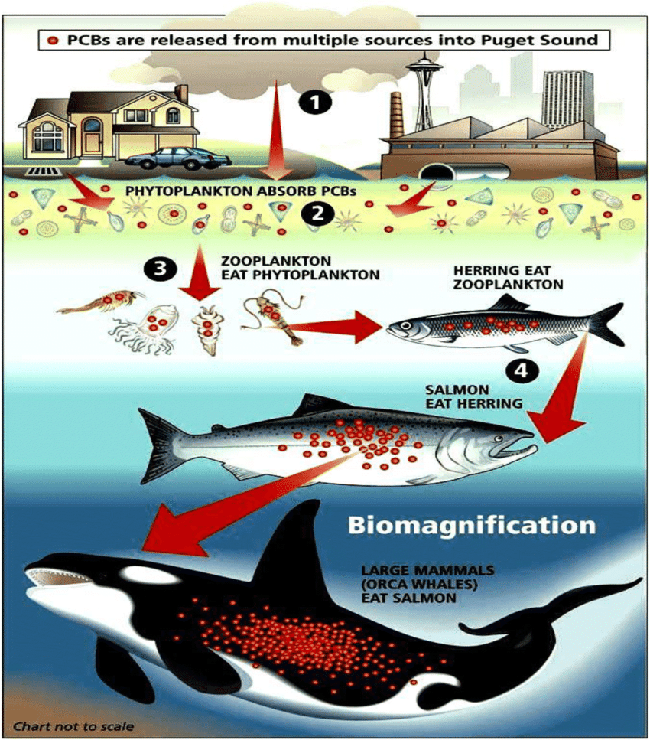
Note: PCB’s are toxic manmade chemicals

Slide 33
KS3 Biology Workbook: Lesson 22 Suggested Outline Predator, Prey and Populations
NB: These are suggestions only and won’t work for all teaching and learning styles
Hand out the Workbook and Student Answer Sheet. Ask the students to write down the names of as many predators and prey that they can think of, explain if unsure. Discuss their answers. Pose the question: what would happen if you threw 100 piranha into a pond full of small fish (piranha image slide 2)? What might happen to the piranha as there are less and less small fish to eat? Elicit the idea of a rise and fall in populations. Examine graph Q2, which line do you think ‘would’ be the piranha and which the small fish?
Discuss what else could affect the population size of a species.
Watch video https://www.youtube.com/watch?v=J15GK38OYyA consolidate.
Students complete Q1 to Q5. Assist as necessary.
Answers projected for checking/self marking before the end of the lesson (www.nextpagescience.com/downloadables). This also provides opportunity to summarise/emphasise the key points you want taken away.

Slide 34
KS3 Biology Workbook: Lesson 23 Suggested Outline Genetics and Inheritance
NB: These are suggestions only and won’t work for all teaching and learning styles
Hand out the Workbook and Student Answer Sheet. Ask the students to write down what ‘traits’ they think they have from their mom or dad. Traits from Parents are called inherited traits. Examine image top right page 23. Discuss genes, DNA, chromosomes and that they carry the characteristic one from each parent. Verbally run through Q2 as a class. Examine the Punnett square example as a class, ask the students to predict the answer to Q3 part 1.
Watch video https://www.youtube.com/watch?v=jUHokSPkzT8 explain allele is another word for gene at this level.
Complete Q2 together to ensure accuracy.
Students complete Q1 to Q5. Assist as necessary.
Answers projected for checking/self marking before the end of the lesson (www.nextpagescience.com/downloadables). This also provides opportunity to summarise/emphasise the key points you want taken away.

Slide 35
KS3 Biology Workbook: Lesson 24 Suggested Outline Variation
NB: These are suggestions only and won’t work for all teaching and learning styles
Hand out the Workbook and Student Answer Sheet. Ask the students to write down as many differences between humans as they can. Explain this variation can be categorized or measured, e.g., eye colour or weight. Discuss the difference between continuous and discontinuous data. Use the examples on following slides. Asks students if they can think of others, e.g., dimples, hair colour, ….
Students complete Q1 to Q5 on Student Answer sheet. Assist as necessary.
Answers projected for checking/self marking before the end of the lesson (www.nextpagescience.com/downloadables). This also provides opportunity to summarise/emphasise the key points you want taken away.

Slide 38
KS3 Biology Workbook: Lesson 25 Suggested Outline Adaptation
NB: These are suggestions only and won’t work for all teaching and learning styles
Hand out the Workbook and Student Answer Sheet. Ask the students to choose one animal and write down things that the animal has or can do, that helps it to survive. Use the responses to elicit a discussion.
Complete Q2 together to focus in on plants and their adaptations.
Video https://www.youtube.com/watch?v=anRp7FQ9CKY can be used (5 mins), good adaptation examples and its link to survival/reproduction.
Students complete Q1 to Q4, Q4 best completed before Q3. Assist as necessary. (You may want to give students chance to show off / explain the animal they have designed from Q3).
Answers projected for checking/self marking before the end of the lesson (www.nextpagescience.com/downloadables). This also provides opportunity to summarise/emphasise the key points you want taken away.

Slide 39
KS3 Biology Workbook: Lesson 26 Suggested Outline Biodiversity and Gene Banks
NB: These are suggestions only and won’t work for all teaching and learning styles
Hand out the Workbook and Student Answer Sheet. Recap what a gene is/does and what it means for species and offspring. As an introduction to the topic watch. https://www.youtube.com/watch?v=GK_vRtHJZu4 . Ask the students whilst watching the short clip to write down one important point about biodiversity. Use responses for discussion.
Pose question: how can we keep genetic information for endangered or extinct species? Answer: gene banks, explain idea and importance.
Students complete Q1 to Q4. Assist as necessary.
Answers projected for checking/self marking before the end of the lesson (www.nextpagescience.com/downloadables). This also provides opportunity to summarise/emphasise the key points you want taken away.

Slide 40
KS3 Biology Workbook: Lesson 27 Suggested Outline Evolution and Natural Selection
NB: These are suggestions only and won’t work for all teaching and learning styles
Hand out the Workbook and Student Answer Sheet. Ensure students know what evolve means. Discuss the correct order of Q2, b, a, d, e, c. What are some of the clear differences? Elicit bigger brain and bipedalism. How do these help humans survive? Use 1 and 6 from Q2 ii. as good examples of bigger brains. Bipedalism means we can walk, carry and use weapons and tools this meant that homo sapiens had an advantage for survival so their populations grew.
Use slide 2 (Giraffes) to emphasise species with adaptations that give them an advantage for living in their habitat meaning they are more likely to survive (survival of the fittest).
Watch video https://www.youtube.com/watch?v=BcpB_986wyk which nicely brings together the main ideas.
Students complete Q1 to Q4. Assist as necessary.
Answers projected for checking/self marking before the end of the lesson (www.nextpagescience.com/downloadables). This also provides opportunity to summarise/emphasise the key points you want taken away.

Slide 42
KS3 Biology Workbook: Lesson 28 Suggested Outline The Blood and Fighting Disease
NB: These are suggestions only and won’t work for all teaching and learning styles
Hand out the Workbook and Student Answer Sheet. Ask the students to write down anything they know about the blood as a starter. Discuss responses. Use the image on slide 2 to talk through the four main components.
Watch video https://www.youtube.com/watch?v=UgvH3A-BDx8 as a follow up.
Students complete Q1 to Q5. Assist as necessary.
Answers projected for checking/self marking before the end of the lesson (www.nextpagescience.com/downloadables). This also provides opportunity to summarise/emphasise the key points you want taken away.

Slide 44
KS3 Biology Workbook: Lesson 29 Suggested Outline Food Tests
NB: These are suggestions only and won’t work for all teaching and learning styles
Hand out the Workbook and Student Answer Sheet. This is best done as a follow up lesson after completing the food tests practical.
Recap or watch the video: https://www.youtube.com/watch?v=HtooKsIsB0Y .
Point out any differences you may have used.
Students complete Q1 to Q4. Assist as necessary.
Answers projected for checking/self marking before the end of the lesson (www.nextpagescience.com/downloadables). This also provides opportunity to summarise/emphasise the key points you want taken away.

Slide 45
KS3 Biology Workbook: Lesson 30 Suggested Outline The Circulatory System
NB: These are suggestions only and won’t work for all teaching and learning styles
Hand out the Workbook and Student Answer Sheet. Use the following animated slide 2 to introduce the difference between a double and single circulatory system. Explain that arteries carry blood away from the heart and veins towards the heart. Name the main arteries: pulmonary artery and aorta and main veins: pulmonary vein and vena cava before attempting slide 2 together.
Ask for volunteers to say where each of the labels should go a. to g. for slide 2.
Introduce the names of the chambers and explain why left and right are opposite to what we’d expect.
Discuss what the blood carries around the body and why it might pump faster or slower.
Use video https://www.youtube.com/watch?v=pjOxpLEynIE as a follow up.
Students complete Q1 to Q4. Assist as necessary.
Answers projected for checking/self marking before the end of the lesson (www.nextpagescience.com/downloadables). This also provides opportunity to summarise/emphasise the key points you want taken away.

Slide 46
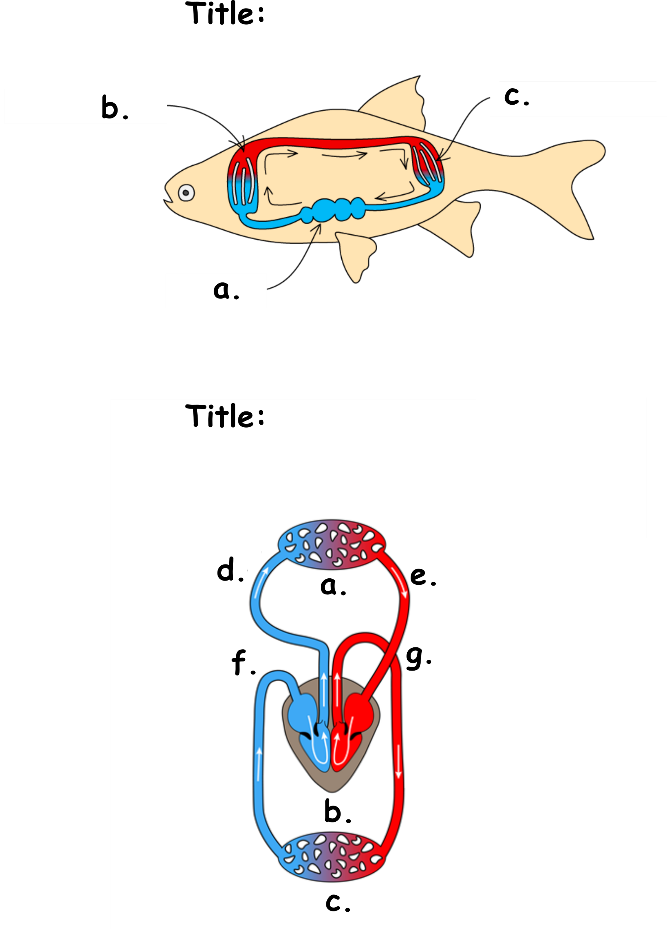
Single circulatory system
Double circulatory system
Heart
Gill Capillaries
Body Capillaries
Heart
The four chambers:
Lungs
Left ventricle
Body
Right ventricle
Pulmonary artery
Left atrium
Pulmonary vein
Aorta
Right atrium
Vena cava

