Slide 1
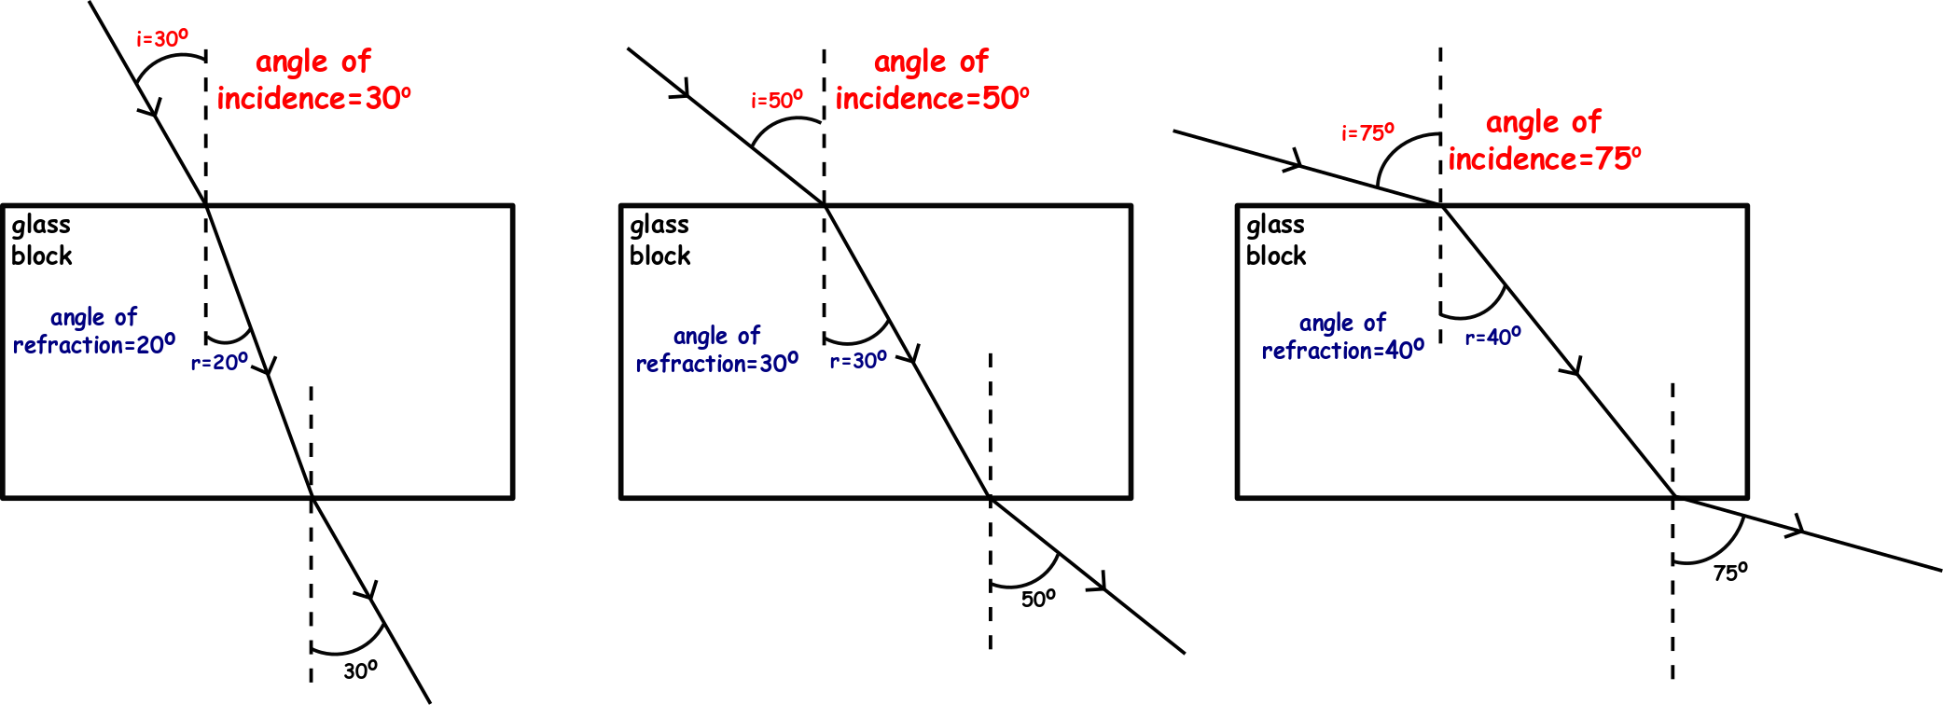
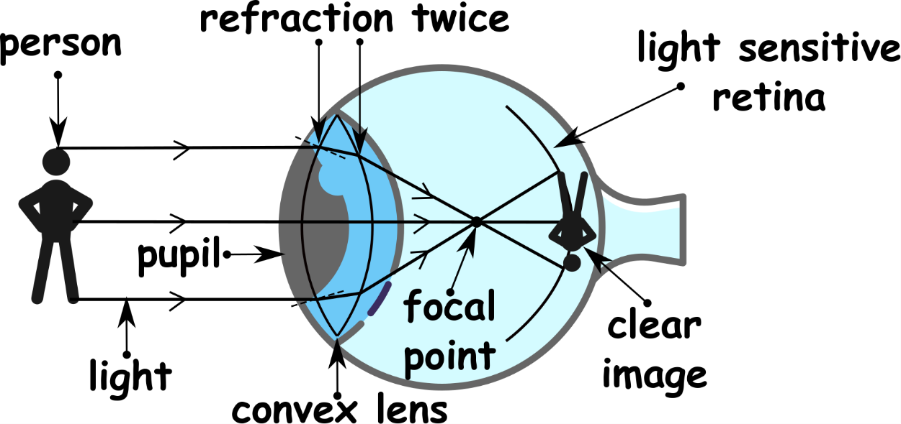
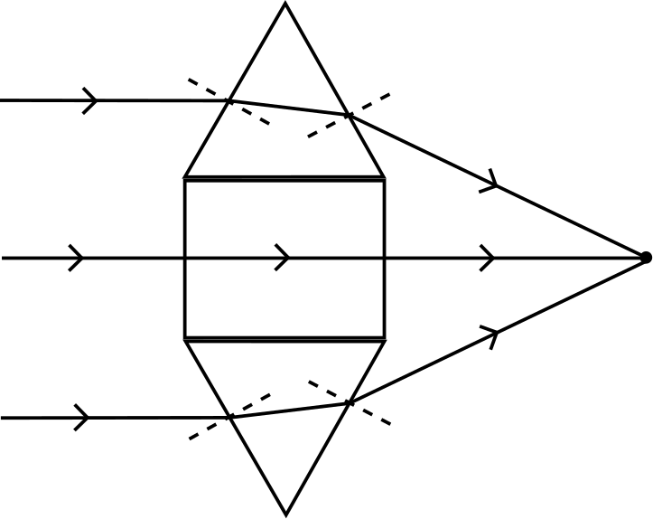
Write down the date and today’s title
REFRACTION, LENSES AND THE EYE
DO IT NOW; The diagrams below show a ray of light entering a glass block. How does the angle of incidence compare to the angle of refraction in each case? What else do you notice?
Lens focussing light
Sequence on click
in slide show.
Stretch
Solve the clues. In our eyes we have? LSESEN
Lenses ERFRCAT light? This FUSOCSES the light forming an AGIME on our RTIENA.
Stretch
Solve the clues. In our eyes we have? LENSES
Lenses ERFRCAT light? This FUSOCSES the light forming an AGIME on our RTIENA.
Stretch
Solve the clues. In our eyes we have? LENSES
Lenses REFRACT light. This FUSOCSES the light forming an AGIME on our RTIENA.
Stretch
Solve the clues. In our eyes we have? LENSES
Lenses REFRACT light. This FOCUSES the light forming an AGIME on our RTIENA.
Stretch
Solve the clues. In our eyes we have? LENSES
Lenses REFRACT light. This FOCUSES the light forming an IMAGE on our RTIENA.
Stretch
Solve the clues. In our eyes we have? LENSES
Lenses REFRACT light. This FOCUSES the light forming an IMAGE on our RETINA.
Notes:
Questions appears in slide show.

Slide 2
SUMMARY
Refraction occurs as light slows down or speeds up moving between different substances e.g. from air into glass.
Light slowing down bends towards the normal line, light speeding up bends away.
Convex lenses in our eyes refract light, focussing it onto our retina to produce an image.
Eye defects such as short sightedness can be also be corrected with lenses (glasses).

