Slide 1
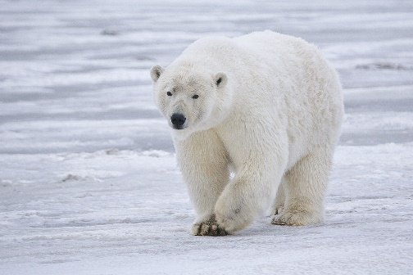
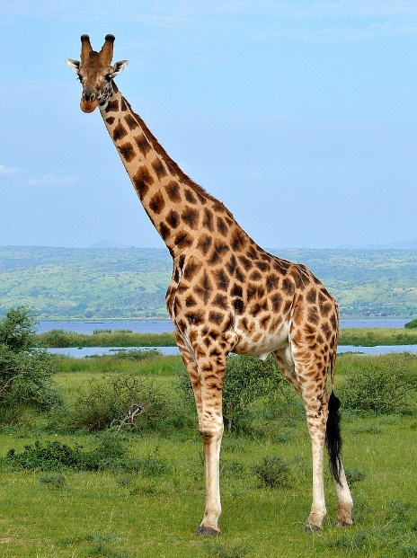
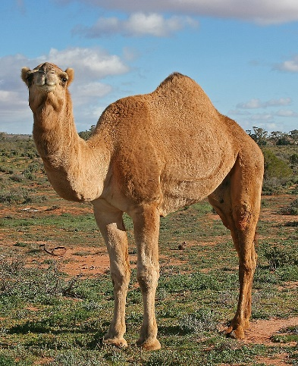
Write down the date and today’s title
ADAPTATION
DO IT NOW; Look at the organisms below and write down what you think helps them to survive.
Answers on click
in slide show.
Stretch
What do you think has helped humans to survive?
What has this led to? (Clue; 8x10⁹)
What problem does this create for wildlife?
Stretch
What do you think has helped humans to survive? A big brain/intelligence.
What has this led to? (Clue; 8x10⁹)
What problem does this create for wildlife?
Stretch
What do you think has helped humans to survive? A big brain/intelligence.
What has this led to? (Clue; 8x10⁹) A population approaching 8 billion.
What problem does this create for wildlife?
Stretch
What do you think has helped humans to survive? A big brain/intelligence.
What has this led to? (Clue; 8x10⁹) A population approaching 8 billion.
What problem does this create for wildlife? Loss of habitat
Notes:
Questions appear in slide show.

Slide 2
SUMMARY
Adaptations are characteristics that help a species to survive in its habitat.
Examples include;
Long necks of giraffes for reaching food
Streamlined shape of a shark for speed
Spines of a cactus to protect it from being eaten
Wide feet of a polar bear so it doesn’t sink into the snow
The hump of a camel for storing fat
Adaptations usually happen slowly over time and make it easier for that organism to survive. They therefore become more common in the population.

