Slide 1
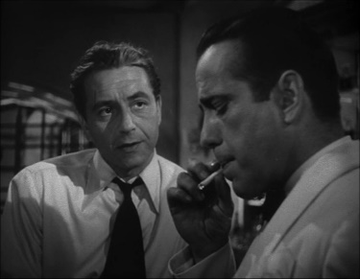
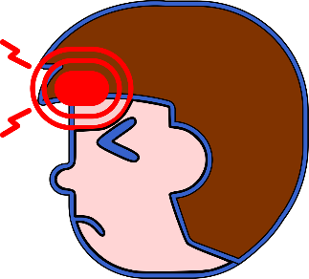
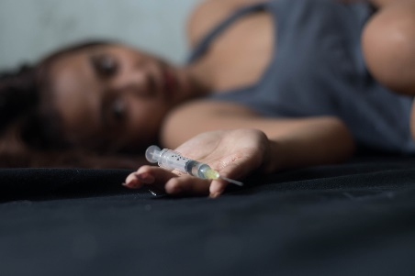
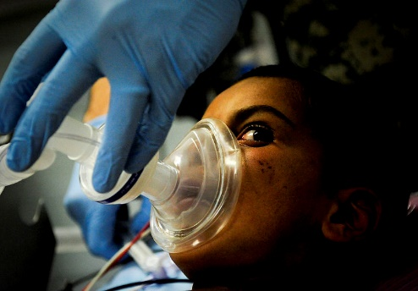
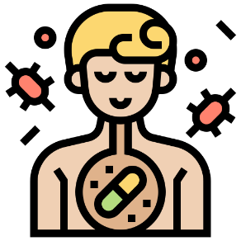
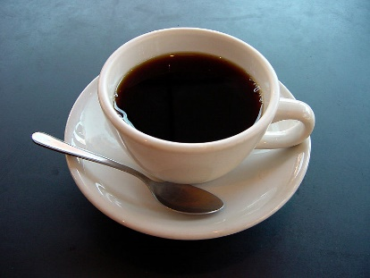
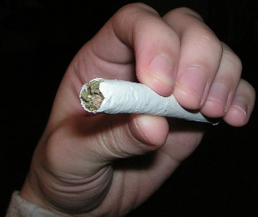
Write down the date and today’s title
DRUGS AND THEIR IMPACT
DO IT NOW; Write down any positives or negatives you know about the drugs below.
Sequence on click
in slide show.
Pain relief (headaches)
Smoking
Alcohol
Heroin
Anaesthetic
Antibiotics
Coffee
Marijuana/Cannabis
Stretch
Can you solve the jumbled words that describe drugs?
Drugs taken for pleasure. CREREATIONAL
Drugs that speed up nerve activity. STANTSIMUL
Drugs that slow down nerve activity DEPANTSRESS
Stretch
Can you solve the jumbled words that describe drugs?
Drugs taken for pleasure. RECREATIONAL
Drugs that speed up nerve activity. STANTSIMUL
Drugs that slow down nerve activity DEPANTSRESS
Stretch
Can you solve the jumbled words that describe drugs?
Drugs taken for pleasure. RECREATIONAL
Drugs that speed up nerve activity. STIMULANTS
Drugs that slow down nerve activity DEPANTSRESS
Stretch
Can you solve the jumbled words that describe drugs?
Drugs taken for pleasure. RECREATIONAL
Drugs that speed up nerve activity. STIMULANTS
Drugs that slow down nerve activity DEPRESSANTS

Slide 2
SUMMARY
Drugs that have positive effects are called medicines.
Examples of medicines are………………………………
All drugs, even medicines have side effects.
Drugs taken for pleasure only are called recreational drugs.
Recreational drugs are often addictive (you keep wanting to take them again) and often have very negative side effects.
Drugs called stimulants speed up nerve activity. Drugs called depressants slow down nerve activity.

