Slide 1
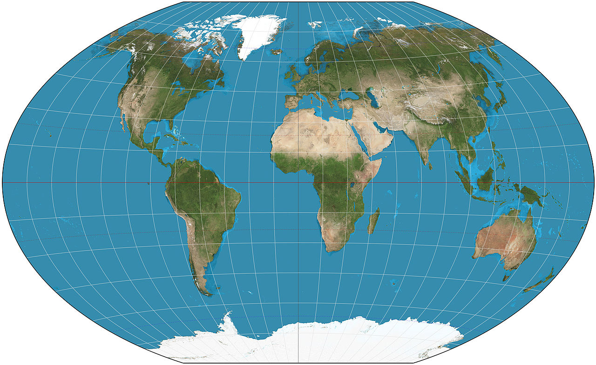
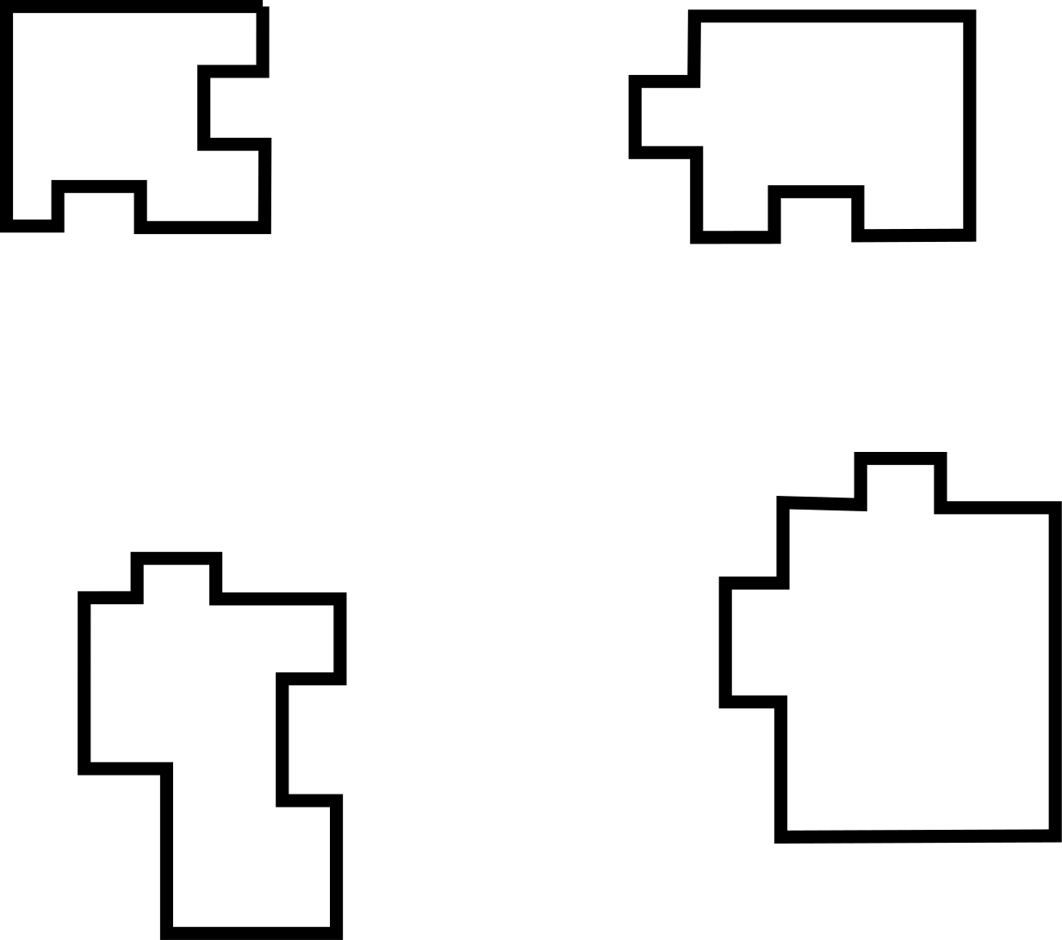
Write down the date and today’s title
COMPOSITION AND STRUCTURE OF THE EARTH
DO IT NOW; Below are four ‘icebergs’. Write down what tells you they were once on big berg?
4.
3.
Answer
They fit together like a jigsaw.
Answer
They fit together like a jigsaw.
That in the past it was one big iceberg.
Sequence on click
in slide show.
2.
1.
2000 miles
Stretch
It is too far to swim from berg 1 to berg 2 yet the same penguins are found on both. What is this further evidence of?
What is similar in the world map picture?
Notes:
Questions appears in slide show.

Slide 2
SUMMARY
The earth is layered like an onion. The four main layers are the crust, the mantle, the outer liquid core and the inner solid core.
The density of the layers increases as you move towards the centre, it also gets hotter.
The inner and outer cores are mainly nickel and iron, magnetic metals.
Scientists have evidence that the earth was once one big continent called Pangaea.
The continent broke up into ‘plates’ that moved apart and collided making mountain ranges like the Himalayas.

