Slide 1
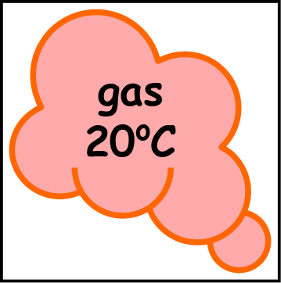
Write down the date and today’s title
PROPERTIES OF METALS AND NON-METALS
DO IT NOW; Write the elements below under the metal or non-metals column.
NON-METALS
METAL
NON-METAL
Iron
Nitrogen
Oxygen
Copper
Sequence on click
in slide show.
Zinc
Helium
Chlorine
Lead
Argon
Aluminium
Stretch
Now that we know the answers, in what state of matter do we often find non-metals? Gases
What does this mean about the boiling points (turning from liquid to gas) of some of the non-metals? Low boiling point (below room temp)
Stretch
Now that we know the answers, in what state of matter do we often find non-metals? Gases
What does this mean about the boiling points (turning from liquid to gas) of some of the non-metals?
Stretch
Now that we know the answers, in what state of matter do we often find non-metals?
What does this mean about the boiling points (turning from liquid to gas) of some of the non-metals?
Notes:
Use zoom function in slide show to make visible. Questions appear in slide show.

Slide 2
SUMMARY
A ‘staircase’ runs from the bottom of astatine to boron separating the metals from the non-metals.
Metals have properties such as;
High melting and boiling points
Strong
Dense
Shiny
Good conductors
Magnetic (Iron, Cobalt and nickel)
Ductile
Malleable
Non-metals have mostly the opposite properties to metals such as……………………………………………………

