Slide 1
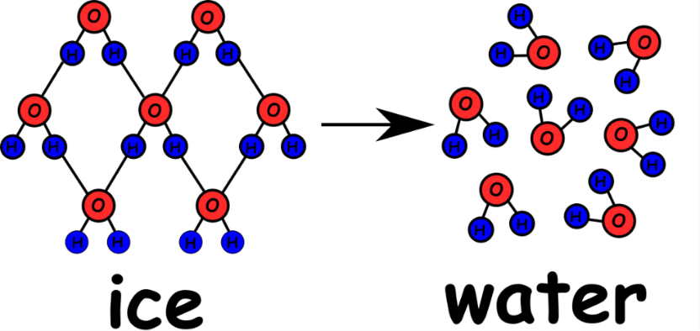
Write down the date and today’s title
CHEMICAL REACTIONS; ATOMS REARRANGED
DO IT NOW; below are two examples of chemical reactions and one example of a physical reaction. Write down what differences you can see.
Chemical reaction
Physical reaction
(product)
Sequence on click
in slide show.
Chemical reaction
( products )
Stretch; complete the sentences below into your books
In a chemical reaction something n_ _ is formed, called the p_ _ _ _ _ _. In a physical reaction there is only a change of s _ _ _ _ e.g. from a s _ _ _ _ to a l _ _ _ _ _ to a g _ _ or vice versa.
Stretch; complete the sentences below into your books
In a chemical reaction something n e w is formed, called the p r o d u c t . In a physical reaction there is only a change of s t a t e e.g. from a s o l i d to a l i q u i d to a g a s or vice versa.

Slide 2
SUMMARY
In a chemical reaction atoms rearrange their position.
Bonds are made or broken (or both) and a new substance(s) is made.
The new substance(s) is called the product(s).
Chemical reactions aren’t usually reversible. This means you can’t easily get back what you started with e.g. turning rust back into metal!
In a physical change no new substance is made and the reaction is reversible.

