Slide 1
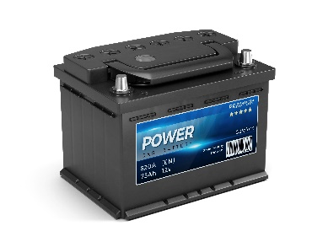
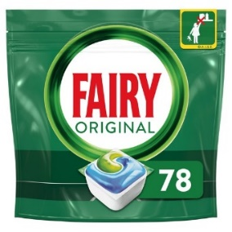
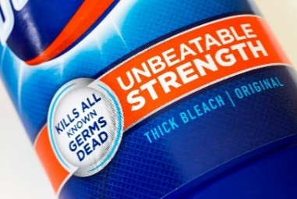
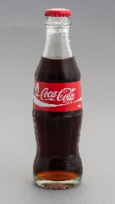
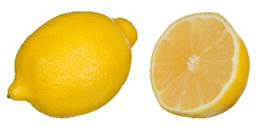
Write down the date and today’s title
ACIDS, ALKALIS, NEUTRALISATION AND THE pH SCALE
DO IT NOW; Write down the examples below and next to them whether you think they are acidic or alkaline.
ALKALINE
ALKALINE
ACIDIC
ALKALINE
Bleach
Washing powder
Car battery
Dishwasher tablets
Sequence on click
in slide show.
ACIDIC
ALKALINE
ACIDIC
ACIDIC
Vinegar
Lemons
Soap
Fizzy drinks
Stretch
If something is neither acidic nor alkaline what do we call it?
How could you make this?
Stretch
If something is neither acidic nor alkaline what do we call it? neutral
How could you make this?
Stretch
If something is neither acidic nor alkaline what do we call it? neutral
How could you make this? combine acid and alkali (in equal amounts)
Notes:
See slide show for sequence.

Slide 2
SUMMARY
Acids and alkalis are chemical opposites, they are both corrosive.
They are both found commonly in foods and products and are only harmful if concentrated or strong.
The pH scale measures the strength of an acid or alkali. pH 1 (red) is strongly acidic, pH 7 (green) is neutral and pH 14 (blue/purple) is strongly alkaline.
Adding the right amount of acid to the right amount of alkali is called neutralisation. The resulting solution will have a pH of 7.

