Slide 1
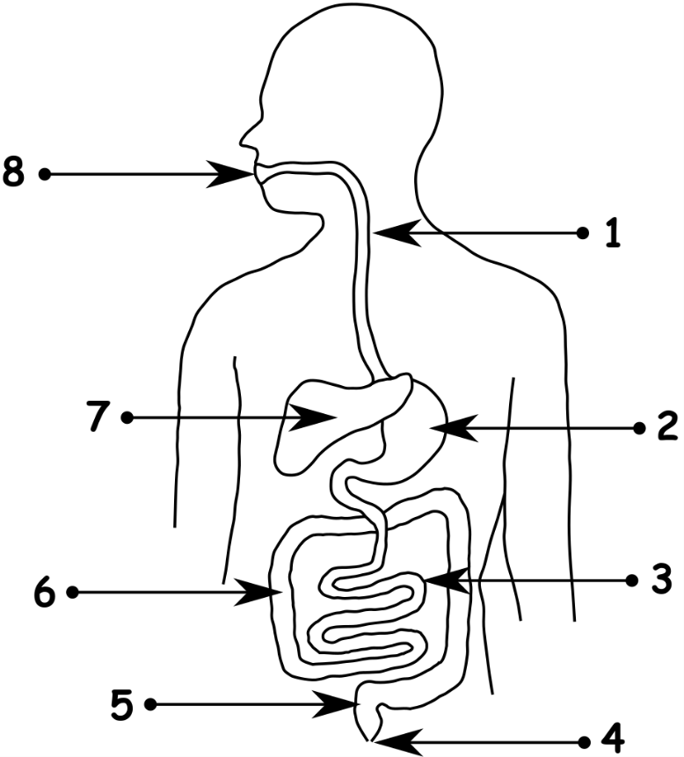
Write down the date and today’s title
THE HUMAN DIGESTIVE SYSTEM
DO IT NOW; How many organs
(numbers 1 to 8) can you name using
the words on the left. You have
one minute to look before hands up.
Liver
Large intestine
Sequence on click
in slide show.
Mouth
Oesophagus
Anus
Rectum
Stomach
Small intestine
Stretch
What do you think the purpose of digestion is? Break down food into soluble molecules for absorption into the blood
Can you tell us what any of the organs of the digestive system do?
Stretch
What do you think the purpose of digestion is?
Can you tell us what any of the organs of the digestive system do?
Notes:
The labels fly into position 1 to 8 in the slide show.

Slide 2
SUMMARY
The purpose of digestion is to turn large insoluble pieces of food into the smaller soluble molecules it is made from.
Food is broken up in the mouth and digestive juices from saliva are added.
The broken down food is absorbed into the blood in the small intestines.
Food is pushed through the digestive system by muscle contractions called peristalsis.
Bacteria in our digestive system help to keep it healthy.

